Slide 1
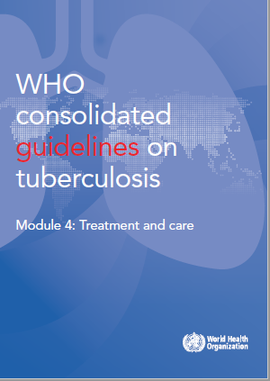
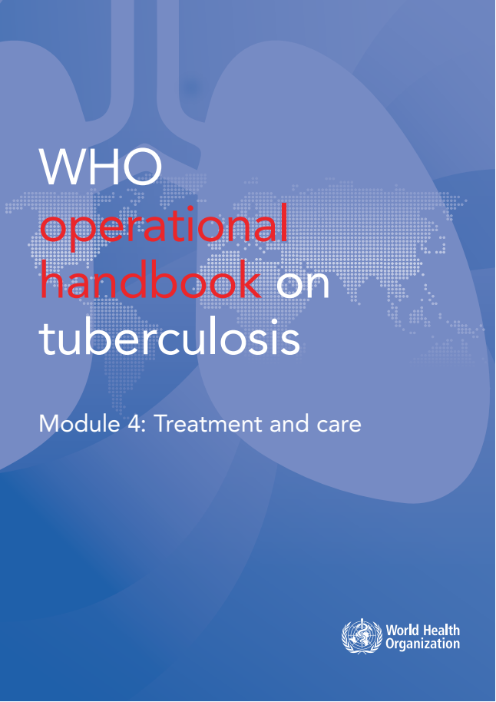
WHO guidelines & operational handbook:
Module 4: treatment and care
TB care and support
(Chapter 3)

Slide 2
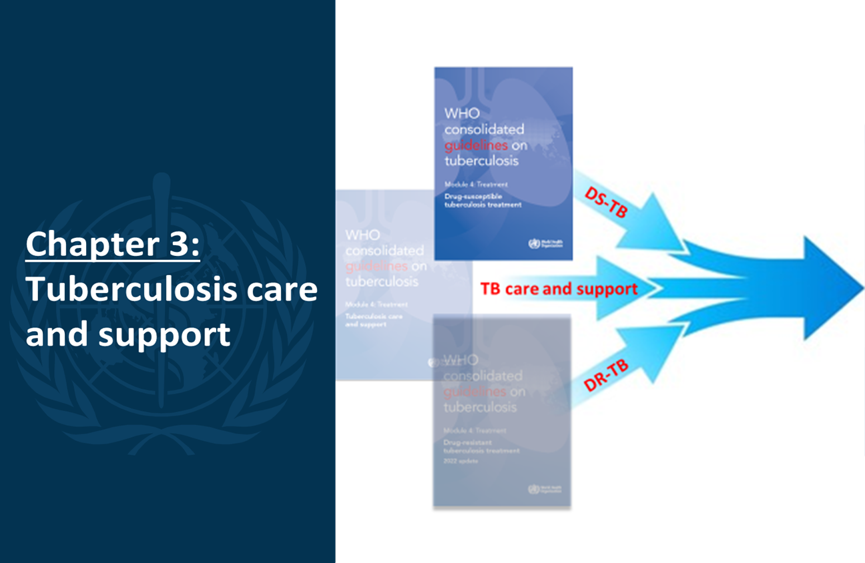
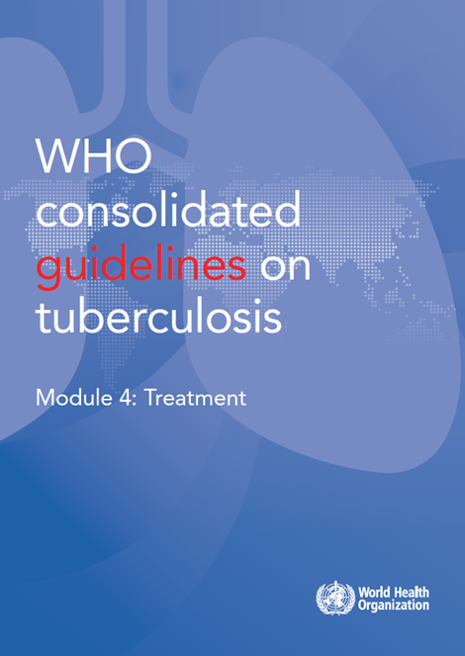
Consolidation of 2025 TB-treatment guidelines
2025

Slide 3
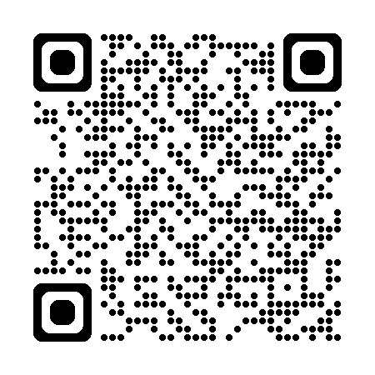
Overview of guidelines
2025
There are 8 recommendations, structured in 3 sections
Section 1. Care and support interventions for all people with TB
4 recommendations
Section 2. Models of care for people with drug-resistant TB
2 recommendations
Section 3: Models of care for children and adolescents exposed to TB or with TB disease
2 recommendations
https://tbksp.who.int/en/node/2951

Slide 4

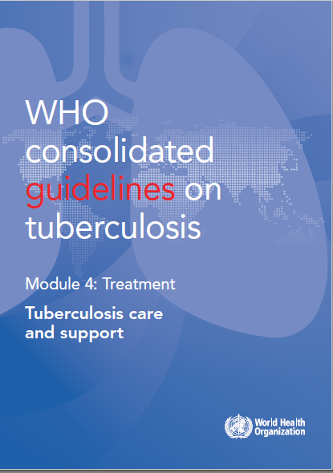
Background
New developments in 2022: Guidelines
2011
2017
2022
2022
Ambulatory model of care for MDR-TB
Care and support interventions for all people with TB
Decentralized model of care for MDR-TB
Models of care for children and adolescents
Consolidation of all the evidence-based recommendations on TB care and support

Slide 5
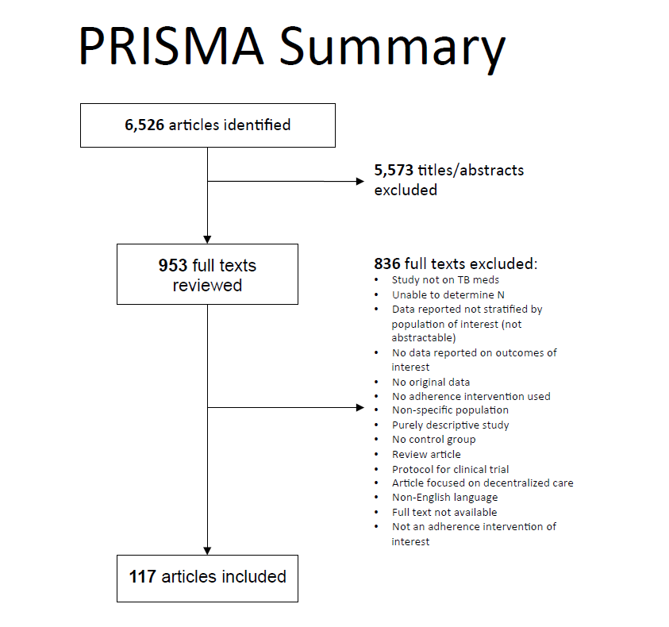
Evidence: Systematic reviews
1. TB care and support interventions for patients with TB (Systematic review 2017)
Combination of treatment adherence interventions*
vs treatment support alone or self-administered treatment
Outcome | Study design | RR (95% CI)
Mixed treatment adherence interventions vs treatment support alone
Success ↑ | RCT | 1.16 (1.11 – 1.22)
Loss to follow up ↓ | RCT | 0.38 (0.25 – 0.57)
Mixed interventions vs self-administered treatment
Success ↑ | RCT | 1.36 (1.06 – 1.75)
Sputum conversion ↑ | RCT | 1.65 (1.16 – 2.34)
Loss to follow up ↓ | RCT | 0.58 (0.36 – 0.93)
*Treatment adherence interventions include:
patient education
material support (e.g. food, financial incentive, transport fee)
psychological support
staff education
home visit or digital health communication (e.g. SMS, phone call)
medication monitor
Alipanah N et al. Adherence interventions and outcomes of tuberculosis treatment: A systematic review and meta-analysis of trials and observational studies. PLoS Med 15(7): e1002595. July 2018. https://doi.org/10.1371/journal.pmed.1002595

Slide 6
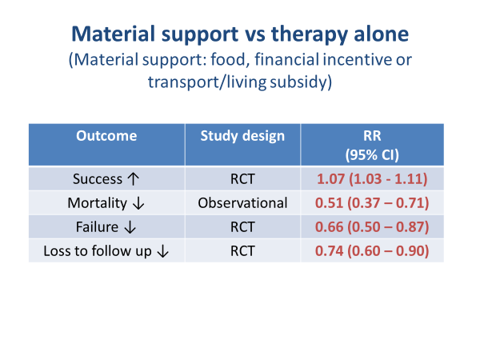
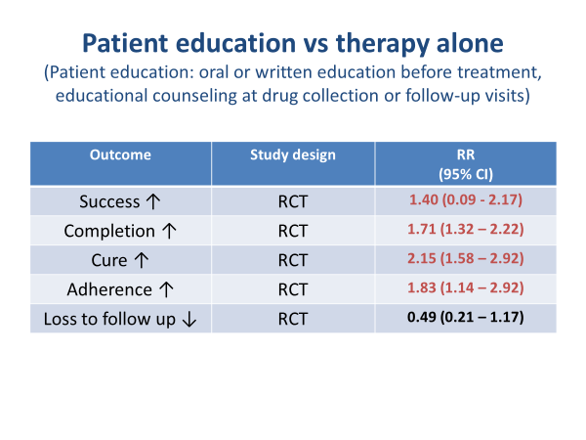
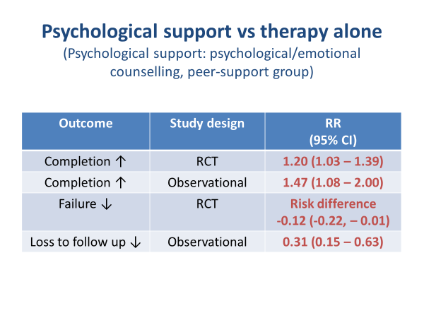
Evidence: Systematic reviews
1. TB care and support interventions for patients with TB
5

Slide 7
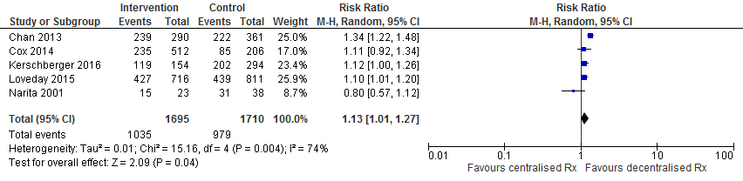
Evidence: Systematic reviews
2. Models of care for patients with MDR-TB
Ambulatory vs hospitalized MDR-TB care
(Data review 2011)
Data from published and unpublished cost-effectiveness studies in four countries (Estonia, Peru, the Philippines and the Russian Federation [Tomsk oblast]).
Outcomes from models of MDR-TB care based mainly on clinic-based ambulatory treatment were compared with hospital-based inpatient treatment.
Cost-effectiveness was modelled in a probabilistic analysis of the data from the four countries
Decentralized vs centralized MDR-TB care
(Systematic review 2017)
A systematic review to assess effectiveness of decentralized model of care for patients with MDR-TB, in comparison with centralized approaches
A total of 8 studies included in the review
Decentralized vs centralized MDR-TB care
Treatment Success
Overall RR for treatment success = 1.13 (1.01-1.27)
Ho J et al. Decentralised treatment and care for patients with multidrug-resistant tuberculosis – a systematic review and meta-analysis. Bulletin of the World Health Organization 2017;95:584-593. http://dx.doi.org/10.2471/BLT.17.193375

Slide 8
Evidence: Systematic reviews
Models of care for children and adolescents
Systematic review (2022) on decentralized, integrated or family-centred care models on TB diagnosis, treatment or prevention in children and adolescents
A total of 22 studies included:
  16 had elements of decentralization
  5 had elements of integration
  3 had elements of family-centred care
  4 studies had elements of more than one care model of interest and were only included based on their main model
Most studies focused on the 0-14-year age group

Slide 9
Recommendations
Treatment adherence interventions
Health education and counselling on the disease and treatment adherence should be provided to patients on TB treatment
(strong recommendation, moderate certainty of evidence)
A package of treatment adherence interventions* may be offered for patients on TB treatment in conjunction with the selection of a suitable treatment administration option
(conditional recommendation, low certainty of evidence)
* Treatment adherence interventions include social support, communication with patient, medication monitor, and staff education.
The interventions should be selected on the basis of the assessment of individual patient's needs, provider's resources and conditions for implementation.
One or more of the following treatment adherence interventions may be offered to patients on TB treatment or to health-care providers:
  material support to patient (e.g. meals, food baskets, food supplements, food vouchers, transport subsidies, living allowance, housing incentives, or financial bonus)
  psychological support to patient (e.g. counselling sessions or peer-group support)
  tracers (e.g. SMS, telephone calls, or home visit) or digital medication monitor
  staff education (adherence education, chart or visual reminder, educational tools and desktop aids for decision-making and reminder)

Slide 10
Recommendations
Treatment adherence interventions
The following treatment administration options may be offered to patients on TB treatment:
  Community- or home-based treatment support is recommended over health facility-based treatment support or unsupervised treatment
  Treatment support administered by trained lay providers or health-care workers is recommended over treatment support administered by family members or unsupervised treatment
  Video-supported treatment (VST) can replace in-person treatment support when the video communication technology is available and can be appropriately organized

Slide 11
Recommendations
Models of care for MDR-TB patients
A decentralized model of care is recommended over a centralized model for patients on MDR-TB treatment
(conditional recommendation, very low certainty of evidence)
Patients with MDR-TB should be treated using mainly ambulatory care rather than models of care based principally on hospitalization
(conditional recommendation, very low certainty of evidence)

Slide 12
Recommendations
Models of care for children and adolescents
exposed to TB or with TB disease
In TB high-burden settings, decentralized models of care may be used to deliver TB services to children and adolescents with signs and symptoms of TB and/or those exposed to TB
(conditional recommendation, very low certainty of evidence)
Family-centred, integrated models of care to deliver TB services may be used in children and adolescents with signs and symptoms of TB and/or those exposed to TB, in addition to standard models of care
(conditional recommendation; very low certainty of evidence)

Slide 13
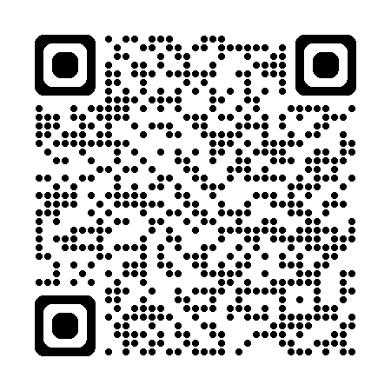
Operational Handbook
Overview of the operational handbook structure
2025
People-centred approach
Care and support interventions to enable TB treatment adherence
Health education and counselling for people affected with tuberculosis
Models of care for TB services
Palliative care
https://tbksp.who.int/en/node/3011

Slide 14
Operational Handbook
What assessments for patient care that are required to be done prior to the start of treatment for each individual patient ?
Patient’s needs for social support - for the decision on what kind of support to be provided to the patient
Risk of treatment interruption - for the decision on an appropriate treatment administration option
Resources and conditions for implementation of individual intervention - for the decision on a package of patient support interventions and a model of care

Slide 15
Operational Handbook
What are the recommended treatment adherence interventions?
Treatment adherence intervention | Description
Patient education | Health education and counselling.
Staff education | Education, chart or visual reminder, educational tool and desktop aid for decision-making and reminder.
Material support | Food or financial support such as meals, food baskets, food supplements, food vouchers, transport subsidies, living allowance, housing incentives or financial bonus. This support addresses indirect costs incurred by patients or their attendants in accessing health services and, possibly, tries to mitigate the consequences of income loss related to the disease.
Psychological support | Counselling sessions or peer-group support.
Communication with the patient | Home visit or via mobile telephone communication such as SMS or telephone (voice) call.
Digital medication monitor | A digital medication monitor is a device that can measure the time between openings of the pill box. The medication monitor can give audio reminders or send SMS to remind patient to take medications, along with recording when the pill box is opened.

Slide 16
Operational Handbook
What is the treatment support in the context of TB care and support?
Treatment support terminology is used to describe an approach to supporting patients who are taking prescribed doses of TB medicines in order to help ensure adherence to treatment and maximize its efficacy. Treatment support needs to be provided in the context of people-centred care and should be based on the individual patient’s needs, acceptability and preferences. It includes aspects of support, motivation and understanding of patients without coercion.
Historically, this group of interventions were labelled as “directly observed treatment” or DOT. However, with a need to emphasize the need to support people in adhering to treatment, as recommended by the WHO TB ethics guidance of 2010 and 2017, this legacy terminology has been replaced by “treatment support” in order to align the language with the essence of the recommendation of the WHO TB ethics guidance.

Slide 17
Operational Handbook
What types of counselling may TB patients need?
Counselling to provide information about TB and the responsibilities of affected individuals and communities
Counselling to provide information about TB treatment and to ensure adherence to treatment
Counselling to provide psychological support
Counselling on nutritional care and support
Counselling at the end of TB treatment
Counselling on palliative care

Slide 18
Operational Handbook
What are the considerations for implementation of models of care for patients with TB?
With the increasing use of all oral DR-TB treatment, patients with DR-TB should be treated whenever possible in an outpatient-based treatment programme similar to patients with DS-TB.
Additionally, for both patients with DR-TB and those with DS-TB, treatment should move towards a decentralized, ambulatory care setting in order to make it easier for all patients to access medications and treatment support and for TB treatment to be less disruptive to their lives.
However, sometimes patients do require treatment in the hospital (inpatient). These may be patients with DR-TB, but they may also be patients with DS-TB with severe disease or treatment complications.

Slide 19
Operational Handbook
What are the advantages and potential benefits of decentralization of TB care for children and adolescents at the community level?
Advantages:
increased equity via improved access to health services
provision of TB care at the same time and in the same place for all family members
savings in time and money when care is provided closer to home
continuity of care between the person’s home, community and local health centre
increased community support, which may lead to better adherence to treatment and can be instrumental in overcoming barriers to long-term care, including treatment adherence, transportation costs, missing school, and loss of wages during sickness and clinic visits
Potential benefits:
increased treatment coverage in children and adolescents
reduced time to diagnosis and time to treatment
improved treatment success among children and adolescents started on TB treatment and TPT initiation
reduced transmission

Slide 20
Operational Handbook
What key elements need to be considered for planning and implementing palliative care for people affected by TB?
  Integration of palliative care into national tuberculosis programmes
  Essential package of palliative care for people affected by TB
  Oxygen for relief of mild dyspnoea
  Morphine for safe relief of chronic or refractory dyspnoea
  Palliative care teamwork
  Management of substance use disorders and other comorbidities
  Monitoring and evaluation of palliative care for people affected by TB
  Cost savings from palliative care integration into TB programmes
What factors to be considered for planning and implementing end-of-life care for people with TB?
  When should suspension of TB treatment be considered?
  Important considerations in suspending TB treatment
  Decision-making about suspension of TB treatment
  Providing end-of-life care for people with TB

Slide 21
Main messages
Health education and counselling are strongly recommended for all patients with TB
A package of treatment adherence interventions should be considered for enhancing TB treatment outcomes in addition to the selection of an appropriate treatment administration option
Decentralized and ambulatory care should be provided for MDR-TB patients instead of centralized and hospitalized models of care
Decentralized or family-centred, integrated models of care are recommended to deliver TB services for children and adolescents with signs and symptoms of TB and/or those exposed to TB
Palliative care, including end-of-life care, needs to be available to people affected with TB.

Slide 22
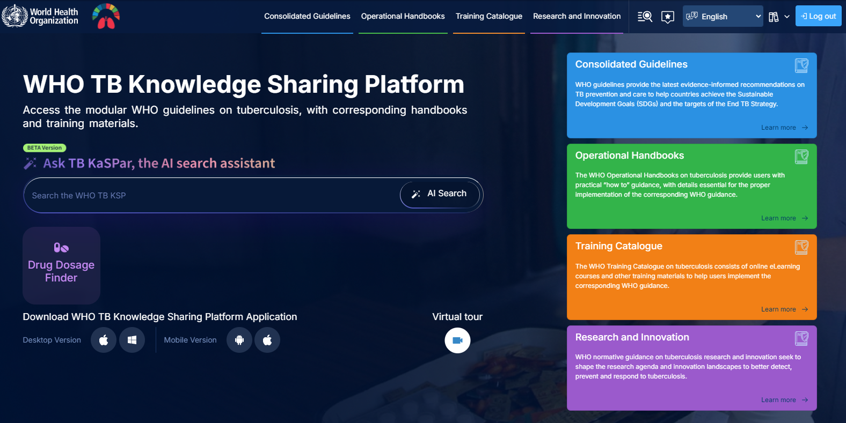
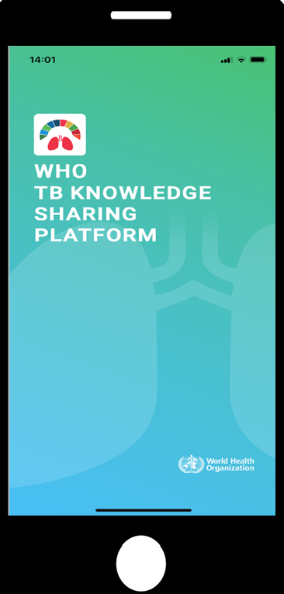
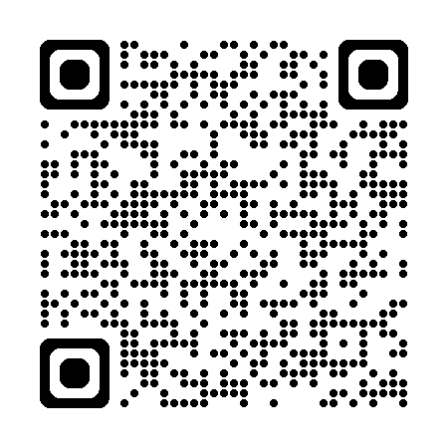
https://tbksp.who.int

Slide 23
© WORLD HEALTH ORGANIZATION 2025
All rights reserved. Publications of the World Health Organization can be obtained from WHO Press, World Health Organization, 20 Avenue Appia, 1211 Geneva 27, Switzerland (tel: +41 22 791 3264; fax: +41 22 791 4857; email: bookorders@who.int). Requests for permission to reproduce or translate WHO publications – whether for sale or for noncommercial distribution – should be addressed to WHO Press, at the above address (fax: +41 22 791 4806; email: permissions@who.int).
The designations employed and the presentation of the material in this publication do not imply the expression of any opinion whatsoever on the part of the World Health Organization concerning the legal status of any country, territory, city or area or of its authorities, or concerning the delimitation of its frontiers or boundaries. Dotted lines on maps represent approximate border lines for which there may not yet be full agreement.
The mention of specific companies or of certain manufacturers’ products does not imply that they are endorsed or recommended by the World Health Organization in preference to others of a similar nature that are not mentioned. Errors and omissions excepted, the names of proprietary products are distinguished by initial capital letters.
All reasonable precautions have been taken by the World Health Organization to verify the information contained in this publication. However, the published material is being distributed without warranty of any kind, either expressed or implied. The responsibility for the interpretation and use of the material lies with the reader. In no event shall the World Health Organization be liable for damages arising from its use.

