Slide 1
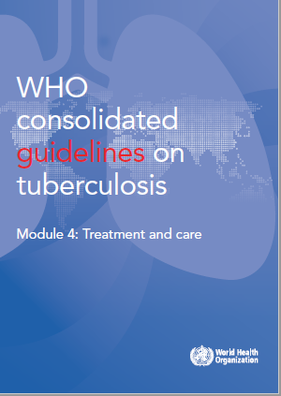
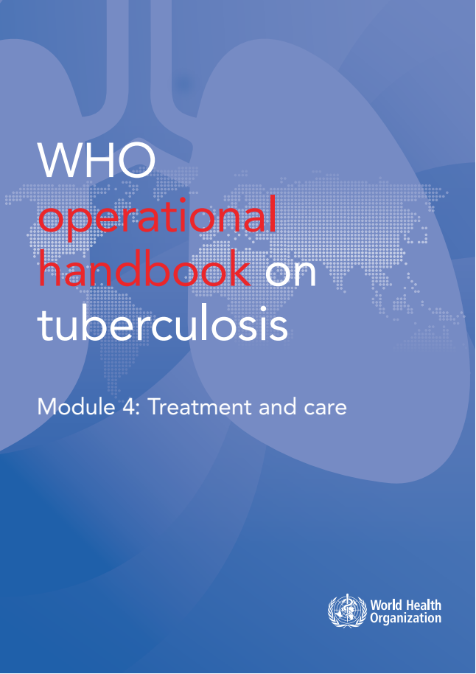
WHO guidelines & operational handbook:
Module 4: treatment and care
Drug-susceptible TB treatment
(Chapter 1)

Slide 2
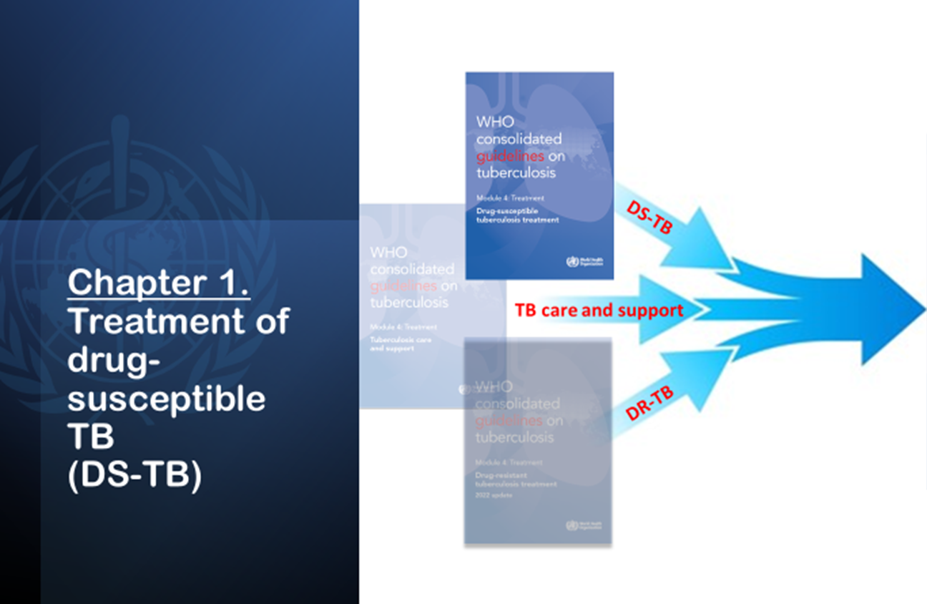
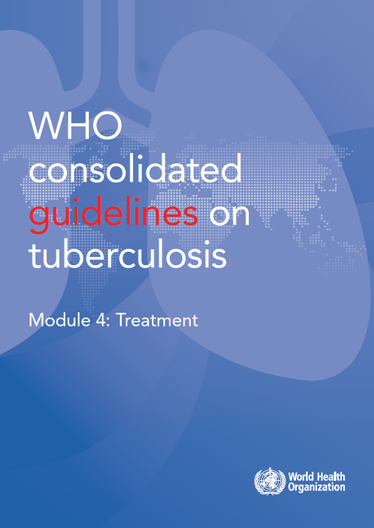
Consolidation of 2025 TB-treatment guidelines
2025

Slide 3
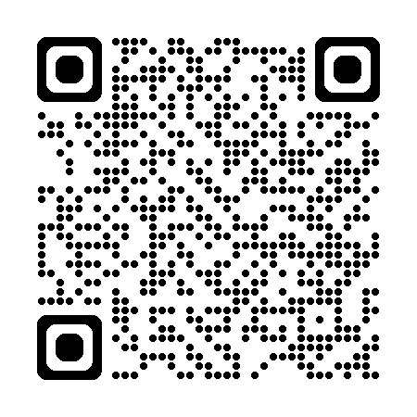
Overview of 2025 guidelines DS-TB chapter (1)
2025
Introductions & Objectives
Methods used to update the guideline
Recommendations:
Treatment of drug-susceptible TB using 6-month regimen
Treatment of drug-susceptible TB using 4-month regimens
Drug-susceptible TB treatment and ART in PLHIV
The use of adjuvant steroids in the treatment of TB meningitis & pericarditis
Research priorities
Annex. Summary of changes in policy of DS-TB since 2010 & mapping of recommendations
https://tbksp.who.int/en/node/2951

Slide 4
Overview of 2025 guidelines DS-TB chapter (2)
There are 11 DS-TB treatment recommendations
in the 2025 update:
The 4-month regimen for people aged 12 years or older with drug-susceptible pulmonary TB
The 4-month regimen for children and adolescents between 3 months and 16 years of age with non-severe TB
5 recommendations for treatment of drug-susceptible TB using 6-month regimen
2 recommendations for drug-susceptible TB treatment and antiretroviral therapy (ART) in people living with HIV
2 recommendations on the use of adjuvant steroids for the treatment of TB pericarditis and meningitis
2025
https://tbksp.who.int/en/node/2951

Slide 5
Background
New developments in 2022: Guidelines
4-month 2HPMZ/2HPM regimen
4-month 2HRZE/2HR regimen for children
Consolidating all recommendations on DS-TB (2021)
DS-TB guidelines 2021 (update)
DS-TB

Slide 6
Evidence: 4-month 2HPMZ/2 HPM: Data and studies considered
Study31/A5349 : A randomized, open-label, controlled phase 3 clinical trial
A recent phase III trial ‘’Study 31’’ (TBTC study 31/ACTG A5349, or S31/A5349) assessed the safety and efficacy of two 4-month regimens for the treatment of DS-TB.
A total of 2 516 patients from 13 countries (in Brazil, China, Haiti, India, Kenya, Malawi, Peru, South Africa, Thailand, Uganda, USA, Viet Nam and Zimbabwe) were randomly assigned to the treatment regimen.
Study 31 is the first and only phase III trial demonstrated the noninferiority of the 4-month regimen for treatment of DS-TB when compared to the standard of care
There was little or no difference in all-cause mortality and adverse events during treatment – a slight increase in retention on treatment was noted in the rifapentine-moxifloxacin arm.

Slide 7
Evidence: 4-month 2HRZ(E)/2 HR: Data and studies considered
2. SHINE trial : Shorter treatment for non-severe tuberculosis
Shorter treatment for non-severe tuberculosis in African and Indian children (SHINE), phase 3 randomized trial evaluated duration of TB treatment in children with non-severe DS-TB.
The trial showed that a 4-month treatment regimen, 2HRZ(E)/2HR, was non-inferior to the standard 6-month regimen (2HRZ(E)/4HR).
Experimental regimen: 4-months (16 weeks) of TB treatment using WHO-recommended pediatric doses.
Comparator: 6 months (24 weeks) of treatment using WHO-recommended pediatric doses

Slide 8
Recommendations
Treatment of DS-TB using 6-month regimen
Recommendation 1: New patients with pulmonary TB should receive a regimen containing 6 months of rifampicin: 2HRZE/4HR
(strong recommendation, high certainty of evidence)
Remarks
A: The recommendation also applies to extrapulmonary TB – except TB of the central nervous system, bone or joint for which some expert groups suggest longer therapy.
B: WHO recommends that national TB control programmes provide supervision and support for all TB patients in order to ensure completion of the full course of therapy.
C: WHO recommends drug resistance surveys (or surveillance) for monitoring the impact of the treatment programme, as well as for designing standard regimens.

Slide 9
Recommendations
Treatment of DS-TB using 6-month regimen
Recommendation 2:
Wherever feasible, the optimal dosing frequency for new patients with pulmonary TB is daily throughout the course of therapy.
(strong recommendation, high certainty of evidence)
Recommendation 3:
In all patients with DS PTB, the use of 3x dosing is not recommended in both the intensive and continuation phases of therapy, and daily dosing remains the recommended dosing frequency
(conditional recommendation, very low certainty of evidence).
Recommendation 4:
The use of fix-dose combination (FDC) is recommended over separate drug formulations in treatment of patients with DS-TB.
(conditional recommendation, low certainty of evidence)
Recommendation 5:
In new PTB patients treated with the regimen containing rifampicin throughout treatment, if a positive sputum smear is found at completion of the intensive phase, the extension of the intensive phase is not recommended .
(strong recommendation, high certainty of evidence)

Slide 10
Recommendations
Treatment of DS-TB using 4-month regimens
Recommendation 6: People aged 12 years or older with drug-susceptible pulmonary TB, may receive a 4-month regimen of isoniazid, rifapentine, moxifloxacin and pyrazinamide.
(conditional recommendation, moderate certainty of evidence)
Recommendation 7: In children and adolescents between 3 months and 16 years of age with non-severe TB (without suspicion or evidence of MDR/RR-TB), a 4-month treatment regimen (2HRZ(E)/2HR) should be used.
(strong recommendation, moderate certainty of evidence)
Remarks
Non-severe TB is defined as: Peripheral lymph node TB; intrathoracic lymph node TB without airway obstruction; uncomplicated TB pleural effusion or paucibacillary, non-cavitary disease, confined to one lobe of the lungs, and without a miliary pattern;
Children and adolescents who do not meet the criteria for non-severe TB should receive the standard six-month regimen (2HRZE/4HR), or recommended treatment regimens for severe forms of extrapulmonary TB.
The use of ethambutol in the first two months is recommended in settings with a high prevalence of HIV, or of INH resistance

Slide 11
Recommendations
DS-TB treatment & ART in people living with HIV
Recommendation 8: It is recommended that TB patients who are living with HIV should receive at least the same duration of daily TB treatment as HIV-negative TB patients.
(strong recommendation, high certainty of evidence)
Recommendation 9: ART should be started as soon as possible within two weeks of initiating TB treatment, regardless of CD4 cell count, among people living with HIV.
Adults and adolescents (strong recommendation, low to moderate certainty of evidence;
Children and infants (strong recommendation, very low certainty of evidence)
Remarks
Except when signs and symptoms of meningitis are present (applies to Recommendation 9).

Slide 12
Recommendations
The use of adjuvant steroids for TB meningitis and pericarditis
Recommendation 10: In patients with tuberculous meningitis, an initial adjuvant corticosteroid therapy with dexamethasone or prednisolone tapered over 6–8 weeks should be used.
(strong recommendation, moderate certainty of evidence)
Recommendation 11: In patients with tuberculous pericarditis, an initial adjuvant corticosteroid therapy may be used.
(conditional recommendation, very low certainty of evidence)

Slide 13
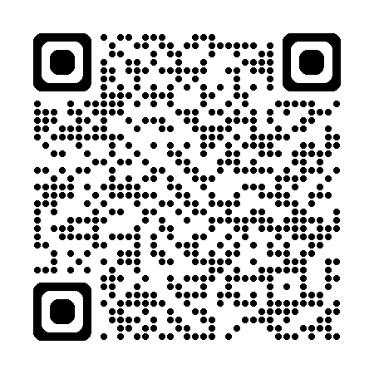
Operational Handbook
https://tbksp.who.int/en/node/3011
What are the treatment options for DS-TB patients?
2025
2HRZE/4HR
Applicable for ages 12 years old and above
2HRZ(E)/2HR
For children and adolescents between 3 months and 16 years of age
2HPMZ/2HPM
Can be used with PLHIV with a CD4 count > 100 cells/mm3;
Can be used regardless of HIV status or disease severity.
Considered safe for pregnant woman;
Can be used in all age groups;
Without severe extrapulmonary TB
pregnant, breastfeeding and postpartum women cannot benefit from this regimen
with non-severe TB
without suspicion or evidence of MDR/RR-TB

Slide 14
Operational Handbook
The composition and duration of 6-month regimen 2HRZE/4HR
6-month regimen: 2 HRZE / 4 HR
Initial phase: 2 H-R-Z-E
Continuation phase: 4 H-R
Continuation phase comprises of 2 months of daily isoniazid and rifampicin.
Initial phase comprises of 2 months of daily isoniazid, rifampicin pyrazinamide and ethambutol.
Duration is fixed at 6 months; prolonging treatment beyond 6 months is not recommended.
In children (<10 y) ethambutol should be used in settings with high isoniazid resistance, HIV infection or in children with HIV.

Slide 15
Operational Handbook
Who is eligible for a 6-month regimen 2HRZE/4HR regimen?
Any patient - whether a child or an adult – with DS-TB is eligible for the 6-month regimen
6-month regimen:
Considered safe in pregnancy;
Can be used in children of all ages; however, ethambutol can be omitted for HIV negative patients or in settings with low prevalence of isoniazid resistance;
Can be used regardless of HIV status or disease severity

Slide 16
Operational Handbook
The composition and duration of 4-month (2HPMZ/2HPM) regimen
4-month regimen: 2 H-P-M-Z / 2 H-P-M
Initial phase: 2 H-P-M-Z
Continuation phase: 2 H-P-M
Continuation phase involves 2 months of daily isoniazid, rifapentine and moxifloxacin.
Initial phase comprises of 2 months of daily isoniazid, rifapentine, moxifloxacin & pyrazinamide.
Daily dosing (7 days per week) is suggested; treatment supporters and video-supported treatment (VST) are means to enhance medication adherence and administration.
Duration is fixed at 4 month; prolonging beyond 4 months is not recommended

Slide 17
Operational Handbook
Who is eligible for a 4-month (2HPMZ/2HPM) regimen?
Adults and children aged 12 years or older with a body weight of more than 40 kg with pulmonary DS-TB are eligible for this regimen.
Except the following:
patients weighing less than 40 kg;
people with HIV with a CD4 count of less than 100 cells/mm3;
pregnant, breastfeeding and postpartum women
children and adolescents aged under 12 years;
patients with severe extrapulmonary TB (e.g. tuberculous meningitis, disseminated TB, osteoarticular TB or abdominal TB);

Slide 18
Operational Handbook
What criteria guide treatment choice in adolescents and adults?
Factors/conditions | 2 HRZE/4HR | 2HPMZ/2HPM
Age | No age restriction | Yes (12 years and above)
Weight | Any | > 40kg
Severe EPTB (meningitis, disseminated TB, osteoarticular TB or abdominal TB) | Yes | No
HIV infection | Regardless of CD4 count | CD4 count >100 cells/mm3
Pill burden | Fixed dose combination | Loose formulation
Duration of treatment | 6 months | 4 months
Pregnancy and breastfeeding | Yes | No
Other factors to be considered:
preferences of patients and clinicians feasibility of monitoring for drug adverse effects availability and cost of medicines

Slide 19
Operational Handbook
The composition and duration of 4-month (2HRZ(E)/2HR) regimen in children and adolescents
4-month regimen: 2 H-R-Z- (E) / 2 H-R
Initial phase: 2 H-R-Z- (E)
Continuation phase includes 2 months of daily isoniazid and rifampicin.
Initial phase comprises of 2 months of daily isoniazid, rifampicin and pyrazinamide, with or without ethambutol.
Daily dosing (7 days per week) is suggested; treatment supporters or VST can improve adherence.
Treatment should be continued for 6 months amongst those who have not responded clinically (i.e. haven’t demonstrated weight gain or resolution of TB symptoms).
Continuation phase: 2 H-R

Slide 20
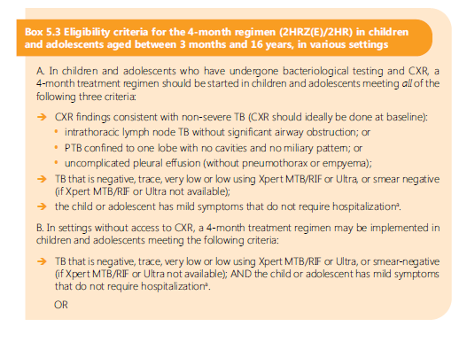
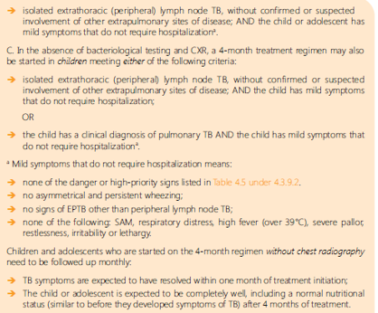
Operational Handbook
Who is eligible for a 4-month (2HRZ (E)/2 HR) regimen?
https://tbksp.who.int/en/node/2127

Slide 21
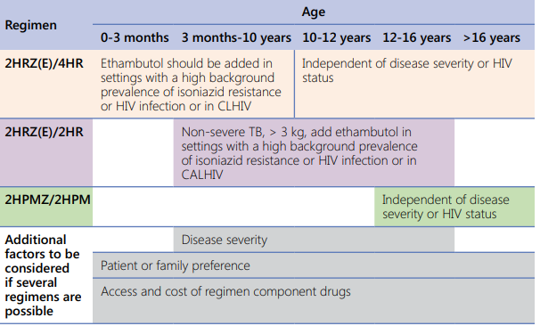
Operational Handbook
What key factors should be taken into consideration when making decisions about selecting the available treatment regimens?

Slide 22
Operational Handbook
What is the recommended dosing frequency for DS-TB in all patients?
The optimal dosing frequency for DS TB patients is daily throughout the course of therapy
Daily dosing remains the recommended dosing frequency for both HIV-negative people and people living with HIV
The term ‘daily’ indicates an intake of TB drugs for 7 days per week
Daily administration reduces the rate of acquired drug-resistance by up to 3 times when compared with intermittent dosage

Slide 23
Operational Handbook
How to monitor treatment response in DS-TB patients?
Clinical evaluation: During the first 2 months: every day; after the second month: once per month unless there is a medical necessity to see the patient more often.
The table below summarizes the activities involved in and the frequency of monitoring
 | Baseline | 2nd months | End of treatment | End of treatment
Sputum smear & culture | X | X | X | X
 | Culture can be done monthly if feasible
Chest X-ray | X | X |  | X
Body weight | X | Based on needs
Rapid molecular testing | X
DST | X | should be repeated for patients who do not improve clinically and radiologically and remain sputum smear +

Slide 24
Operational Handbook
Which regimens should be offered for patients with extrapulmonary TB?
Pulmonary and extrapulmonary TB in adults can be treated with the same 2HRZE/4HR regimen;
However, for TB meningitis, osteoarticular TB or other types of extrapulmonary TB, treatment can be prolonged up to 12 months, as decided by clinicians.
4-month 2HPMZ/2HPM regimen was not studied in EPTB and is thus not recommended.
In children and adolescents with TB meningitis, the following alternative regimens are recommended:
2 H-R-Z-E/10H-R or 6 H-R-Z-Eto

Slide 25
Main messages
The 6-month regimen is applicable for all DS-TB patients regardless of age, including children, adolescents and adults.
While 4-month regimens represent a significant advancement in DS-TB treatment, they have certain limitations
For patients aged between 12 and 16 years, it is essential to follow specific criteria when selecting the appropriate treatment regimen.
Age, weight, duration, pill burden, severity of EPTB and other considerations should guide the decision when opting for 4-months regimens.

Slide 26
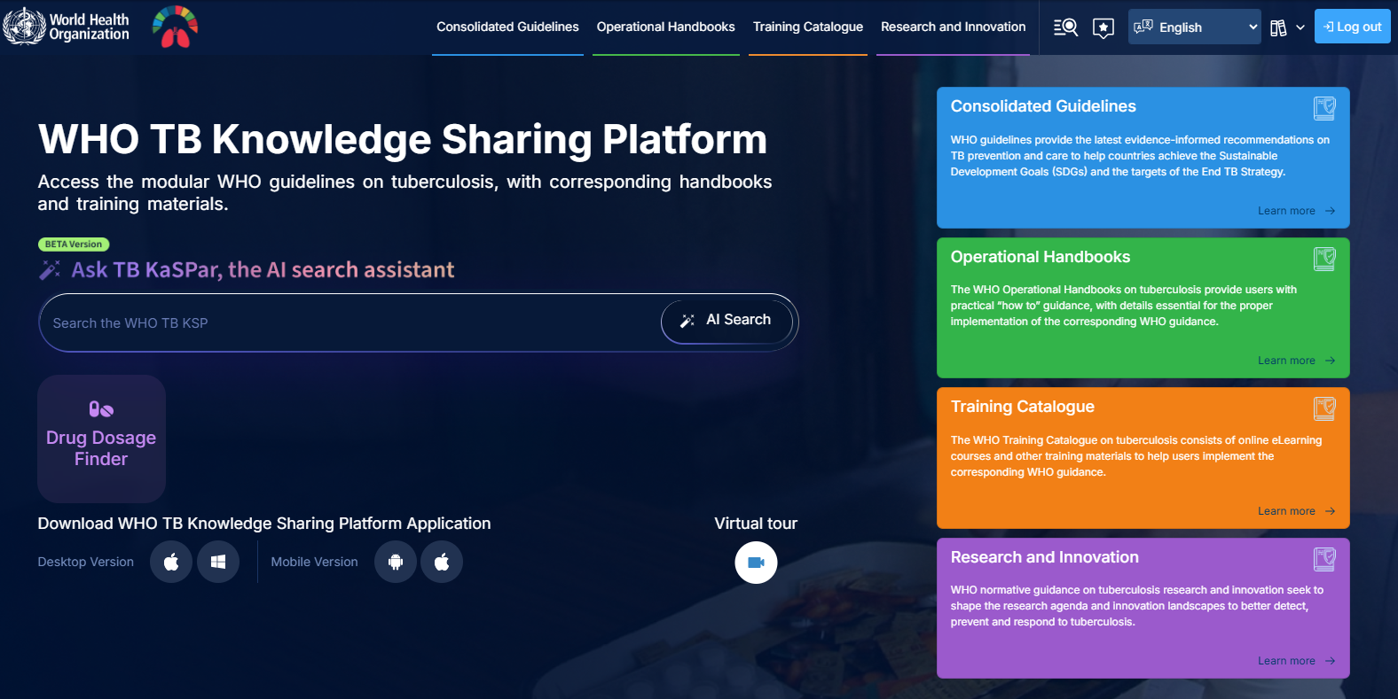
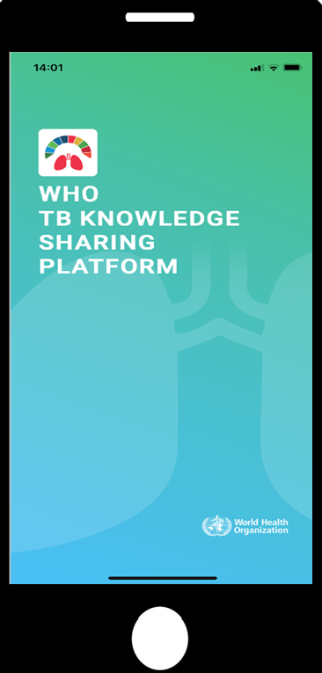
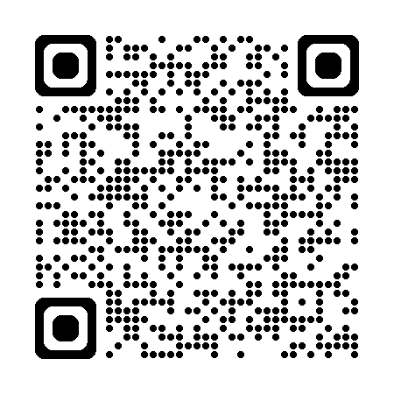
https://tbksp.who.int

Slide 27
© WORLD HEALTH ORGANIZATION 2025
All rights reserved. Publications of the World Health Organization can be obtained from WHO Press, World Health Organization, 20 Avenue Appia, 1211 Geneva 27, Switzerland (tel: +41 22 791 3264; fax: +41 22 791 4857; email: bookorders@who.int). Requests for permission to reproduce or translate WHO publications – whether for sale or for noncommercial distribution – should be addressed to WHO Press, at the above address (fax: +41 22 791 4806; email: permissions@who.int).
The designations employed and the presentation of the material in this publication do not imply the expression of any opinion whatsoever on the part of the World Health Organization concerning the legal status of any country, territory, city or area or of its authorities, or concerning the delimitation of its frontiers or boundaries. Dotted lines on maps represent approximate border lines for which there may not yet be full agreement.
The mention of specific companies or of certain manufacturers’ products does not imply that they are endorsed or recommended by the World Health Organization in preference to others of a similar nature that are not mentioned. Errors and omissions excepted, the names of proprietary products are distinguished by initial capital letters.
All reasonable precautions have been taken by the World Health Organization to verify the information contained in this publication. However, the published material is being distributed without warranty of any kind, either expressed or implied. The responsibility for the interpretation and use of the material lies with the reader. In no event shall the World Health Organization be liable for damages arising from its use.

