Slide 1
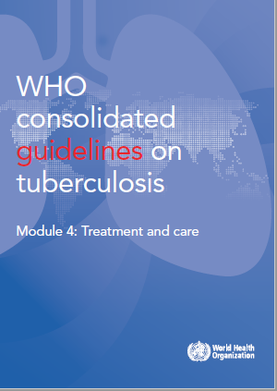
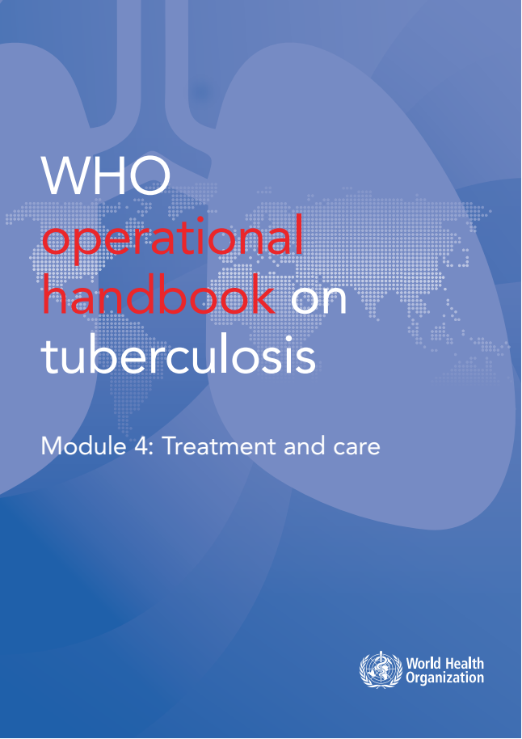
WHO guidelines & operational handbook:
Module 4: treatment and care
Drug-resistant TB treatment
(Chapter 2)

Slide 2
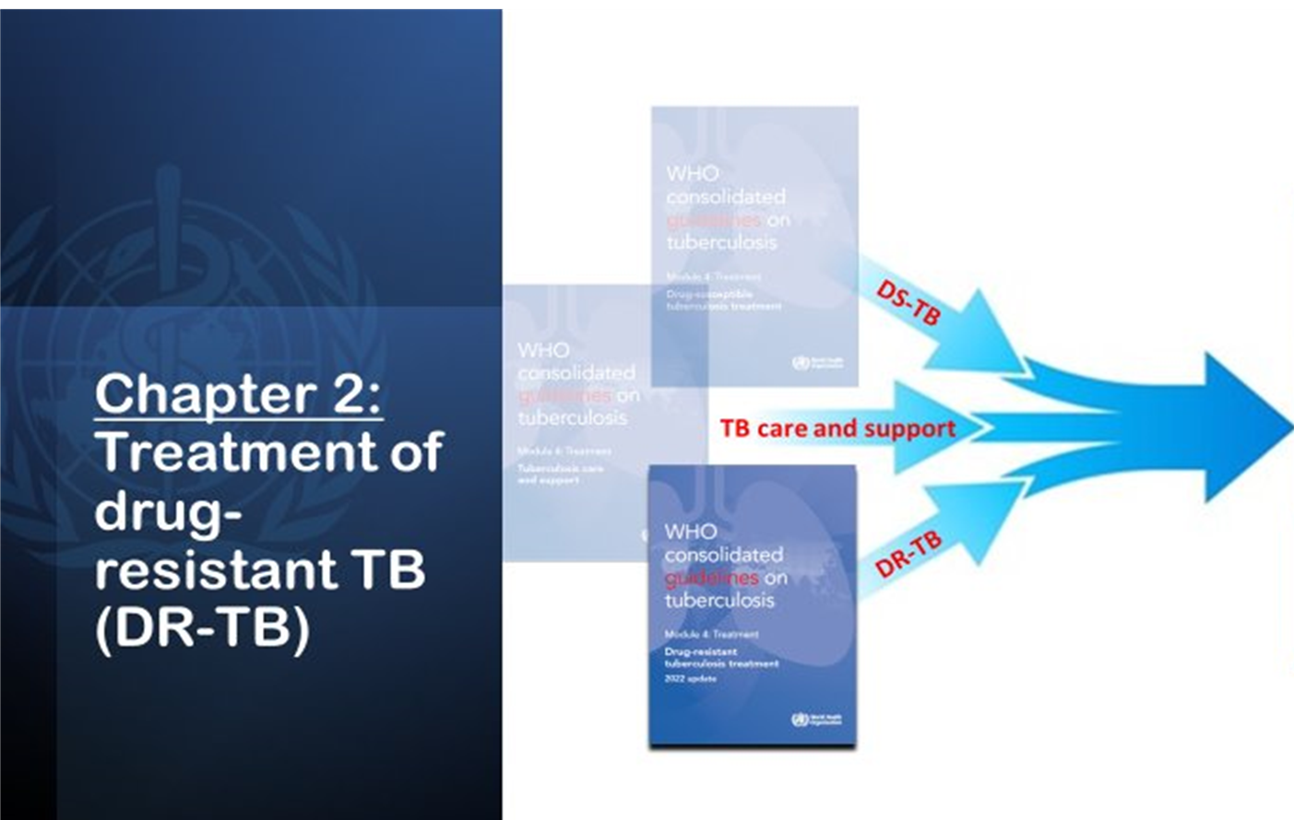
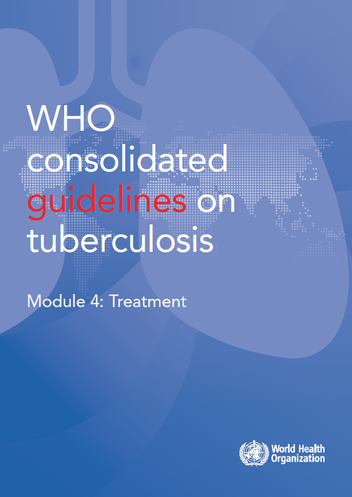
Consolidation of 2025 TB-treatment guidelines
2025

Slide 3
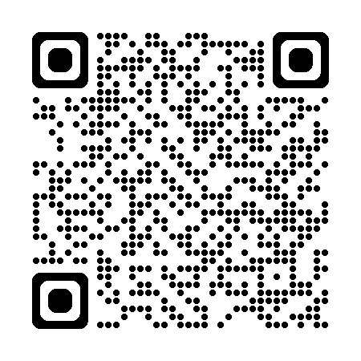
Overview of 2025 guidelines DR-TB chapter
Treatment of drug-resistant TB using 6-month regimens ​
The 6-month bedaquiline, pretomanid, linezolid, and moxifloxacin (BPaLM) regimen​
The 6-month bedaquiline, delamanid, linezolid, levofloxacin and clofazimine (BDLLfxC) (NEW)​
Treatment of drug-resistant TB using 9-month regimens ​
The 9-month all-oral regimen for MDR/RR-TB​
The modified 9-month all-oral regimens for MDR/RR-TB (NEW)​
Treatment of drug-resistant TB using longer regimens​
Regimen for Rif-susceptible & Inh-resistant tuberculosis​
Start of antiretroviral therapy in MDR/RR-TB patients
Surgery for patients on MDR/RR-TB treatment​
Hepatitis C virus (HCV) and MDR/RR-TB treatment co-administration (NEW)​
Monitoring patient response to MDR/RR-TB treatment (consolidated)
2025
2sn025
https://tbksp.who.int/en/node/2951

Slide 4
Background
New developments in 2025: Guidelines
Review of the BEAT-TB trial: 6-month regimen (BDLLfxC) for MDR/RR-TB or pre-XDR-TB
Review of the EndTB trial: 9-month regimens
(BLMZ, BLLfxCZ, BDLLfxZ) for MDR/RR-TB
Review of Hepatitis C virus (HCV) and MDR/RR-TB treatment co-administration
DR-TB guidelines 2025 (update)
DR-TB
Chapter 2

Slide 5
Evidence: BPaLM: Data and studies considered
TB PRACTECAL
(sites: Uzbekistan, South Africa, Belarus)
ZENIX
(sites: Georgia, Moldova, Russia, and South Africa)
Arm 1: bedaquiline (B)+pretomanid(Pa) +linezolid (Lzd)+ moxifloxacin (Mfx)for 24 weeks (BPaLM)
Arm 2: bedaquiline + pretomanid + linezolid + clofazimine for 24 weeks (BPaLC)
Arm 3: bedaquiline + pretomanid + linezolid for (BPaL) 24 weeks
Investigational regimen
Arm 1: bedaquiline +pretomanid +linezolid+ moxifloxacin for 24 weeks (BPaLM)
9-month &18-month regimens depending on the site, for MDR/RR-TB
1200mg 26 weeks
1200mg 9 weeks
600mg 26 weeks
600mg 9 weeks
No SoC comparator regimen
Bedaquiline & pretomanid at standard doses. One of the following Lzd doses:
BPaL regimen with different doses and duration of linezolid
Comparator: Standard of care
Investigational regimens
2025

Slide 6
Evidence: BDLLfxC: Data and studies considered
BEAT-TB trial
(site: South Africa)
Population: MDR/RR-TB or pre-XDR-TB
6 Bdq-Dlm-Lzd-Lfx-Cfz
Comparator:
9-month regimen with Lzd for Fq-susceptible
Longer regimens for Fq-resistant
Intervention: 6-month regimen BDLLfxC
2025

Slide 7
Evidence: 9-month regimens: Data and studies considered
Intervention | Comparator | Comparator
9-month regimens: Programmatic data from South Africa
9-month regimen with Eto: Bdq(6m)-Lfx/Mfx-Eto-Cfz-Hh-Z-E | WHO recommended longer regimens
9-month regimen with Lzd: Lzd(2m)-Bdq(6m)-Lfx-Cfz-Hh-Z-E | WHO recommended longer & shorter regimens

Slide 8
Evidence: 9-month regimens: Data and studies considered
Intervention | Comparator | Comparator
Modified 9-month regimens: EndTB trial multicountry: 9-month regimens
Bdq-Lzd-Mfx-Z Bdq-Lzd-Cfz-Lfx-Z Bdq-Lzd-Dlm-Lfx-Z Dlm-Cfz-Lzd-Lfx-Z Dlm-Cfz-Mfx-Z | WHO recommended longer regimens

Slide 9
Recommendations
Recommendation 1.1
WHO suggests the use of a 6-month treatment regimen composed of bedaquiline, pretomanid, linezolid (600 mg) and moxifloxacin (BPaLM) rather than the 9-month or longer (18-month) regimens in MDR/RR-TB patients.
(Conditional recommendation, very low certainty of evidence)
Remarks
DST for fluoroquinolones is strongly encouraged in people with MDR/ RR-TB, and although it should not delay initiation of the BPaLM, results of the test should guide the decision on whether moxifloxacin can be retained or should be dropped from the regimen – in cases of documented resistance to fluoroquinolones, BPaL without moxifloxacin would be initiated or continued.
This recommendation does not apply to pregnant and breastfeeding women owing to limited evidence on the safety of pretomanid.
The recommended dose of linezolid is 600 mg once daily for BPaLM/BPaL

Slide 10
Recommendations
Recommendation 1.2
WHO suggests the use of a 6-month treatment regimen composed of bedaquiline, delamanid, linezolid (600 mg), levofloxacin, and clofazimine (BDLLfxC) in MDR/RR-TB patients with or without fluoroquinolone resistance.
(Conditional recommendation, very low certainty of evidence)
Remarks
Drug susceptibility testing (DST) for fluoroquinolones is strongly encouraged in people with MDR/RR-TB. Although it should not delay the initiation of the BDLLfxC, the test results should guide the decision on whether levofloxacin or clofazimine should be retained.
This recommendation applies to the following:
People with MDR/RR-TB or pre-XDR-TB (i.e. MDR/RR-TB and resistance to fluoroquinolones).
Patients with less than 1 month of previous exposure to bedaquiline, linezolid, delamanid or clofazimine. When exposure is greater than 1 month, these patients may still receive the regimen if resistance to the specific medicines involved in such exposure has been ruled out.
People with diagnosed pulmonary TB of all ages, including children, adolescents, PLHIV, and pregnant and breastfeeding women.
People with all forms of extrapulmonary TB except for TB involving the CNS, osteoarticular TB, or disseminated forms of TB with multiorgan involvement.
Children and adolescents who do not have bacteriological confirmation of TB or resistance patterns but who do have a high likelihood of MDR/RR-TB (based on clinical signs and symptoms of TB, in combination with a history of contact with a patient with confirmed MDR/RR-TB).
3. When resistance to fluoroquinolones is unknown, the regimen should be started as BDLLfxC and then adjusted based on the DST results. In cases of quinolone susceptibility, clofazimine should be dropped and the regimen started or continued as bedaquiline, delamanid, linezolid and levofloxacin (BDLLfx). In cases of resistance to fluoroquinolones, levofloxacin should be dropped and the regimen started or continued as bedaquiline, delamanid, linezolid and clofazimine (BDLC).

Slide 11
Recommendations
Recommendation 2.1
WHO suggests the use of the 9-month all-oral regimen rather than longer (18-month) regimens in patients with MDR/RR-TB and in whom resistance to fluoroquinolones has been excluded.
(Conditional recommendation, very low certainty of evidence)
Remarks
The 9-month all-oral regimen consists of bedaquiline (used for 6 months), in combination with levofloxacin/moxifloxacin, ethionamide, ethambutol, isoniazid (high-dose), pyrazinamide and clofazimine (for 4 months, with the possibility of extending to 6 months if the patient remains sputum smear positive at the end of 4 months), followed by treatment with levofloxacin/moxifloxacin, clofazimine, ethambutol and pyrazinamide (for 5 months). Ethionamide can be replaced by 2 months of linezolid (600 mg daily).
A 9-month regimen with linezolid instead of ethionamide may be used in pregnant women, unlike the regimen with ethionamide.
3. This recommendation applies to :
a. people with MDR/RR-TB and without resistance to fluoroquinolones.
b. patients without extensive TB disease and without severe extrapulmonary TB.
c. patients with less than 1 month exposure to bedaquiline, fluoroquinolones, ethionamide, linezolid and clofazimine; when exposure is greater than 1 month, these patients may still receive this regimen if resistance to the specific medicines with such exposure has been ruled out;.
d. All people regardless of HIV status.
e. children (and patients in other age groups) who do not have bacteriological confirmation of TB or resistance patterns but who do have a high likelihood of MDR/RR-TB (based on clinical signs and symptoms of TB, in combination with a history of contact with a patient with confirmed MDR/RR-TB).

Slide 12
Recommendations
Recommendation 2.2 & 2.3
- WHO suggests using the 9-month all-oral regimens (BLMZ, BLLfxCZ and BDLLfxZ) over currently recommended longer (>18 months) regimens in patients with MDR/RR-TB and in whom resistance to fluoroquinolones has been excluded. Among these regimens, using BLMZ is suggested over using BLLfxCZ, and BLLfxCZ is suggested over BDLLfxZ.
(Conditional recommendation, very low certainty of evidence)
- WHO suggests against using 9-month DCLLfxZ or DCMZ regimens compared with currently recommended longer (>18 months) regimens in patients with Fq-susceptible MDR/RR-TB.
(Conditional recommendation, very low certainty of evidence)
Remarks
The recommended modified 9-month all-oral regimens comprise bedaquiline, linezolid and pyrazinamide in different combinations with levofloxacin/moxifloxacin, clofazimine and delamanid.
This recommendation applies to the following:
People with MDR/RR-TB and in whom resistance to fluoroquinolones has been excluded.
People with diagnosed pulmonary TB, including children, adolescents, PLHIV, and pregnant and breastfeeding women.
People with extensive TB disease and all forms of extrapulmonary TB except for TB involving the CNS, osteoarticular TB or disseminated forms of TB with multiorgan involvement.
People with MDR/RR-TB and less than 1 month of previous exposure to any of the component medicines of the regimen (apart from pyrazinamide and fluoroquinolones). When exposure is greater than 1 month, these patients may still receive one of the regimens if resistance to the specific medicines with such exposure has been ruled out.
Children and adolescents who do not have bacteriological confirmation of TB or resistance patterns but do have a high likelihood of MDR/RR-TB (based on clinical signs and symptoms of TB, in combination with a history of contact with a patient with confirmed MDR/RR-TB).

Slide 13
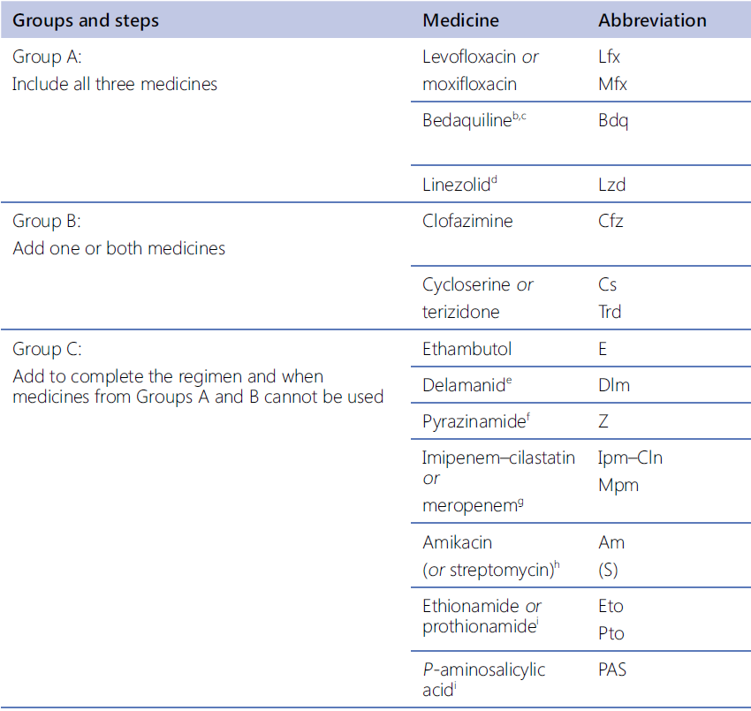
Recommendations
Recommendations 3.2-3.14
In MDR/RR-TB patients on longer regimens, all three Group A agents and at least one Group B agent should be included to ensure that treatment starts with at least four TB agents likely to be effective, and that at least three agents are included for the rest of the treatment if bedaquiline is stopped. If only one or two Group A agents are used, both Group B agents are to be included.
If the regimen cannot be composed with agents from Groups A and B alone, Group C agents are added to complete it.
(Conditional recommendation, very low certainty of evidence)
In Children as a part of all-oral treatment regimen:
<6 years: bedaquiline may be used
<3 years: delamanid may be used

Slide 14
Recommendations
Duration of longer regimen: 3.15 – 3.17
Regimen for rifampicin-susceptible and isoniazid-resistant TB: 4.1 - 4.2
Monitoring patient response to MDR/RR-TB treatment using culture: 5.1
Starting antiretroviral therapy in patients on MDR/RR-TB regimens: 6.1
Surgery for patients on MDR/RR-TB treatment: 7.1
3.15:
In MDR/RR-TB patients on longer regimens, a total treatment duration of 18–20 months is suggested for most patients; the duration may be modified according to the patient’s response to therapy.
(Conditional recommendation, very low certainty of evidence
6.1:
Antiretroviral therapy is recommended for all patients with HIV and drug-resistant tuberculosis requiring second-line antituberculosis drugs, irrespective of CD4 cell count, as early as possible (within the first 8 weeks) following initiation of antituberculosis treatment.
(Strong recommendation, very low certainty of evidence)
7.1:
In patients with rifampicin-resistant tuberculosis (RR-TB) or multidrug-resistant TB (MDR-TB), elective partial lung resection (lobectomy or wedge resection) may be used alongside a recommended MDR-TB regimen.
(Conditional recommendation, very low certainty of evidence
4.2:
In patients with confirmed rifampicin-susceptible, isoniazid-resistant tuberculosis, it is not recommended to add streptomycin or other injectable agents to the treatment regimen.
(Conditional recommendation, very low certainty of evidence)
5.1:
In MDR/RR-TB patients on longer regimens, the performance of sputum culture in addition to sputum smear microscopy is recommended to monitor treatment response. It is desirable for sputum culture to be repeated at monthly intervals.
(Strong recommendation, moderate certainty of evidence)
4.1:
In patients with confirmed rifampicin-susceptible, isoniazid-resistant tuberculosis , treatment with rifampicin, ethambutol, pyrazinamide and levofloxacin is recommended for a duration of 6 months.
(Conditional recommendation, very low certainty in the estimates of evidence)
3.16:
In MDR/RR-TB patients on longer regimens, a treatment duration of 15–17 months after culture conversion is suggested for most patients; the duration may be modified according to the patient’s response to therapy.
(Conditional recommendation, very low certainty of evidence)
3.17:
In MDR/RR-TB patients on longer regimens containing amikacin or streptomycin, an intensive phase of 6–7 months is suggested for most patients; the duration may be modified according to the patient’s response to therapy.
(Conditional recommendation, very low certainty of evidence)

Slide 15
Recommendations
Recommendation 8.3
In patients with MDR/RR-TB and HCV co-infection, the WHO suggests the co-administration of HCV and TB treatment over delaying HCV treatment until after treatment of MDR/RR-TB is completed.
(Conditional recommendation, very low certainty of evidence)
Remarks
1. This recommendation applies to people with confirmed MDR/RR-TB and HCV.
2. Treatment initiation should take into account potential drug-drug interactions (DDI) and other co-morbidities.

Slide 16
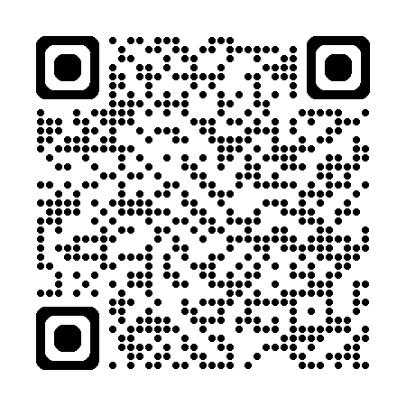
Operational Handbook
Module 4: treatment and care
Chapter 2: Drug-resistant tuberculosis treatment
2025
https://tbksp.who.int/en/node/3011

Slide 17
Operational Handbook
What are the treatment options for MDR/RR-TB patients?
≥14 years with MDR/RR-TB w/o exposure to B, Pa &L.
- This regimen may be used without moxifloxacin (BPaL) in the case of documented resistance to fluoroquinolones (in patients with pre-XDR-TB).
- DST to fluoroquinolones is strongly encouraged, but DST should not delay treatment initiation.
- Cannot be used during pregnancy
- People with all forms of extrapulmonary TB except for TB involving the CNS, osteoarticular, or disseminated forms of TB with multi-organ involvement.
9-month regimens (MDR/RR-TB)
- 2 months of linezolid (600 mg) can be used as an alternative to 4 months of ethionamide.
- no previous exposure to second-line treatment (including bedaquiline),
- no fluoroquinolone resistance and
- no extensive pulmonary TB disease or severe extrapulmonary TB.
- rapid DST for ruling out fluoroquinolone resistance is required.
- can be used in all age groups
- Lzd variation can be used in pregnant women
Longer (18 m), mostly in XDR-TB)
- Last resort regimen
- Those who failed or not eligible for shorter regimens
- XDR-TB patients
- Individualized based on current recommendations
6-month BDLLfxC (MDR/RR-TB & pre-XDR-TB)
- People with MDR/RR-TB or pre-XDR-TB
- People with MDR/RR-TB and less than one month of previous exposure to bedaquiline, linezolid, delamanid, or clofazimine.
Modified 9-month (MDR/RR-TB)
- People with diagnosed pulmonary TB, including children, adolescents, PLHIV, pregnant and breastfeeding women.
- People with all forms of extrapulmonary TB except for TB involving the CNS, osteoarticular, or disseminated forms of TB with multi-organ involvement.
- People with MDR/RR-TB and without resistance to fluoroquinolones;
- People with diagnosed pulmonary TB, including children, adolescents, PLHIV, pregnant and breastfeeding women.
- People with extensive TB disease and all forms of extrapulmonary TB except for TB involving the CNS, osteoarticular, or disseminated forms of TB with multi-organ involvement.
- People with MDR/RR-TB and less than one month of previous exposure to bedaquiline, fluoroquinolones, linezolid, and clofazimine
6-month BPaLM/BPaL (MDR/RR-TB & pre-XDR-TB)

Slide 18
Operational Handbook: 6-month BPaLM regimen
What are the eligibility criteria for the BPaLM regimen?
MDR/RR-TB or pre-XDR-TB
PTB, and EPTB, except CNS TB, osteoarticular, disseminated TB with multiorgan involvement
Age 14 years or older
All people regardless of HIV status.
MDR/RR-TB and <1 month of previous exposure to B, L, Pa
Not pregnant or breastfeeding
not XDR-TB according to the 2021 WHO definitions

Slide 19
Operational Handbook: 6-month BpaLM regimen
What is the composition and dosage of BPaLM regimen?
BPaLM is a combination of bedaquiline, pretomanid, linezolid and moxifloxacin
Drug | Dose
Bedaquiline (100 mg tablet) | 400 mg daily for 2 weeks, then 200 mg 3X per week (Product label) OR 200 mg daily for 8 weeks, then 100 mg daily ( ZeNIX trial)
Pretomanid (200 mg tablet) | 200 mg once daily
Linezolid (600 mg tablet) | 600 mg once daily
Moxifloxacin (400 mg tablet) | 400 mg once daily

Slide 20
Operational Handbook: 6-month BpaLM regimen
What is the recommended dosage of Linezolid in BPaLM regimen and how does it vary in specific situations?
1–9 weeks | >9–18 weeks | >18–26 weeks | >26–39 weeks
600 mg daily, throughout the treatment OR If Lzd permanently discontinued in the first 9 weeks, the entire regimen should be stopped. | Dose may be reduced to 300mg till the end OR resumed to 600 mg as tolerated | LZD may be omitted till the end of treatment OR Re-started at 300 mg or 600 mg as tolerated | BPaL can be extended
 |  | If Lzd is withheld in the later weeks, and the remaining regimen duration is no more than 8 weeks, the regimen may be completed with the remaining drugs.

Slide 21
Operational Handbook: 6-month BpaLM regimen
What is the duration of BPaL and BPaLM regimens?
BPaLM
Start
Record treatment outcome
Monthly sputum culture monitoring
No treatment extension
6 months
(26 weeks)
BPaL
Start
Record treatment outcome
(if sputum culture converted
Continue till 9 months (39 weeks)
if lack of bacteriological
or clinical response by month 4
Monthly sputum culture monitoring
6 months
(26 weeks)
9 months
(39 weeks)
All medicines to be used throughout treatment duration
Ideally, missing doses of all three or four drugs in the regimen should be avoided
If doses are missed, any interruption of >7 days should be made up for by extending the treatment duration (for Nos of missed doses)

Slide 22
Operational Handbook: 6-month BDLLfxC regimen
What are the eligibility criteria for the BDLLfxC regimen?
MDR/RR-TB or pre-XDR-TB
MDR/RR-TB and <1 month of previous exposure to B, L, D or C
PTB, children, adolescents, PLHIV, pregnant, breastfeeding women
EPTB, except CNS TB, osteoarticular, disseminated TB with multiorgan involvement
children and adolescents without bacteriological confirmation of TB but with a high likelihood of MDR/RR-TB (based on TB symptoms, history of MDR/RR-TB contact and etc)

Slide 23
Operational Handbook: 6-month BDLLfxC regimen
What is the composition of BDLLfxC regimen?
If DST for FQ is unknown or cannot be carried out at baseline
The regimen will include all five medicines – bedaquiline, delamanid, linezolid, levofloxacin and clofazimine.
If DST is susceptible to FQ
The regimen will include four medicines – bedaquiline, delamanid, linezolid and levofloxacin
If DST is resistant to FQ
The regimen will include four medicines – bedaquiline, delamanid, linezolid and clofazimine.
BDLLfxC
BDLLfx
BDLC

Slide 24
Operational Handbook: 6-month BDLLfxC regimen
Duration:
6 months (24 weeks)
Extended duration:
9 months (36 weeks)
What is the duration of the BDLLfxC regimen?
Reasons for extension:
Extensive pulmonary disease
Slow clinical response
No culture conversion by month 4.
If month 5&6 cultures are positive, suspect treatment failure, especially with poor adherence or clinical deterioration.
In Children, treatment extension based on clinical assessment, considering potential causes for deterioration.

Slide 25
Operational Handbook: 6-month BDLLfxC regimen
When to discontinue 6-month BDLLfxC regimen?
Safety Concerns & Toxicity
Sustained interruption in drug supply (e.g., Dlm)
DST results show resistance to regimen components.
Treatment Failed
Adverse effects (AEs) of the regimen components.
Linezolid toxicity within the first 2 months resulting in permanent discontinuation of treatment
Drug-Resistance & Supply issues
Further deterioration despite treatment.
Reconversion of negative cultures to positive.
Clinician-patient decision to switch to a more suitable regimen.

Slide 26
Operational Handbook: modified 9-month regimens
What is the eligibility criteria of the modified 9-month regimens?
People with MDR/RR-TB in whom resistance to fluoroquinolones has been excluded.
People with PTB, children, adolescents, PLHIV, pregnant and breastfeeding women.
People with extensive TB disease and all forms of EPTB, except CNS TB, osteoarticular TB or disseminated forms of TB with multiorgan involvement.
People with MDR/RR-TB and <1 month of previous exposure to any of the component medicines of the regimen (apart from pyrazinamide and fluoroquinolones). When exposure is >r than 1 month, resistance should be ruled out.
children and adolescents without bacteriological confirmation of TB but with a high likelihood of MDR/RR-TB (based on TB symptoms, history of MDR/RR-TB contact and etc)

Slide 27
Operational Handbook: modified 9-month regimens
What is the composition and duration of the modified 9-month regimens?
BLMZ
Bedaquiline-linezolid-moxifloxacin-pyrazinamide
BLLfxCZ
Bedaquiline-linezolid-levofloxacin-clofazimine-pyrazinamide
BDLLfxZ
Bedaquiline-delamanid- linezolid-levofloxacin-pyrazinamide
Swapping fluroquinolones ( Mfx to Lfx or vise versa) is not advisable
Treatment lasts for 9 months, with extensions not routinely practiced
All medicines are administered thought treatment, there is no intensive and continuation phase

Slide 28
Operational Handbook: modified 9-month regimens
What is the dosage and frequency of the modified 9-month regimens?
Linezolid:
- 600 mg once daily for 16 weeks then reduced to 300 mg once daily till the end of treatment or
- 600 mg 3 times a week until the end of treatment for an adult.
Either linezolid dose reduction strategy is acceptable & standard practice
Either Bdq dosing strategy is acceptable
Linezolid may be reduced or discontinued earlier if toxicity occurs before 16 weeks, but ideally not before 9 weeks.
Early discontinuation requires good clinical response (culture conversion, symptom resolution, or no radiological worsening)
Bedaquiline:
-higher loading dose first 2 weeks, then 3 times a week or
-daily dosing for the entire period of treatment

Slide 29
Operational Handbook: modified 9-month regimens
What is the role of pyrazinamide in the modified 9-month regimens?
PZA susceptibility
PZA resistance
PZA can be discontinued
PZA DST unknown
Continue PZA as part of the regimen
Monitor for hepatotoxicity and discontinue if severe toxicity occurs
PZA resistance does not significantly reduce treatment success.
Regimen remains effective, but careful monitoring is required
Regimens can still be used if DST is unavailable or pending.
Monitor for hepatotoxicity and adjust treatment if needed.
Decisions on discontinuation should be based on severity of liver toxicity

Slide 30
Operational Handbook: 9-month regimens
What is the composition and duration of 9-month regimens?
Ethionamide variation:
4-6 Bdq-Eto-Lfx/Mfx-Cfz-Z-E-Hh / 5Lfx/Mfx-Cfz-Z-E
Continuation phase:
5Lfx/Mfx-Cfz-Z-E
-Bdq may extend to 9 m
Linezolid variation:
4-6 Bdq–Lzd-Lfx/Mfx-Cfz-Z-E-Hh / 5Lfx/Mfx-Cfz-Z-E
- Lzd is only given the first 2 months
- High-dose H can be dropped depending on smear status
Continuation phase:
5Lfx/Mfx-Cfz-Z-E
-Bdq may extend to 9 m
- Eto & High-dose H can be dropped depending on smear status
If SS remains (+) at month 4, initial phase is extended to 6 months
Duration of continuation phase is fixed at month 5

Slide 31
Main messages
6-month BPaLM/BPaL regimen is the preferred choice for patients with MDR/RR-TB > 14 years
6-month BDLLfxC regimen is an alternative for those not eligible for BPaLM, and it can be used in all patients (including children and pregnant women)​
Modified 9-month regimens can be considered as good alternatives, although they have some limitations, but have less medicines compared to 9-month regimens
Longer, 18-20 months regimen – the “last resort” individualized regimen
DST, extent of TB disease and other factors to be considered for choosing the shorter regimens.
The duration of MDR/RR-TB treatment can be the same as of DS-TB treatment. including children and during pregnancy.​

Slide 32
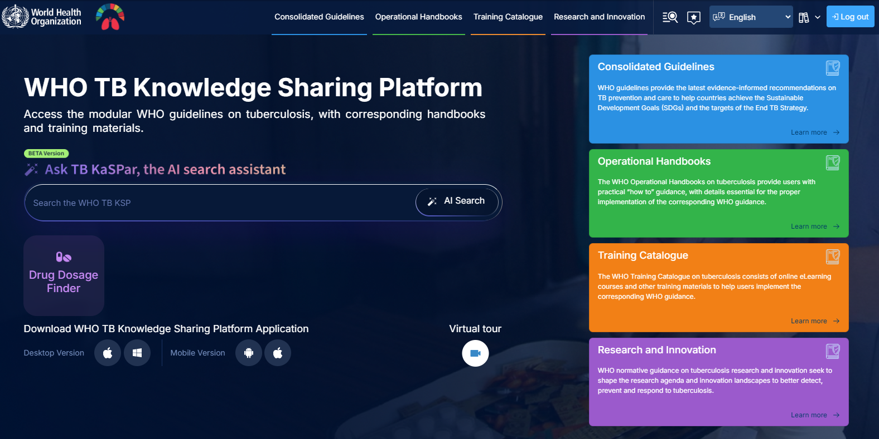
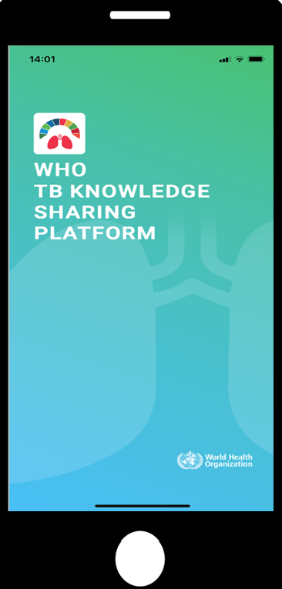
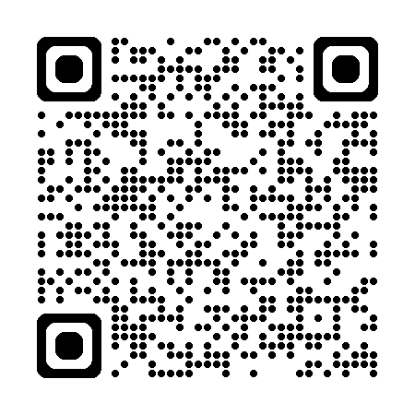
https://tbksp.who.int

Slide 33
© WORLD HEALTH ORGANIZATION 2025
All rights reserved. Publications of the World Health Organization can be obtained from WHO Press, World Health Organization, 20 Avenue Appia, 1211 Geneva 27, Switzerland (tel: +41 22 791 3264; fax: +41 22 791 4857; email: bookorders@who.int). Requests for permission to reproduce or translate WHO publications – whether for sale or for noncommercial distribution – should be addressed to WHO Press, at the above address (fax: +41 22 791 4806; email: permissions@who.int).
The designations employed and the presentation of the material in this publication do not imply the expression of any opinion whatsoever on the part of the World Health Organization concerning the legal status of any country, territory, city or area or of its authorities, or concerning the delimitation of its frontiers or boundaries. Dotted lines on maps represent approximate border lines for which there may not yet be full agreement.
The mention of specific companies or of certain manufacturers’ products does not imply that they are endorsed or recommended by the World Health Organization in preference to others of a similar nature that are not mentioned. Errors and omissions excepted, the names of proprietary products are distinguished by initial capital letters.
All reasonable precautions have been taken by the World Health Organization to verify the information contained in this publication. However, the published material is being distributed without warranty of any kind, either expressed or implied. The responsibility for the interpretation and use of the material lies with the reader. In no event shall the World Health Organization be liable for damages arising from its use.

