Slide 1
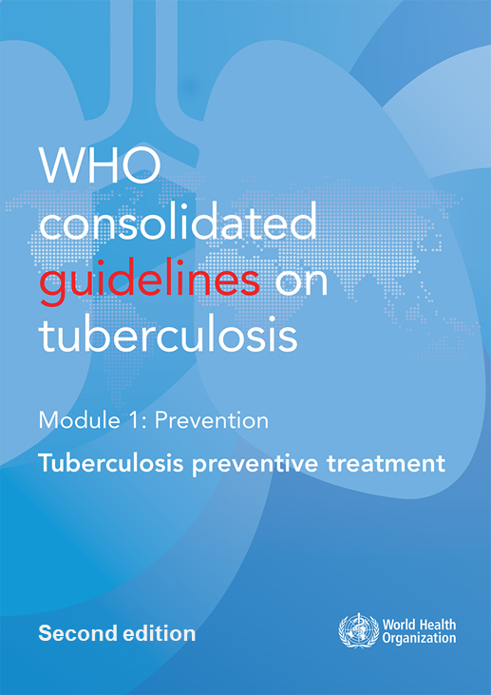
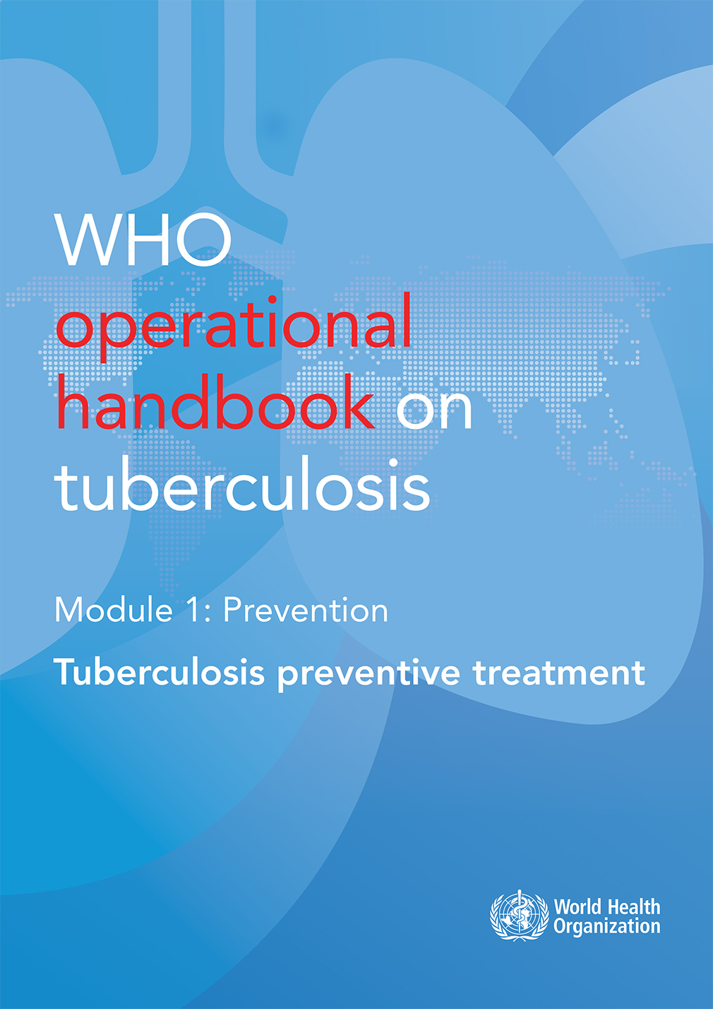

WHO guidelines & operational handbook: ​
Module 1:​
Tuberculosis preventive treatment​

Slide 2

Overview of guidelines
21 recommendations on 4 critical steps of the TB preventive care cascade:
Identify people at risk
Screen for TB and rule out TB
Test for TB infection
Select TPT regimen
(Research gaps)
2024
https://tbksp.org/en/node/619
Notes:
21 recommendations are presented following the cascade of care approach

Slide 3
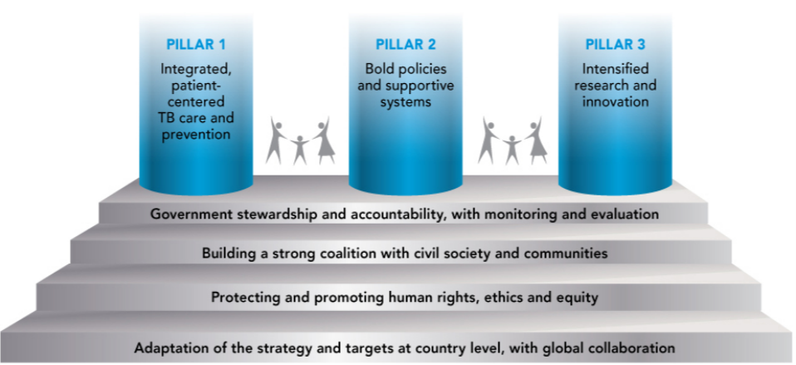
Background (1)
The End TB Strategy – Pillars 1 & 2
TB preventive treatment (TPT) fits within a larger framework of preventive actions envisaged by Pillars 1 and 2 of the End TB Strategy, ranging from active TB case finding, infection control, prevention and care of HIV and other co-morbidities and health risks, access to universal health care, social protection and poverty alleviation.

Slide 4
Background (2)
The potential of TPT to accelerate the decline in TB incidence
Baseline
1000
Mitigate risk factors
Prevent infection
100
Treat TB disease
TB incidence (cases per million pop. per year)
Treat TB infection
10
End TB Strategy : -90% by 2035
Treat TB disease
and infection
2000
2010
2020
2030
2040
2050
From Dye C et al., Prospects for Tuberculosis Elimination. Ann Rev Public Health 2013. 34:271-86
Notes:
This slide from a study performed ahead of the launch of the End TB Strategy models the expected impact of different interventions for TB. It shows that only an approach that combines the treatment of both TB disease and TB infection at large scale would be expected to bring down the TB incidence to the levels envisaged by the End TB Strategy by 2035.

Slide 5
Evidence (1): TPT for people living with HIV
Adults and adolescents living with HIV (Pre-ART)
In a systematic review of 12 RCTs (8578 people living with HIV), isoniazid preventive treatment reduced overall risk for TB by 33% (relative risk 0.67, 95% CI: 0.51–0.87)
  TST positive, the reduction increased to 64% (RR 0.36, 95% CI 0.22–0.61)
  TST negative, 14% (RR 0.86, 95% CI 0.59–1.26)
Adults and adolescents living with HIV (ART)
In one RCT (2056 people living with HIV), isoniazid preventive treatment showed additive benefits to ART in reducing both TB incidence and overall mortality
In one double-blind RCT (1329 people living with HIV receiving ART), the effect of isoniazid preventive treatment was not statistically significantly different between patients who were positive or negative on TST or IGRA
Children and infants with HIV
Overall limited or low-quality evidence in children with HIV, but Guideline Development Groups deemed it biologically plausible to extrapolate evidence from adults with HIV with and without ART to children
Notes:
1.Akolo C, Adetifa I, Shepperd S, Volmink J. Treatment of latent tuberculosis infection in HIV infected persons. Cochrane Database of Systematic Reviews [Internet]. 2010 Jan 20 [cited 2022 Mar 16];(1). Available from: https://www.cochranelibrary.com/cdsr/doi/10.1002/14651858.CD000171.pub3/ful
2.Rangaka MX, Wilkinson RJ, Boulle A, Glynn JR, Fielding K, Van Cutsem G, et al. Isoniazid plus antiretroviral therapy to prevent tuberculosis: A randomised double-blind, placebo-controlled trial. The Lancet [Internet]. 2014 Aug 23 [cited 2022 Feb 11];384(9944):682–90. Available from: http://www.thelancet.com/article/S0140673614601628/fulltext
3.Badje A, Moh R, Gabillard D, Guéhi C, Kabran M, Ntakpé JB, et al. Effect of isoniazid preventive therapy on risk of death in west African, HIV-infected adults with high CD4 cell counts: long-term follow-up of the Temprano ANRS 12136 trial. Lancet Glob Health [Internet]. 2017 Nov 1 [cited 2022 Feb 11];5(11):e1080–9. Available from: https://europepmc.org/article/med/29025631
4.The TASG. A Trial of Early Antiretrovirals and Isoniazid Preventive Therapy in Africa. New England Journal of Medicine. 2015;373(9):808-22.

Slide 6
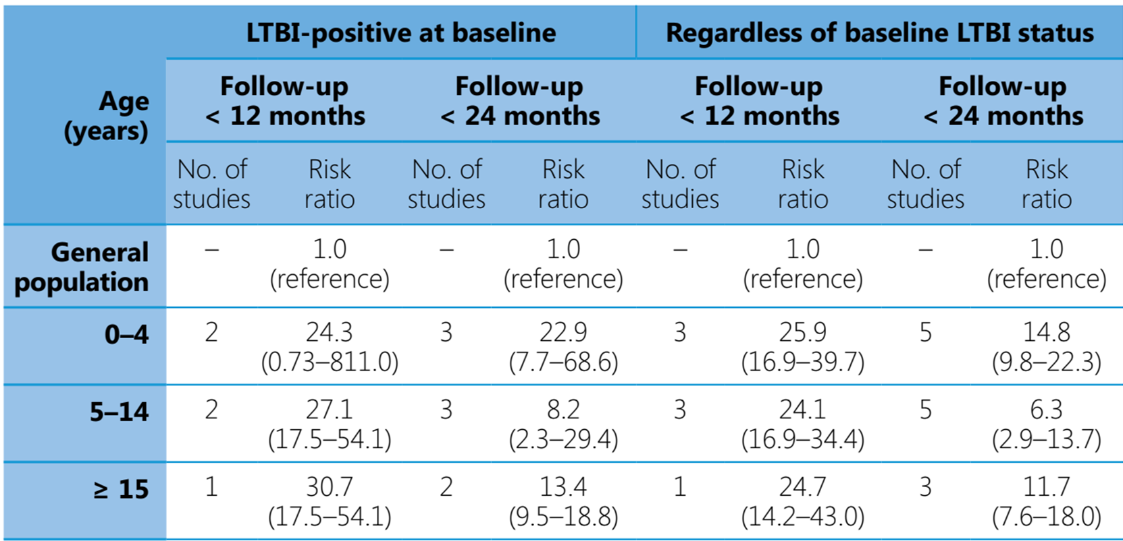
Evidence (2): TPT for household contacts
Risk for TB in household contacts by age-group and baseline infection status, compared with the general population
Notes:
1.Akolo C, Adetifa I, Shepperd S, Volmink J. Treatment of latent tuberculosis infection in HIV infected persons. Cochrane Database of Systematic Reviews [Internet]. 2010 Jan 20 [cited 2022 Mar 16];(1). Available from: https://www.cochranelibrary.com/cdsr/doi/10.1002/14651858.CD000171.pub3/ful
2.Rangaka MX, Wilkinson RJ, Boulle A, Glynn JR, Fielding K, Van Cutsem G, et al. Isoniazid plus antiretroviral therapy to prevent tuberculosis: A randomised double-blind, placebo-controlled trial. The Lancet [Internet]. 2014 Aug 23 [cited 2022 Feb 11];384(9944):682–90. Available from: http://www.thelancet.com/article/S0140673614601628/fulltext
3.Badje A, Moh R, Gabillard D, Guéhi C, Kabran M, Ntakpé JB, et al. Effect of isoniazid preventive therapy on risk of death in west African, HIV-infected adults with high CD4 cell counts: long-term follow-up of the Temprano ANRS 12136 trial. Lancet Glob Health [Internet]. 2017 Nov 1 [cited 2022 Feb 11];5(11):e1080–9. Available from: https://europepmc.org/article/med/29025631
4.The TASG. A Trial of Early Antiretrovirals and Isoniazid Preventive Therapy in Africa. New England Journal of Medicine. 2015;373(9):808-22.

Slide 7
Evidence (3): TPT options
Daily rifapentine plus isoniazid for one month (1HP)
In one multi-country RCT, among all study participants, the difference in incidence rate of TB between 1HP and 9H (i.e., 1HP arm minus 9H arm) was −0.02 per 100 person-years (95% confidence interval [CI], −0.35; +0.30)
Non-inferiority was also shown for the sub-group with confirmed TB infection (incidence rate difference per 100 person-years = 0.069 [-0.830 to 0.690]), and among those on or without ART at start of study.
Weekly rifapentine plus isoniazid for 3 months (3HP)
A systematic review was conducted for the 2018 guidelines update to compare effectiveness of 3HP with that of isoniazid monotherapy (4 RCTs).
  No significant difference found in incidence of TB disease between 3HP and 6H or 9H (RR 0.73, 95% CI 0.23; 2.30)
  3HP associated with higher completion in all subgroups (adults with HIV: RR 1.25, 95% CI 1.01; 1.55).
Notes:
1.Swindells S, Ramchandani R, Gupta A, Benson CA, Leon-Cruz J, Mwelase N, et al. One Month of Rifapentine plus Isoniazid to Prevent HIV-Related Tuberculosis. N Engl J Med. 2019;380(11):1001-11.
2.Martinson NA, Barnes GL, Moulton LH, Msandiwa R, Hausler H, Ram M, et al. New regimens to prevent tuberculosis in adults with HIV infection. N Engl J Med. 2011;365(1):11-20.
3.Sterling TR, Villarino ME, Borisov AS, Shang N, Gordin F, Bliven-Sizemore E, et al. Three months of rifapentine and isoniazid for latent tuberculosis infection. N Engl J Med. 2011;365(23):2155-66.
4.Sterling TR, Scott NA, Miro JM, Calvet G, La Rosa A, Infante R, et al. Three months of weekly rifapentine and isoniazid for treatment of Mycobacterium tuberculosis infection in HIV-coinfected persons. AIDS. 2016;30(10):1607-15.
5.Villarino ME, Scott NA, Weis SE, Weiner M, Conde MB, Jones B, et al. Treatment for preventing tuberculosis in children and adolescents: a randomized clinical trial of a 3-month, 12-dose regimen of a combination of rifapentine and isoniazid. JAMA Pediatr. 2015;169(3):247-55.

Slide 8
Evidence (4): TPT options
Daily rifampicin plus isoniazid for 3 months (3HR)
A systematic review updated in 2017 showed that the efficacy and the safety profile of 3–4 months daily rifampicin plus isoniazid were similar to those of 6 months daily isoniazid
Daily rifampicin monotherapy for 4 months (4R)
A systematic review conducted for the 2015 TPT guidelines and updated in 2017 showed
  similar efficacy for 3–4 months daily rifampicin and 6 months daily isoniazid (OR, 0.78; 95% CI, 0.41–1.46)
  individuals given rifampicin daily for 3–4 months had a lower risk for hepatotoxicity than those treated with isoniazid monotherapy (OR 0.03; 95% CI 0.00–0.48)
  in individuals <18 years, the difference in rate of TB disease between 4R and 9H (4R arm minus 9H arm) was -0.37 cases per 100 person-years (95% CI, −0.88; 0.14), while in individuals >17 years, the difference was <0.01 cases cases per 100 person-years (95%CI, −0.14;–0.16)
Notes:
1.Zenner D, Beer N, Harris RJ, Lipman MC, Stagg HR, van der Werf MJ. Treatment of Latent Tuberculosis Infection: An Updated Network Meta-analysis. Ann Intern Med. 2017;167(4):248-55.
2.Stagg HR, Zenner D, Harris RJ, Muñoz L, Lipman MC, Abubakar I. Treatment of latent tuberculosis infection: a network meta-analysis. Ann Intern Med. 2014;161(6):419-28.
3.Diallo T, Adjobimey M, Ruslami R, Trajman A, Sow O, Obeng Baah J, et al. Safety and Side Effects of Rifampin versus Isoniazid in Children. N Engl J Med. 2018;379(5):454-63.
4.Menzies D, Dion MJ, Rabinovitch B, Mannix S, Brassard P, Schwartzman K. Treatment completion and costs of a randomized trial of rifampin for 4 months versus isoniazid for 9 months. Am J Respir Crit Care Med. 2004;170(4):445-9.
5.Menzies D, Long R, Trajman A, Dion MJ, Yang J, Al Jahdali H, et al. Adverse events with 4 months of rifampin therapy or 9 months of isoniazid therapy for latent tuberculosis infection: a randomized trial. Ann Intern Med. 2008;149(10):689-97.

Slide 9
Evidence (5): TPT options
Efficacy of levofloxacin
Estimated treatment effect across different analyses: TB disease by 54 weeks
Posterior probability that levofloxacin is superior to placebo in VQUIN population=98%
Posterior probability that levofloxacin is superior to placebo in TB-CHAMP population=98%
Notes:
There is a clear protective effect of Levofloxacin in reducing the risk of TB among contacts exposed to DR TB demonstrated in both VQUIN and TB-CHAMP trials
The overall individual patient data meta-analysis shows an estimated TB risk reduction with Levofloxacin of about 60% at 54 weeks follow-up, compared to the Placebo (range between 10% and 83% risk reduction following Levo TPT). This is statistically significant, although confidence intervals with standard analysis of individual trial data include 1.
Evidence from the two clinical trials suggests a 98% chance that levofloxacin is more effective than a placebo in preventing TB in the study populations.

Slide 10
Recommendations (1) Identify people at risk
People living with HIV
Adults and adolescents (>10y) [regardless of ARV, pregnancy, previous TB treatment, immunosuppression and availability of test for TB infection]*
Infants aged < 12 months who are in contact with TB*
Children aged ≥ 12 months in a high TB transmission setting
All children who successfully completed treatment for TB disease
Household contacts of pulmonary TB (bacteriologically confirmed)
Children < 5 years*
Individuals aged ≥ 5 years
Exposed to multidrug-resistant tuberculosis
Other risk indicating systematic testing & TPT
People who have silicosis, or who are initiating anti-TNF treatment or dialysis, or preparing for an organ or haematological transplant*
Prisoners, health workers, immigrants from countries with a high TB burden, homeless people and people who use drugs
* Strong recommendation
Notes:
TPT is strongly recommended for people with HIV aged over 10 and for infants in contact with TB, without the need to test for TB infection. In other children with HIV in a high TB transmission setting or who have completed treatment for TB disease, TPT is conditionally recommended. In contacts under 5 years of people with bacteriologically confirmed TB, TPT is strongly recommended, without the need to test for TB infection. In other contacts TPT is conditionally recommended. Systematic testing for TB infection followed by TPT is strongly recommended in people with silicosis, in those starting anti-TNF treatment or dialysis, or people preparing for organ transplant. Testing followed by TPT is conditionally recommended in other groups like prisoners and health-care workers.
In the 2024 edition, the negative recommendation for systematic testing and TPT in diabetes, harmful use of alcohol, tobacco smoking and underweight has been withdrwan and is replaced by an explanatory note in the text

Slide 11
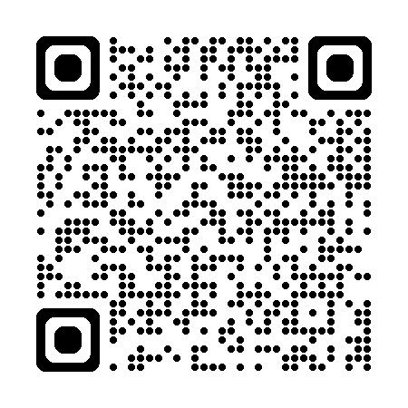
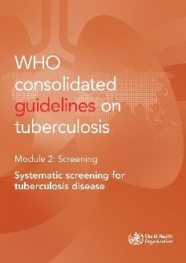
Recommendations (2) Screen for TB and rule out TB
2021
People living with HIV
Infants and children living with HIV who have poor weight gain, fever or current cough or who have a history of contact with a person with TB should be evaluated for TB and other diseases that cause such symptoms. If TB disease is excluded after an appropriate clinical evaluation or according to national guidelines, these children should be offered TB preventive treatment, regardless of their age.*
Adults and adolescents living with HIV should be screened for TB according to a clinical algorithm. Those who do not report any of the symptoms of current cough, fever, weight loss or night sweats are unlikely to have TB disease. Those who report any of these symptoms may have TB and should be evaluated for TB disease and other diseases and offered TB preventive treatment if TB disease is excluded, regardless of their ART status.*
Among adults and adolescents living with HIV, chest X-ray may be used to screen for TB disease.
Among adults and adolescents living with HIV, C-reactive protein using a cut-off of >5mg/L may be used to screen for TB disease.
Among adults and adolescents living with HIV, molecular WHO-recommended rapid diagnostic tests may be used to screen for TB disease.
* Strong recommendation
Notes:
Among infants and children use of the clinical symptoms and history of contact with TB patients are considered for TB screening and ruling out TB disease
Among adults and adolescents living with HIV in addition to symptom screening, chest X-ray, C-reactive protein and mWRD can be used to rule out TB disease. The last three recommendations are from TB screening guidelines published in 2021

Slide 12
Recommendations (3) Screen for TB and rule out TB
2021
Household contacts of pulmonary TB and other risk groups
The absence of any symptoms of TB and the absence of abnormal chest radiographic findings may be used to rule out TB disease among HIV-negative household contacts aged ≥ 5 years and other risk groups before TB preventive treatment.
Among individuals aged 15 years and older in populations in which TB screening is recommended, systematic screening for TB disease may be conducted using a symptom screen, chest X-ray or molecular WHO-recommended rapid diagnostic tests, alone or in combination.
Among individuals younger than 15 years who are close contacts of someone with TB, systematic screening for TB disease should be conducted using a symptom screen including any one of cough, fever or poor weight gain; or chest radiography; or both.*
* Strong recommendation
Notes:
Among HIV-negative adult contacts of TB patients, chest X-ray should be used preferably to rule out TB disease. Among contacts more than 15, mWRD alone or in combination is also recommended

Slide 13
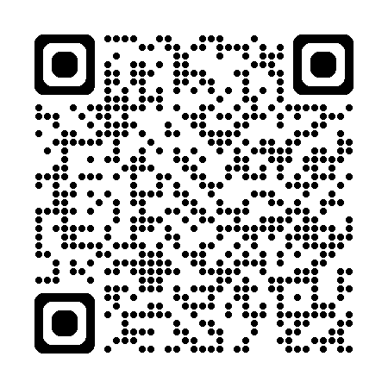
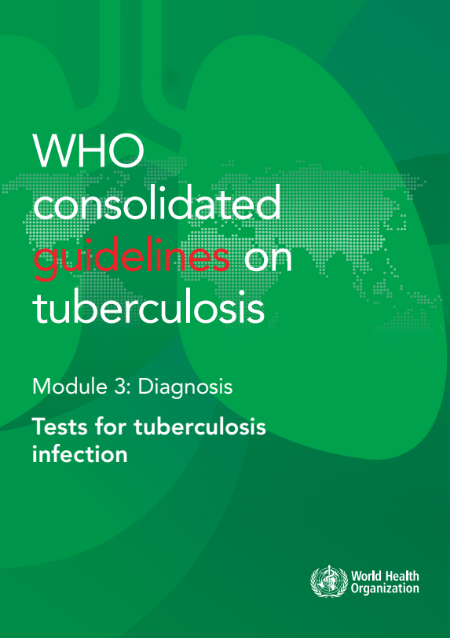
Recommendations (4) Tests for TB infection
2022
Either a TST or IGRA (QuantiFERON®-TB Gold and T-SPOT®.TB) can be used to test for TB infection*
New antigen-based skin tests for TB infection may be used
A test for TB infection is not required to start TPT in people with HIV or contacts aged < 5 years
* Strong recommendation
Notes:
Read slide

Slide 14
Recommendations (5) TPT options
2022
6 or 9-month, daily isoniazid*
3-month, weekly isoniazid and rifapentine*
3-month, daily isoniazid and rifampicin*
1-month, daily isoniazid and rifapentine
4-month, daily rifampicin
6-month, daily levofloxacin after exposure to multidrug- or rifampicin-resistant TB*
* Strong recommendation
Notes:
Several TPT regimens are included in the WHO guidelines. Some regimens, asterisked in this slide, are strongly recommended based on the evidence of potential benefit to harm. Isoniazid monotherapy for 6 or 9 months has been used widely as TPT for several decades. However, shorter options that are better tolerated are now available. The use of rifampicin or rifapentine allows the duration of TPT to be reduced to even one month or 12 doses over 3 months. Six months of levofloxacin is recommended as TPT for exposure to MDR/RR-TB.

Slide 15

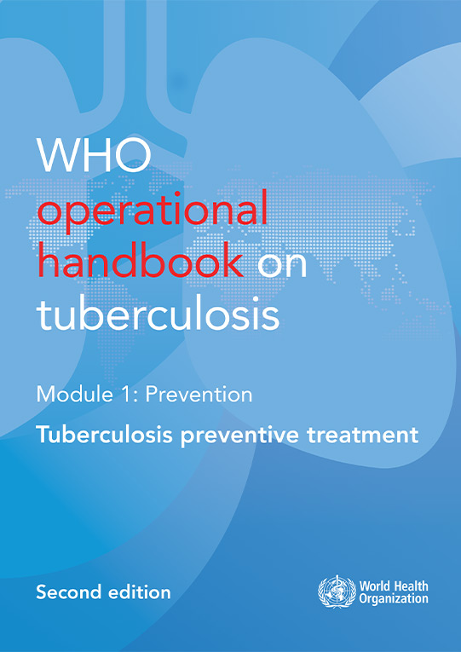
  Operational handbook
2022
Provides complementary details on TPT critical to the implementation of different elements of PMTPT e.g., contact evaluation, drug dosages, safety monitoring, programme indicator
Address frequently asked questions

Slide 16
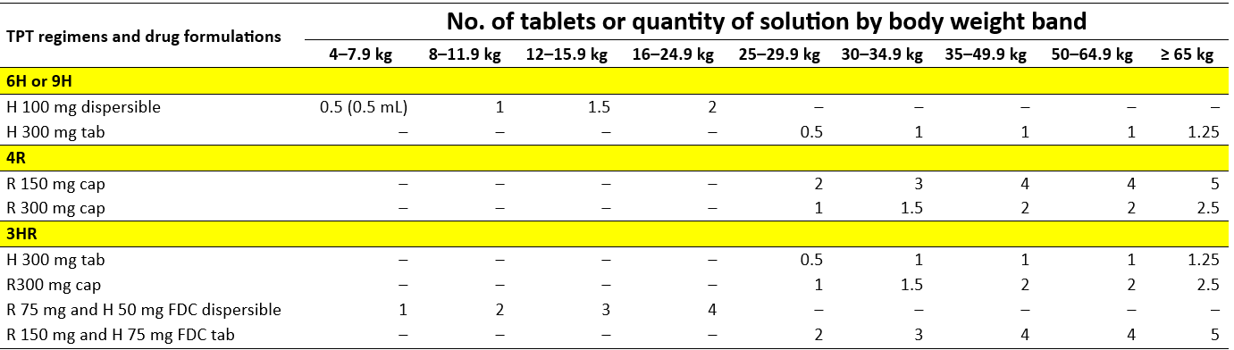
  Operational handbook (1)
  Drug dosage for TPT according to body weight band
2022
Notes:
In the first edition of TPT guidelines
Dose recs for H and R were based on age demarcation and mg/kg body weight. H- age >10 years 5mg/kg and age <10 years 10 mg/kg, same for R of 10mg/kg and 15mg/kg
There were limited PK data to inform appropriate dosage and safety of rifapentine among children < 2 years
Different WHO guidelines use variable weight bands for dosing recs, hence there is organization wide effort to harmonize weight bands
A PK/PD task force convened by GTB before the GDG meeting for the second edition reviewed all available evidence and suggested weight band dosing for all regimens and also attempted to align the weight bands to standard ones use in different WHO guidelines. The alignment was however possible only for 3HP, 1HP, and 6 LFx given the available data
The task force considered avoiding breaking the pills beyond half to retain bioavailability.

Slide 17
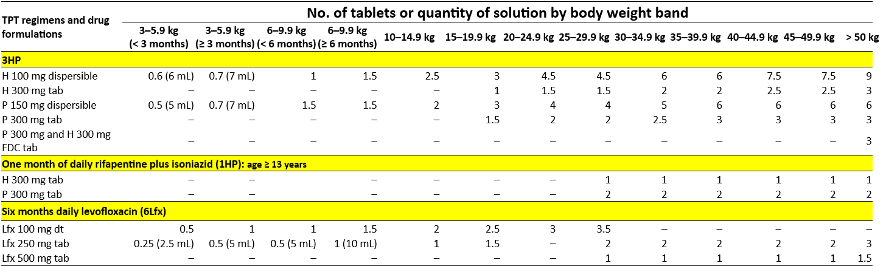
  Operational handbook (2)
  Drug dosage for TPT according to body weight band
different weight bands
2022
Notes:
3HP dosing available across all ages down to 3Kg weight or age under 3 months
Dispersible formulations of rifapentine 150mg scored and INH 100 mg should be preferred in children. At higher weight bands its is possible to use solid formulations if DT are not available
FDC should be used preferable above 50Kg weight, to achieve appropriate dosing for lower weight solid formulations can be used (dosage of H to P did not follow 1:1 ratio below a body weight of 50kg, risk of overdosing with H in younger kids if FDC is used)
1HP lack of evidence hence no recommendation under 13 years of age

Slide 18
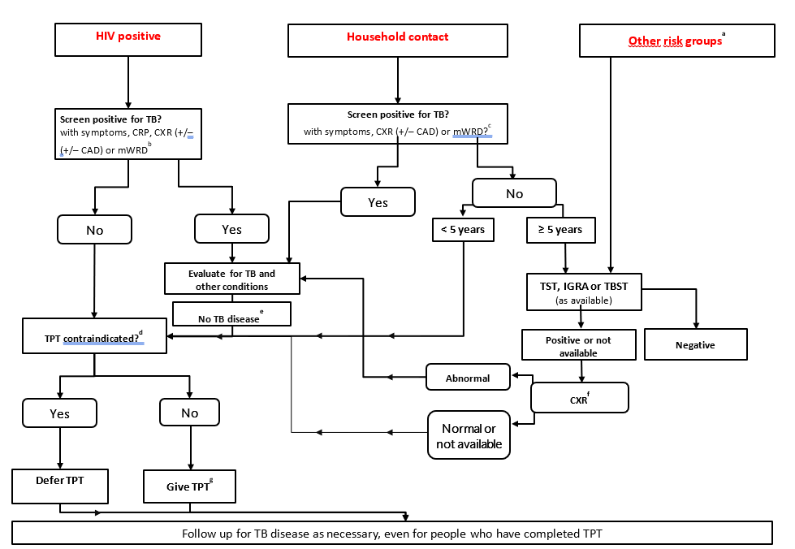
Operational handbook (3)
Combined algorithm for screening and testing before TPT
2022
Notes:
Across all target populations for TPT, ruling out TB disease should start with a symptom screen. If no symptoms are noted, additional tests such as chest X-ray, CRP, WRD may be used to enhance the sensitivity of the screening criterion. This is likely to enhance the acceptability of TPT both among the providers and beneficiaries of TPT.
Further among adult contacts and individuals from other risk groups may be advised tests for TB infection when available and TPT considered among those positive
Among the individuals considered for TPT, the providers should check if any contraindication for TPT exists (acute or chronic hepatitis; peripheral neuropathy (if isoniazid is used); regular and heavy alcohol consumption. Pregnancy or a previous history of TB are not contraindications.)
Once TPT is started, both the providers and recipients should watch for the emergence of TB symptoms and actively investigate when they emerge

Slide 19
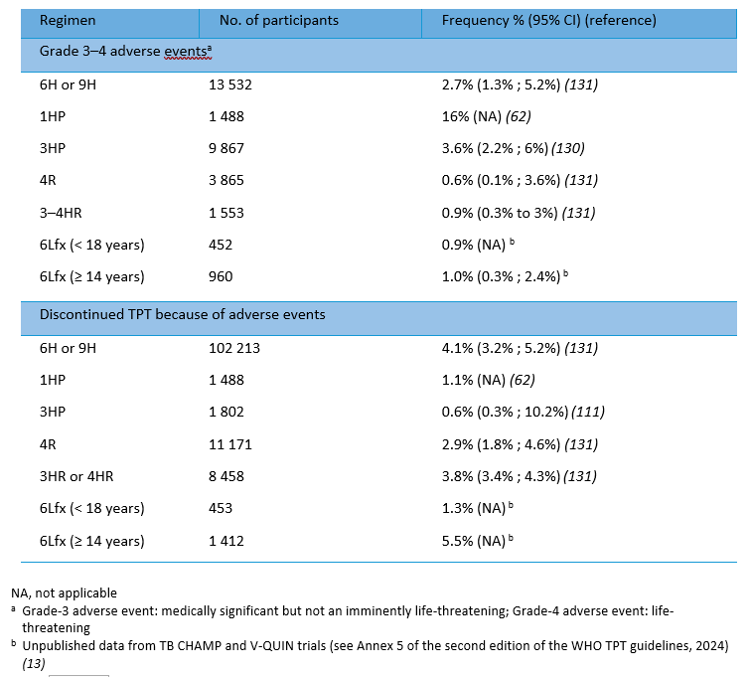
Operational handbook (4)
Adverse events among people on TPT
2022
Overall weak documentation of adverse events
SR published in 2023
  any adverse events 7%
  grades 1 and 2 - 16.4% (8.7%; 28.7%)
  grades 3 and 4 -2.4% (1.7%; 3.5%)
  Children- very low incidence of AEs (all TPT)
  Pregnancy- low TPT discontinuation 0.8% (0.2%; 3.3%).
High rate of hepatotoxicity with 6H or 9H (2–6%) (more in slow acetylators)
Grade 3-4: relatively higher rates with 1HP, 3HP, 6H
Withdrawal due to adverse events: relatively higher rates with 6H or 9H, 3HR, 4R, 6Lfx (adults) and lower with 3HP, 1HP, 6 Lfx (children)
Notes:
Results from the TB CHAMP and V-QUIN studies - important difference in the risks for adverse events between children and adults, with very good tolerance in children but less tolerability with increasing age
One or more adverse events of any grade were reported in about 32% of adolescents and adults taking Lfx in the V-QUIN trial, most being grade 1 or 2. Serious adverse events were infrequent, with about 1% of participants developing grade 3 or 4 events
Pooled analysis of data from the two trials shows that Lfx was associated with more musculoskeletal events (arthritis, arthralgia or tendonitis) in adolescents and adults, mostly grade 1 or 2

Slide 20
Operational handbook (5)
Frequently asked question-How protective is TPT?​
2022
Efficacy of isoniazid preventive treatment ranges from 60-90%
1960s, Alaskan natives: IPT reduced TB incidence by about 55% over 6 years
1993-2007, various countries (Cochrane Review of 12 trials): TPT in people with HIV reduced risk of active TB by about one third. IPT and HR reduced mortality in people with HIV.
2003-2009, Brazil: 6H in TST+ people with HIV reduced TB risk for at least 7 years
2005+, SA gold mines: among HIV+ miners (high transmission / reinfection) TB incidence reduced by 58% while on 9H but risk quickly returned after stopping
2008-2015, Côte d’Ivoire: 6H reduced mortality by 37% (independent of ART and baseline CD4) and benefits sustained for at least 6 years after randomization
Notes:
While the protective effect of IPT has been observed to last unaltered for several years, its efficacy is generally estimated to range from 60-90%. Over the years, other studies have shown substantive reduction in TB incidence and death in different populations on IPT and other TPT regimens, including PLHIV in high TB transmission settings
References
Hanson, ML; Comstock, GW; Haley, CE (1967). Community isoniazid prophylaxis program in an underdeveloped area of Alaska. https://dx.doi.org/10.2307/4593193
Comstock GW, Baum C, Snider DE Jr. Isoniazid prophylaxis among Alaskan Eskimos: a final report of the Bethel isoniazid studies. Am Rev Respir Dis 1979; 119:827–30
Golub JE, Cohn S, Saraceni V, et al. Long-term protection from isoniazid preventive therapy for tuberculosis in HIV-infected patients in a medium-burden tuberculosis setting: the TB/HIV in Rio (THRio) study. Clin Infect Dis. 2014;60(4):639-45.
Akolo C, Adetifa I, Shepperd S, Volmink J. Treatment of latent tuberculosis infection in HIV infected persons. Cochrane Database Syst Rev 2010; CD000171.
Anani Badje et.al. Effect of isoniazid preventive therapy on risk of death in west African, HIV-infected adults with high CD4 cell counts: long-term follow-up of the Temprano ANRS 12136 trial
Churchyard GJ et.al. A Trial of Mass Isoniazid Preventive Therapy for Tuberculosis Control; Jan 2014; NEJM; 2014; 370:301-310; DOI: 10.1056/NEJMoa1214289 (https://www.nejm.org/doi/full/10.1056/NEJMoa1214289)

Slide 21
Operational handbook (6)
Frequently asked question- Do we need to repeat or restart TPT?​
2022
No evidence to date on the utility of repeated courses of TPT
A repeat course of TPT may be considered among people with or without HIV following a fresh exposure to an infectious TB patient based on clinical judgement
The WHIP3TB trial among people with HIV on ART (2019), compared the effectiveness of 3HP given once (N=1802) or twice within 14 months (N=1808) as against one course of 6H (N=404)
  Treatment completion was better with 3HP
  24 months follow-up showed similar rates of incidence of TB, rifampicin-resistant TB and mortality between those receiving 3HP once or twice

Slide 22
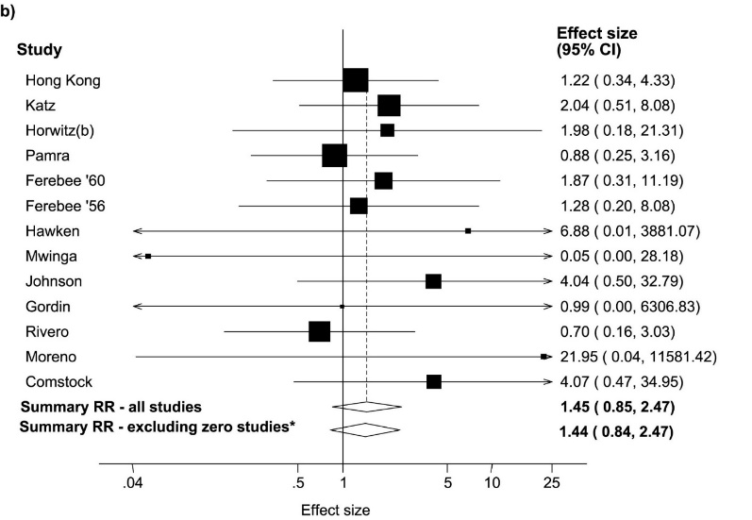
Operational handbook (7)
Frequently asked question- Does TPT fuel emergence of drug resistance?
2022
Systematic review (den Boon S et al; 2016):
6 RCTs of rifamycin based TPT vs active control or placebo
Only 6 (0.09%) rifampicin resistant cases in 6808 individuals receiving rifamycin based TPT
1 (0.01%) rifampicin resistant case among 7415 individuals receiving alternative regimens
RR = 3.45, (95%CI 0.72–16.56; P = 0.12)
3 studies of intermittent rifamycin based TPT vs active control or placebo
3 cases of rifampicin resistance in 4673 individuals on rifamycin-containing TPT regimens
1 case with rifampicin resistance in 4427 in control regimens
Systematic review (Balcells ME et al; 2006):
data published since 1951, 13 studies, IPT = 18095, controls = 17,985
RR of resistance 1.45 (95% CI 0.85 – 2.47)
Similar results when stratified by HIV
Notes:
den Boon S, Matteelli A, Getahun H. Rifampicin resistance after treatment for latent tuberculous infection: a systematic review and meta-analysis. Int J Tuberc Lung Dis. 2016 Aug;20(8):1065-71. doi: 10.5588/ijtld.15.0908. PMID: 27393541; PMCID: PMC5642842.
Balcells M E, Thomas S L, Godfrey-Faussett P, Grant A D. Isoniazid preventive therapy and risk for resistant tuberculosis. Emerging Infectious Diseases 2006; 12(5): 744-751

Slide 23
Operational handbook (8)
Frequently asked question- Is TPT recommended in pregnancy?
2022
Systematic review for the 2020 WHO guidelines showed
No association of IPT with adverse pregnancy outcomes (foetal or neonatal death, prematurity, low birth weight, congenital anomaly) across different studies
No increase in risks for maternal hepatotoxicity, grade 3 or 4 events or death
Limited data on 3HP use (DOLPHIN MOMs)
Therefore,
Pregnancy does not disqualify women living with HIV from TPT or require systematic deferral of TPT to the postpartum period
TPT can be started either in the antenatal or postnatal periods with due clinical care
Vitamin B6 supplementation should be given routinely to pregnant and breastfeeding women on TPT
6 months triple pill combination of H + Cotrimoxazole + B6 may be preferred in pregnant women with HIV
Routine liver function testing is not indicated unless there are other hazards

Slide 24
Operational handbook (9)
Frequently asked question- Which elements to record for the monitoring of TPT activities?
2022
How many people are at risk and could benefit from TPT/DR-TPT?
How many at-risk people were evaluated for TB disease or infection?
How many of those eligible started TPT/DR-TPT?
What were the main reasons for those eligible who did not initiate TPT?
How many of those initiating TPT/DR-TPT completed it?
For those who did not complete TPT/DR-TPT what were the main reasons (e.g., adverse drug reaction monitoring and management) ?

Slide 25
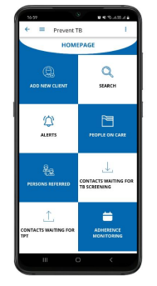
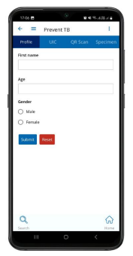
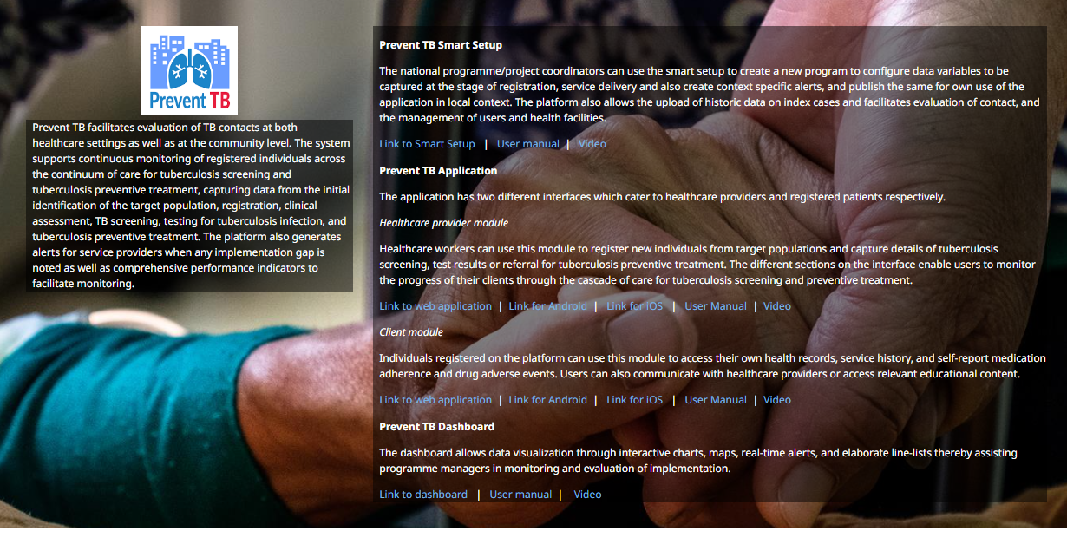
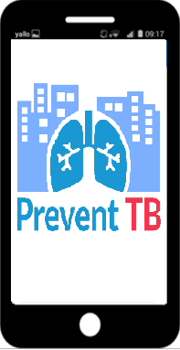
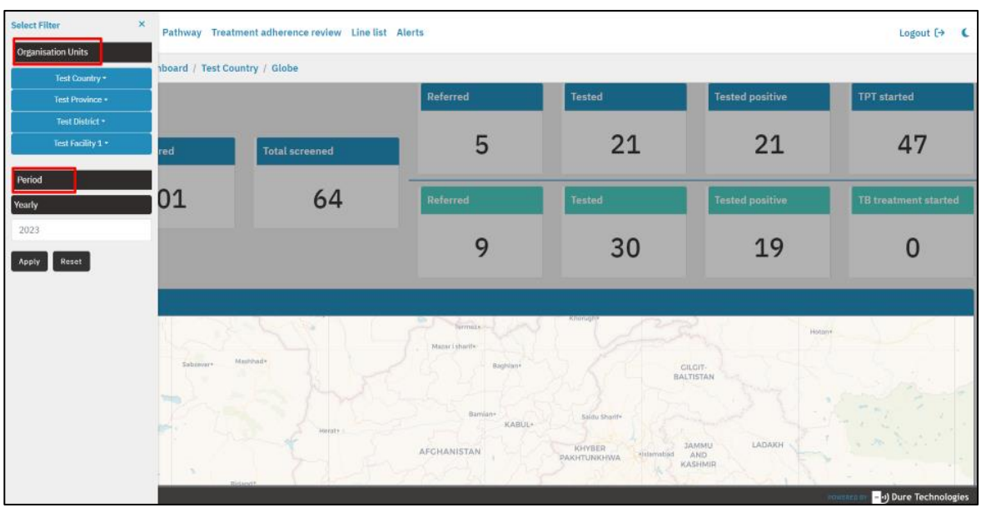

Prevent TB application
2022
https://www.who.int/activities/preventing-tb#app

Slide 26
Main Messages
2022
TPT is effective and safe. There is no evidence that it favours the emergence of drug resistance.
TPT complements other preventive measures and active TB case finding.
There is a need to expand TPT coverage for people at risk, including, household contacts aged 5 years and older and contacts of DR-TB patients.
Chest X-ray can rule out TB more effectively and digital radiography and computer-aided detection make this more feasible. Similarly, CRP and WHO-recommended Rapid Diagnostics may be used when available.
Antigen-based tests for TB infection offer an alternative tool to scale up testing.
Different TPT regimens offer more choices, including shorter ones that are safer and easier to complete and Levofloxacin for contacts of DR-TPT.
New tools for capacity building, monitoring, and evaluation are available.

Slide 27
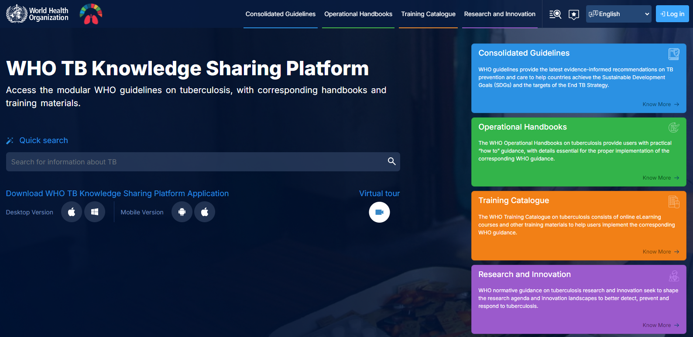
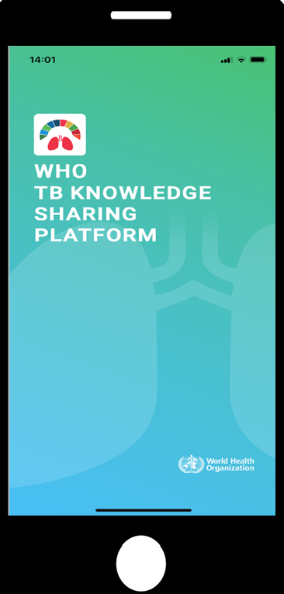
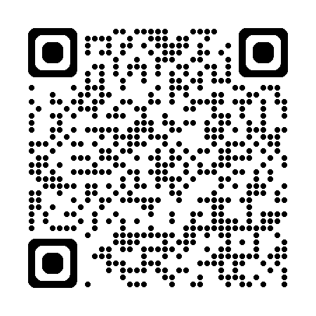
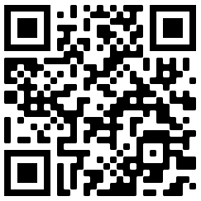
https://tbksp.org/en
Notes:
WHO guidelines and handbooks are now available on the TB Knowledge Sharing Platform or KSP that was launched in June 2021 as both a website and a mobile app. Key features of the website include: access to the panels on guidelines, handbooks and training materials via three big buttons, access to research tools, a function to search quickly across all sections, links to the eTB guidelines recommendation database, capacity to bookmark and customize content in a personal space, and the option to provide feedback.

Slide 28
Acknowledgement
2022
WHO Global Tuberculosis Programme (Dennis Falzon, Avinash Kanchar)​
Other WHO staff at HQ, Regions and Country offices​
Guideline Development Group & other experts (see https://tbksp.org/en/node/1065) ​
Staff of national TB programmes in Member States
Treatment Action Group
USAID, Unitaid, The Global Fund
Many other experts, donors

Slide 29
© WORLD HEALTH ORGANIZATION 2024
All rights reserved. Publications of the World Health Organization can be obtained from WHO Press, World Health Organization, 20 Avenue Appia, 1211 Geneva 27, Switzerland (tel: +41 22 791 3264; fax: +41 22 791 4857; email: bookorders@who.int). Requests for permission to reproduce or translate WHO publications – whether for sale or for noncommercial distribution – should be addressed to WHO Press, at the above address (fax: +41 22 791 4806; email: permissions@who.int).
The designations employed and the presentation of the material in this publication do not imply the expression of any opinion whatsoever on the part of the World Health Organization concerning the legal status of any country, territory, city or area or of its authorities, or concerning the delimitation of its frontiers or boundaries. Dotted lines on maps represent approximate border lines for which there may not yet be full agreement.
The mention of specific companies or of certain manufacturers’ products does not imply that they are endorsed or recommended by the World Health Organization in preference to others of a similar nature that are not mentioned. Errors and omissions excepted, the names of proprietary products are distinguished by initial capital letters.
All reasonable precautions have been taken by the World Health Organization to verify the information contained in this publication. However, the published material is being distributed without warranty of any kind, either expressed or implied. The responsibility for the interpretation and use of the material lies with the reader. In no event shall the World Health Organization be liable for damages arising from its use.

