Slide 1
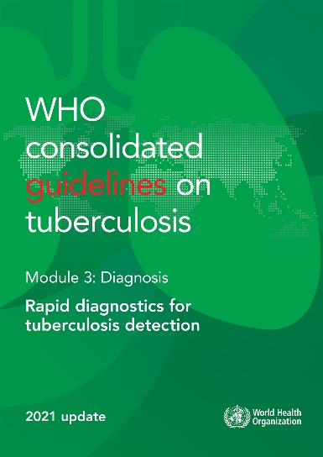
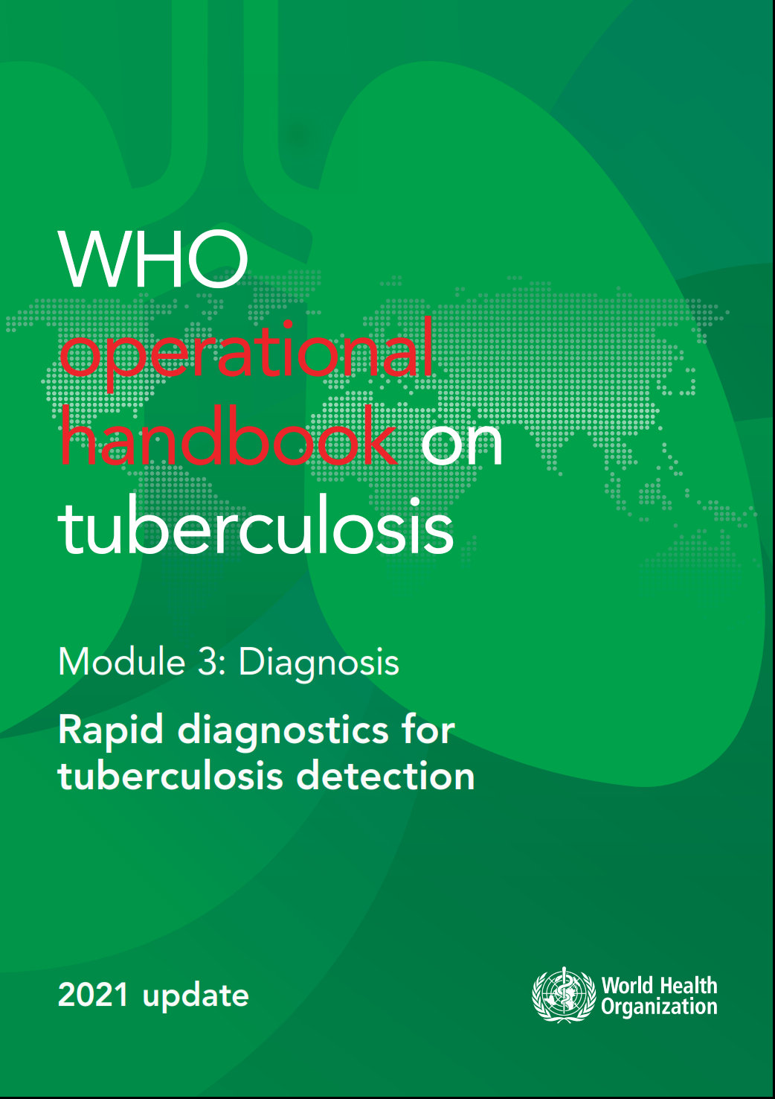
WHO guidelines & operational handbook:
Module 3:
Rapid diagnostics for
tuberculosis detection

Slide 2
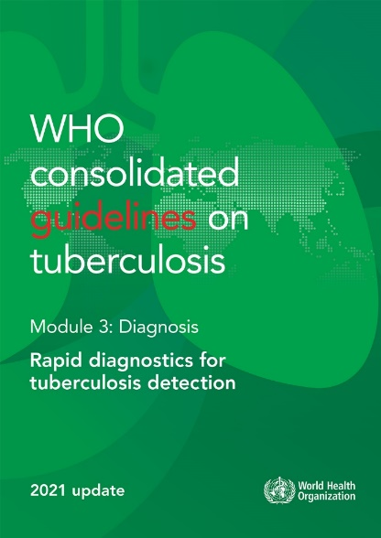
Background (1)
Development of the guidelines is a core WHO function
Diagnostics are a critical step in the management of patients across the entire journey from health, infection, disease and cure
WHO guidelines are grounded on evidence and recommendations are developed following a standardized GRADE approach
Key items should be met in order to appropriately claim that GRADE approach was applied:
      Systematic search for evidence
      Assessment of the certainty of evidence
      Structured transition from evidence to recommendations, covering standard domains (diagnostic accuracy, end-user values and preferences, economic aspects, feasibility, acceptability)

Slide 3



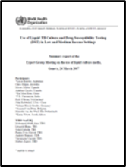
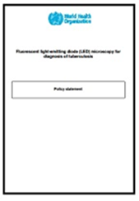
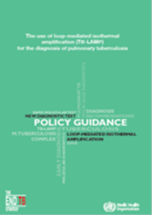
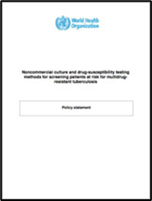


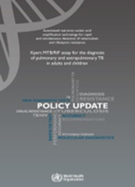
Background (2)
Automated liquid culture; Rapid speciation (2007)
First-line LPA (2008)
DST to second line drugs (2008)
LED microscopy (2010)
Non-commercial DST methods (2010)
Xpert MTB/RIF (2010)
TB IGRAs (2011)
Xpert MTB/RIF Update (2013)
TB-LAMP (2015)
Urine LAM (2015)
First-line LPA (update), Second-line LPA (2016)
Xpert MTB/RIF Ultra (non-inferiority report) (2017)
Urine LAM Update (2019)
Consolidated guidelines on TB Diagnosis (2021)

Slide 4


Overview of guidelines
2021
32 recommendations on 3 groups of TB tests:
  Initial tests for diagnosis of TB with drug-resistance detection
  Initial tests for diagnosis of TB without drug-resistance detection
  Follow on diagnostic tests for detection of additional drug-resistance
Summary of evidence
Implementation considerations
Research needs
https://extranet.who.int/tbknowledge/en/node/49

Slide 5
Evidence 1 : Initial tests for diagnosis of TB without drug-resistance detection
Intervention | Test accuracy (%) | Studies (participants) | Certainty of evidence | 2.5% prevalence | 10% prevalence | 30% prevalence
Xpert MTB/RIF | Se: 0.85 (95% CrI: 0.82–0.88) | 70 (10 409) | High | TP: 21 / FN: 4 | TP: 85 / FN: 15 | TP: 255 / FN: 45
 | Sp: 0.98 (95% CrI: 0.97–0.98) | 70 (26 828) | High | TN: 965 / FP: 10 | TN: 891 / FP: 9 | TN: 693 / FP: 7
Xpert MTB/RIF Ultra | Se: 0.90 (95% CrI: 0.84–0.94) | 6 (960) | High | TP: 22 / FN: 3 | TP: 90 / FN: 10 | TP: 269 / FN: 31
 | Sp: 0.96 (95% CrI: 0.93–0.98) | 6 (1694) | High | TN: 932 / FP: 43 | TN: 860 / FP: 40 | TN: 669 / FP: 31
MC-aNAAT | Se: 0.93 (95% CI: 0.91–0.95) | 29 (4767) | Moderate | TP: 23 / FN: 2 | TP: 93 / FN: 7 | TP: 279 / FN: 21
 | Sp: 0.98 (95% CI: 0.96–0.99) | 29 (9085) | High | TN: 953 / FP: 22 | TN: 879 / FP: 21 | TN: 684 / FP: 16
Truenat MTB | Se: 0.73 (95% CI: 0.68–0.78) | 1 (258) | Moderate | TP: 18 / FN: 7 | TP: 73 / FN: 27 | TP: 220 / FN: 80
 | Sp: 0.98 (95% CI: 0.97–0.99) | 1 (1122) | High | TN: 957 / FP: 18 | TN: 884 / FP: 16 | TN: 687 / FP: 13
Truenat MTB Plus | Se: 0.80 (95% CI: 0.75–0.84) | 1 (261) | Moderate | TP: 20 / FN: 5 | TP: 80 / FN: 20 | TP: 239 / FN: 61
 | Sp: 0.96 (95% CI: 0.95–0.97) | 1 (1087) | High | TN: 940 / FP: 25 | TN: 868 / FP: 32 | TN: 675 / FP: 25
TB detection
Intervention | Test accuracy | Studies (participants) | Certainty of evidence | 2% prevalence | 10% prevalence | 15% prevalence
Xpert MTB/RIF | Se: 0.96 (95% CI: 0.94–0.97) | 48 (1775) | High | TP: 19 / FN: 1 | TP: 96 / FN: 4 | TP: 144 / FN: 6
 | Sp: 0.98 (95% CI: 0.98–0.99) | 48 (6245) | High | TN: 960 / FP: 20 | TN: 882 / FP: 18 | TN: 833 / FP: 17
Xpert MTB/RIF Ultra | Se: 0.94 (95% CI: 0.87–0.97) | 5 (240) | High | TP: 19 / FN: 1 | TP: 94 / FN: 6 | TP: 141 / FN: 9
 | Sp: 0.99 (95% CI: 0.98–1.00) | 5 (690) | High | TN: 970 / FP: 10 | TN: 891 / FP: 9 | TN: 842 / FP: 8
Truenat MTB-RIF Dx | Se: 0.84 (95% CI: 0.72–0.92) | 1 (51) | Very Low | TP: 17 / FN: 3 | TP: 84 / FN: 16 | TP: 126 / FN: 24
 | Sp: 0.97 (95% CI: 0.95–0.99) | 1 (258) | Moderate | TN: 951 / FP: 29 | TN: 873 / FP: 27 | TN: 825 / FP: 25
MC-aNAAT | Se: 0.97 (95% CI: 0.93–0.98) | 18 (702) | Moderate | TP: 19 / FN: 1 | TP: 97 / FN: 3 | TP: 146 / FN: 4
 | Sp: 0.99 (95% CI: 0.97–0.99) | 18 (2172) | High | TN: 970 / FP: 10 | TN: 891 / FP: 9 | TN: 842 / FP: 8
Rifampicin resistance detection
Isoniazid resistance detection
Intervention | Test accuracy | Studies (participants) | Certainty of evidence | 2% prevalence | 10% prevalence | 15% prevalence
MC-aNAAT | Se: 0.86 (95% CI: 0.83–0.89) | 18 (854) | Moderate | TP: 17 / FN: 3 | TP: 86 / FN: 14 | TP: 129 / FN: 21
 | Sp: 0.99 (95% CI: 0.98–1.00) | 18 (1904) | High | TN: 970 / FP: 10 | TN: 891 / FP: 9 | TN: 842 / FP: 8

Slide 6
Evidence 2 : Initial tests for diagnosis of TB without drug-resistance detection
Intervention | Test accuracy (%) | Studies (participants) | Certainty of evidence | 2.5% prevalence | 10% prevalence | 30% prevalence
TB-LAMP | Se: 0.78 (95% CrI: 0.71–0.83) | 7 (1810) | Very low | TP: 20 / FN: 5 | TP: 78 / FN: 22 | TP: 234 / FN: 66
 | Sp: 0.98 (95% CrI: 0.96–0.99) | 7 (1810) | Very low | TN: 955 / FP: 20 | TN: 882 / FP: 18 | TN: 686 / FP: 14
Intervention | Test accuracy (%) | Studies (participants) | Certainty of evidence | 1% prevalence | 10% prevalence | 30% prevalence
LF-LAM | Se: 0.54 (95% CrI: 0.43–0.67) | 6 (781) | Moderate | TP: 5 / FN: 5 | TP: 54 / FN: 46 | TP: 162 / FN: 138
(symptomatic inpatients) | Sp: 0.90 (95% CrI: 0.79–0.95) | 6 (1114) | Low | TN: 891 / FP: 99 | TN: 810 / FP: 90 | TN: 630 / FP: 70
LF-LAM | Se: 0.21 (95% CrI: 0.12–0.34) | 3 (397) | Moderate | TP: 2 / FN: 8 | TP: 21 / FN: 79 | TP: 63 / FN: 237
(symptomatic outpatients) | Sp: 0.97 (95% CrI: 0.87–0.99) | 3 (815) | Moderate | TN: 960 / FP: 30 | TN: 873 / FP: 27 | TN: 679 / FP: 21

Slide 7
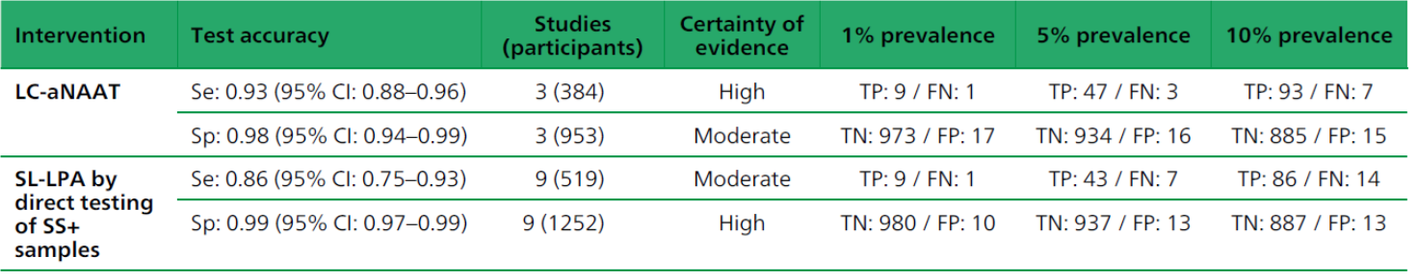
Evidence 3 : Follow on diagnostic tests for detection of additional drug-resistance
INH
resistance detection
Fq
resistance detection

Slide 8
WHO recommended diagnostic tests for TB
LF-LAM
Nipro GenoScholar PZA-TB II strip and Nipro GenoScholar PZA-TB II Kit Contents
FL-LPA
SL-LPA

Slide 9
Recommendations 1: Initial tests for diagnosis of TB with drug-resistance detection
In adults with signs and symptoms of pulmonary TB
  Xpert MTB/RIF should be used as an initial diagnostic test for TB and RR detection in sputum rather than smear microscopy/culture and pDST
  and without a prior history of TB (≤5 years) or with a remote history of TB Tx (>5 years since end of Tx), Xpert Ultra should be used as an initial diagnostic test for TB and RR detection in sputum, to replace smear microscopy /culture and pDST
  and with a prior history of TB and an end of Tx within the last 5 years, Xpert Ultra may be used as an initial diagnostic test for TB and for RR detection in sputum, to replace smear microscopy /culture and pDST
  and Xpert Ultra trace positive result on the initial test, repeated testing with Xpert Ultra may not be used
Strength | CoE*
Strong | High for test accuracy; Moderate for patient-important outcomes
Strong | High
Conditional | Low
Conditional | Very Low
Strong | MTB/RIF: Moderate for sputum; Low for stool, GA** and NPA*** Ultra: Moderate for stool and GA**; Low for sputum Very Low for NPA***
In children with signs and symptoms of pulmonary TB
  Xpert MTB/RIF or Xpert Ultra should be used as an initial diagnostic test for TB and RR in sputum, GA, NPA and stool rather than smear microscopy/ culture and pDST.
  In settings with pretest probability below 5% and an Xpert negative result on the initial test, repeated testing with Xpert MTB/RIF or Xpert Ultra in sputum, gastric fluid, nasopharyngeal aspirate or stool specimens may not be used
  In settings with pretest probability 5% or more and an Xpert negative result on the initial test, repeated testing with Xpert MTB/RIF or Xpert Ultra (for total of two tests) in sputum, gastric fluid, nasopharyngeal aspirate and stool specimens may be used
Conditional | MTB/RIF: Low for sputum; Very low for other specimens Ultra: Very low
Conditional | MTB/RIF: Low for sputum; Very low for other specimens Ultra: Very low
RR- rifampicin resistance; pDST – phenotypic DST; CoE – certainty of evidence; GA – gastric aspirate; NPA – nasopharyngeal aspirate

Slide 10
Recommendations 2: Initial tests for diagnosis of TB with drug-resistance detection
Strength | CoE*
Strong | Moderate for Xpert MTB/RIF; Low for Xpert Ultra
In adults and children with signs and symptoms of TB meningitis:
  Xpert MTB/RIF or Xpert Ultra should be used in cerebrospinal fluid (CSF) as an initial diagnostic test for TB meningitis rather than smear microscopy/culture.
Conditional | Moderate for pleural fluid; Low certainty for lymph node aspirate, peritoneal fluid, synovial fluid, urine; Very low certainty for pericardial fluid, lymph nodes biopsy)
In adults and children with signs and symptoms of EP TB
  Xpert MTB/RIF may be used in lymph node aspirate, lymph node biopsy, pleural fluid, peritoneal fluid, pericardial fluid, synovial fluid or urine specimens as the initial diagnostic test rather than smear microscopy/culture.
  Xpert Ultra may be used in lymph node aspirate and lymph node biopsy, as the initial diagnostic test rather than smear microscopy/culture.
  Xpert MTB/RIF or Xpert Ultra should be used for rifampicin-resistance detection rather than culture and phenotypic DST
Conditional | Low
Strong | High for Xpert MTB/RIF; Low for Xpert Ultra
In HIV-positive adults and children with signs and symptoms of disseminated TB
  Xpert MTB/RIF may be used in blood, as an initial diagnostic test for disseminated TB
Conditional | Very Low

Slide 11
Recommendations 3: Initial tests for diagnosis of TB with drug-resistance detection
Strength | CoE*
Conditional | Moderate
Conditional | Very low
Conditional | Moderate
In people with signs and symptoms of pulmonary TB
  Truenat MTB or MTB Plus may be used as an initial diagnostic test for TB to replace smear microscopy /culture
  and Truenat MTB or MTB Plus positive result, Truenat MTB-RIF Dx may be used as an initial test for RR to replace phenotypic DST
  Moderate complexity automated NAATs may be used on respiratory samples for the detection of pulmonary TB, and of RIF and INH resistance, rather than culture and phenotypic DST

Slide 12
Recommendations 4: Initial tests for diagnosis of TB without drug-resistance detection
In adults with signs and symptoms consistent with pulmonary TB
  TB-LAMP may be used as a replacement test for sputum-smear microscopy for diagnosing pulmonary TB
  TB-LAMP may be used as a follow-on test to smear microscopy in adults with signs and symptoms consistent with pulmonary TB, especially when further testing of sputum smear-negative specimens is necessary
Strength | CoE*
Conditional | Very low
Conditional | Very low
In inpatient settings
  WHO strongly recommends using LF-LAM to assist in the diagnosis of active TB in HIV-positive adults, adolescents and children:
  with signs and symptoms of TB (pulmonary and/or extrapulmonary)
  with advanced HIV disease or who are seriously ill
  irrespective of signs and symptoms of TB and with a CD4 cell count of less than 200 cells/mm³
Strong | Moderate
Strong | Moderate
Strong | Moderate
In outpatient settings
  WHO suggests using LF-LAM to assist in the diagnosis of active TB in HIV-positive adults, adolescents and children:
  with signs and symptoms of TB (pulmonary and/or extrapulmonary) or seriously ill
  irrespective of signs and symptoms of TB and with a CD4 cell count of less than 100 cells/mm³
Conditional | Low
Conditional | Very low
In outpatient settings
  WHO recommends against using LF-LAM to assist in the diagnosis of active TB in HIV-positive adults, adolescents and children:
  without assessing TB symptoms
  without TB symptoms and unknown CD4 cell count or without TB symptoms and CD4 cell count greater than or equal to 200 cells/mm³
  without TB symptoms and with a CD4 cell count of 100–200 cells/mm³
Strong | Very low
Strong | Very low
Conditional | Very low

Slide 13
Recommendations 5: Follow on diagnostic tests for detection of additional drug-resistance
In people with bacteriologically confirmed pulmonary TB
Low complexity automated NAATs may be used on sputum for the initial detection of resistance to isoniazid and fluoroquinolones, rather than culture-based phenotypic DST
and resistance to rifampicin, Low complexity automated NAATs may be used on sputum for the initial detection of resistance to ethionamide, rather than DNA sequencing of the inhA promoter
and resistance to rifampicin, Low complexity automated NAATs may be used on sputum for the initial detection of resistance to amikacin, rather than culture-based phenotypic DST
Strength | CoE*
Conditional | Moderate
Conditional | Very low
Conditional | Low
In people with signs and symptoms of pulmonary TB
  High complexity reverse hybridization-based NAATs may be used on Mtb culture isolates for detection of pyrazinamide resistance rather than culture-based phenotypic DST
Conditional | Very low
For persons with a sputum smear-positive specimen or a cultured isolate of MTBC
  Commercial molecular LPAs may be used as the initial test instead of phenotypic culture-based DST to detect resistance to rifampicin and isoniazid.
Conditional | Moderate
In people with confirmed MDR/RR-TB
  SL-LPA may be used as the initial test, instead of phenotypic culture-based DST, to detect resistance to fluoroquinolones
  SL-LPA may be used as the initial test, instead of phenotypic culture-based DST, to detect resistance to second-line injectable drugs
Conditional | Moderate for sputum specimens, Low for M.tb isolates
Conditional | Low for both sputum specimens and M.tb isolates

Slide 14
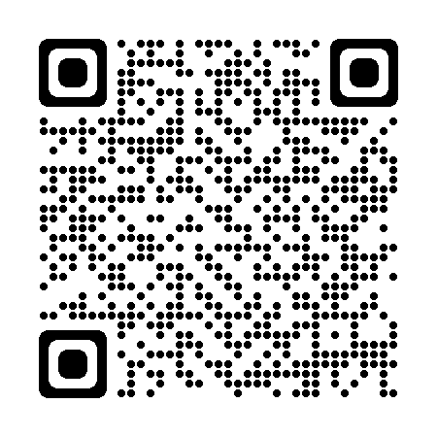
Operational handbook
Describes the WHO-recommended tests for detecting TB and DR-TB and the most recent WHO policy guidance for their use
Describes the processes and steps needed for implementing a diagnostic test for routine use within the TB diagnostic network
Describes the steps that need to be taken to implement a new diagnostic tool
Outlines TB diagnostic model algorithms that incorporate the most recent WHO recommendations for detecting and treating TB and DR-TB, and considerations for the implementation of a new algorithm.
https://extranet.who.int/tbknowledge/en/node/720

Slide 15

Key steps in implementing a new diagnostic test
Establish a technical working group to lead the process
Define the intended use of the new test, and update diagnostic algorithms
Develop a realistic costed implementation plan and budget for ongoing costs
Procure and install equipment in safe, functional testing sites
Ensure a reliable supply of quality-assured reagents and consumables
Develop SOPs and clinical protocols
Implement a comprehensive QA programme
Implement training, mentoring and competency assessment programmes
Monitor and evaluate the implementation and impact of the new test

Slide 16
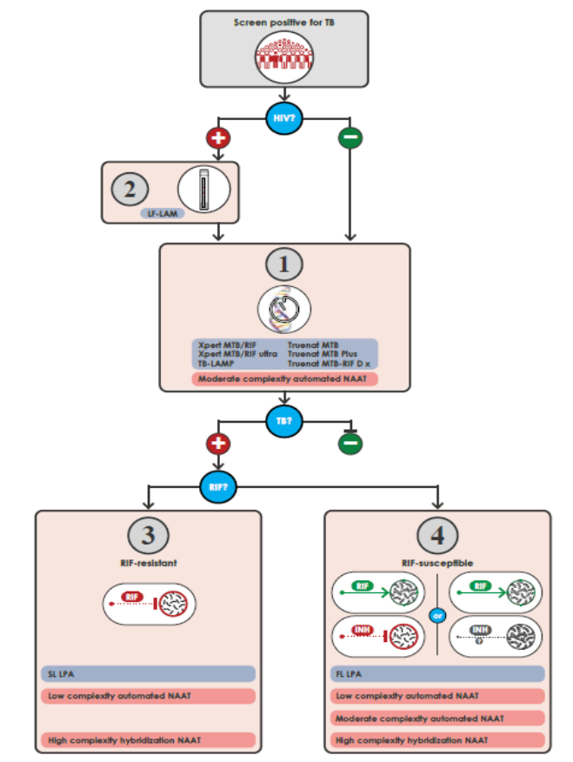
Integrated pathway of the diagnostic algorithms

Slide 17
Integrated pathway of the diagnostic algorithms

Slide 18
Integrated pathway of the diagnostic algorithms

Slide 19
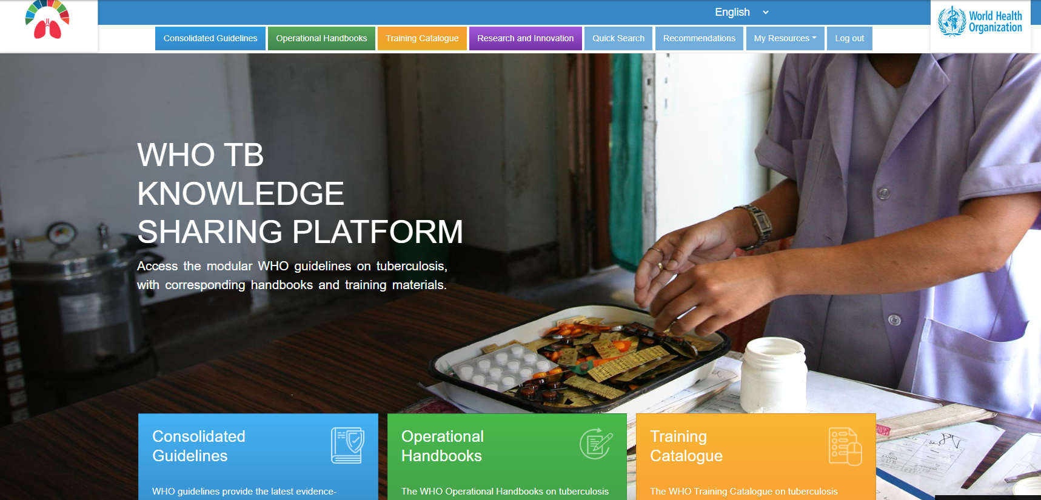

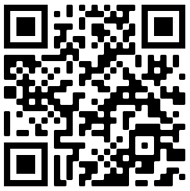
https://extranet.who.int/tbknowledge

Slide 20
Main messages
Developing recommendations is a core function of WHO
WHO guidelines are grounded on evidence and recommendations are developed following a standardized GRADE approach
32 recommendations for TB diagnosis are currently available on 3 groups of TB tests:
  Initial tests for diagnosis of TB with drug resistance detection
  Initial tests for diagnosis of TB without drug resistance detection
    Follow on diagnostic tests for detection of additional drug resistance
WHO promotes universal access to rapid and accurate molecular tests for TB diagnosis
Operational Handbook
Describes the WHO-recommended tests for detecting TB and DR-TB
Describes the steps that need to be taken to implement a new diagnostic tool
Outlines TB diagnostic model algorithms
WHO TB Knowledge Sharing Platform provides unified access to WHO guidelines, operational handbooks and training materials on tuberculosis

Slide 21
Acknowledgements
WHO Global TB Programme
  Nazir Ismail
  Alexei Korobitsyn
  Carl-Michael Nathanson
Other WHO staff at HQ, Regions and Country offices​
Guideline Development Group & other experts
Staff of national TB programmes in Member States
USAID, Unitaid, The Global Fund

Slide 22
© WORLD HEALTH ORGANIZATION 2023
All rights reserved. Publications of the World Health Organization can be obtained from WHO Press, World Health Organization, 20 Avenue Appia, 1211 Geneva 27, Switzerland (tel: +41 22 791 3264; fax: +41 22 791 4857; email: bookorders@who.int). Requests for permission to reproduce or translate WHO publications – whether for sale or for noncommercial distribution – should be addressed to WHO Press, at the above address (fax: +41 22 791 4806; email: permissions@who.int).
The designations employed and the presentation of the material in this publication do not imply the expression of any opinion whatsoever on the part of the World Health Organization concerning the legal status of any country, territory, city or area or of its authorities, or concerning the delimitation of its frontiers or boundaries. Dotted lines on maps represent approximate border lines for which there may not yet be full agreement.
The mention of specific companies or of certain manufacturers’ products does not imply that they are endorsed or recommended by the World Health Organization in preference to others of a similar nature that are not mentioned. Errors and omissions excepted, the names of proprietary products are distinguished by initial capital letters.
All reasonable precautions have been taken by the World Health Organization to verify the information contained in this publication. However, the published material is being distributed without warranty of any kind, either expressed or implied. The responsibility for the interpretation and use of the material lies with the reader. In no event shall the World Health Organization be liable for damages arising from its use.

