Slide 1
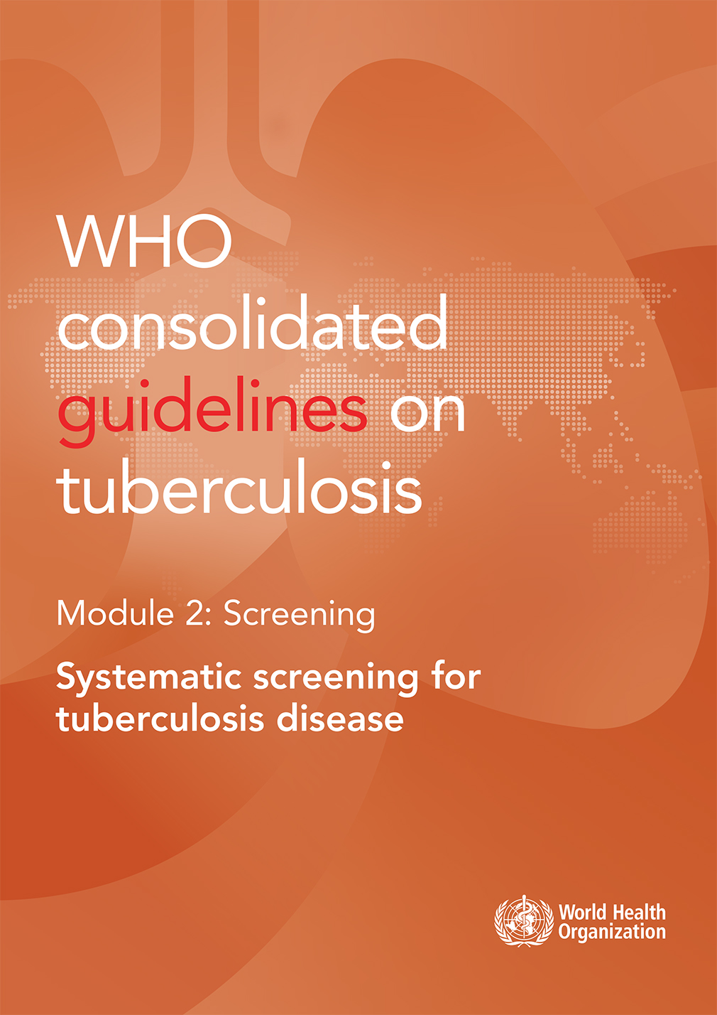
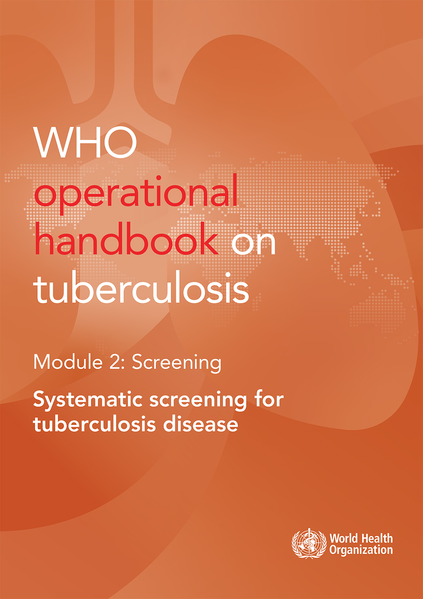
WHO guidelines & operational handbook:
Module 2:
Systematic screening for
TB disease

Slide 2

Overview of guidelines
Released March 2021, composed of
17 recommendations covering two major areas:
Who to screen – what populations and groups should be screened for TB disease
How to screen – what tools should be used for TB screening
https://extranet.who.int/tbknowledge/en/node/1274

Slide 3
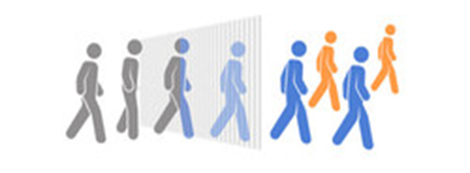
Background: Definition
Definition: Systematic screening for TB disease
“The systematic identification of people at risk for TB disease, in a pre-determined target group, by assessing symptoms and using tests, examinations, or other procedures that can be applied rapidly.”
Key features:
  Should be done systematically in a selected population
  Should be done using a highly sensitive tool to distinguish people with a higher probability of TB
  Should be followed with a diagnostic evaluation using a test with high accuracy to confirm a diagnosis
  Should follow ethical principles specific to screening

Slide 4


Background: Objectives of TB screening
Benefit individuals by detecting TB early or preventing TB
  Improve access to diagnosis and treatment or preventive care
  Reduce delays in diagnosis
  Improve treatment outcomes
  Reduce costs of TB care for people with TB
Improve TB epidemiology at the community level
  Increase detection of people with TB and treat them
  Reduce transmission of TB
  Reduce prevalence over time

Slide 5
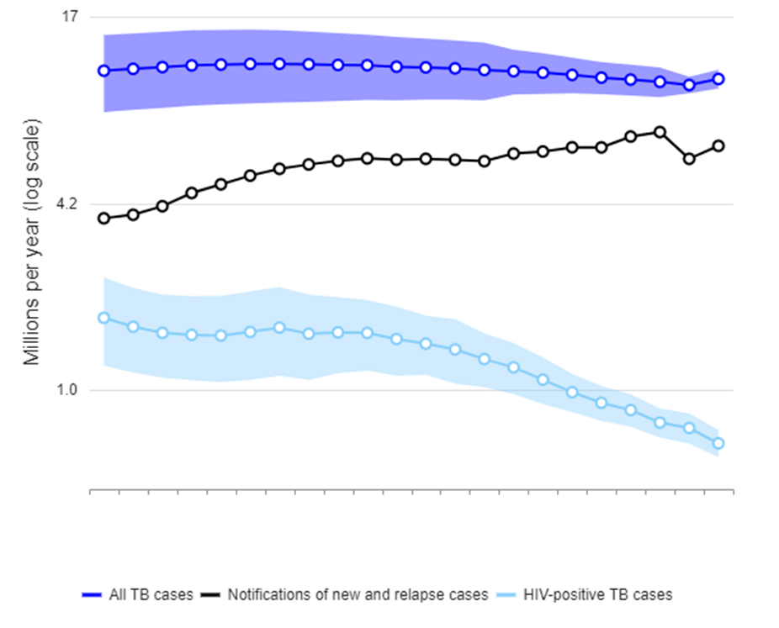
Background: Role of TB screening in overall TB care
Addressing the case detection gap
  The “missing millions” of people who develop TB each year and are not diagnosed, notified, started on treatment
Reaching the most vulnerable groups
  Those with highest risk for TB often have the least access to care
Enabling initiation of TB preventive treatment
  Systematic screening for TB disease is essential first step in initiating TPT in eligible populations
Case detection gap

Slide 6
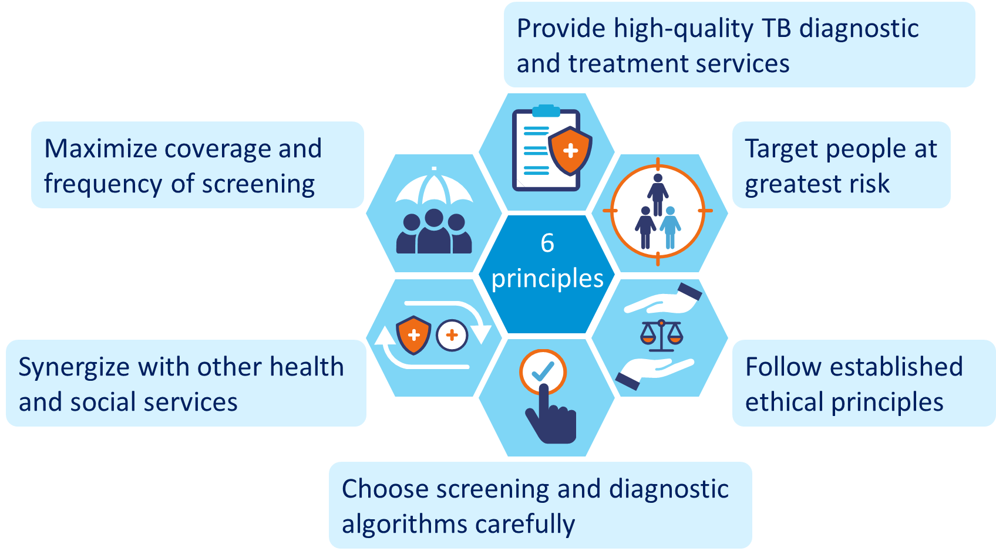
Background: principles of screening
Notes:
Principle 1: TB screening should be done with the intention to follow up with appropriate medical care and only implemented where high-quality TB diagnostic and treatment services are available.
Principle 2: Screening should reach the people at greatest risk of developing TB disease, including high-risk groups and communities with a high prevalence of TB.
Principle 3: TB screening should follow established ethical principles for screening for infectious diseases, including obtaining voluntary informed consent, and observe human rights. It should be designed to minimize the risks of discomfort, pain, stigmatization and discrimination.
Principle 4: The choice of algorithm for screening and diagnosis is based on an assessment of the accuracy of the algorithm for each risk group, as well as the availability, feasibility and cost of the screening tests. After a positive screening test result, the diagnosis of TB should be confirmed before TB treatment is started.
Principle 5: TB screening should be synergized with the delivery of other health and social services.
Principle 6: A screening strategy is expected to maximize coverage and frequency of screening to achieve its aims. Regular monitoring is necessary to inform any re-prioritization of risk groups, resource use, adaptation of screening approaches and discontinuation of screening. This includes the assessment of risk of false-positive diagnoses resulting from screening.

Slide 7
Evidence: populations at risk for TB
Relative risk of TB or prevalence of TB among risk groups:
Risk groups |  | Relative Risk (RR) or Prevalence of TB
Strongly recommended risk groups | Contacts of TB patients | Prevalence = 3.6%
 | People living with HIV | RR = 16
 | Prisoners | Prevalence = 1.4%
 | Miners | RR = 3.8
Clinical risk factors | Diabetes mellitus | RR = 1.5
 | Chronic lung disease | RR = 2.5
 | Smoking | RR = 1.6
 | Alcohol use disorders | RR = 3.3
 | Drug use disorders | Varies
 | Malnourishment | RR = 3.2
 | Healthcare workers | RR = 2.9
Community-based screening groups | Urban poor communities | RR = 3.0
 | Homeless communities | Prevalence = 1.1%
 | Migrants/refugees/IDPs | Varies
Notes:
Sources of estimates:
Contacts of TB patients
Prev = 3.6%
¹Velen K, Shingde RV, Ho J, Fox GJ. The effectiveness of contact investigation among contacts of tuberculosis patients: a systematic review and meta-analysis. The European respiratory journal. 2021;58(6).
People living with HIV
RR = 16
² Global tuberculosis report 2022, Technical appendix: Methods used by WHO to estimate the global burden of TB disease. Geneva: World Health Organization; 2023.
Prisoners
Prev = 1.37%
³ Cords O, Martinez L, Warren JL, O'Marr JM, Walter KS, Cohen T, et al. Incidence and prevalence of tuberculosis in incarcerated populations: a systematic review and meta-analysis. Lancet Public Health. 2021;6(5):e300-e8.
Miners
RR = 3.8
⁴ Litvinjenko S, Magwood O, Wu S, Wei X. Burden of tuberculosis among vulnerable populations worldwide: an overview of systematic reviews. The Lancet Infectious diseases. 2023.
Clinic-based risk groups
People with diabetes mellitus
RR = 1.5
⁵ Hayashi S, Chandramohan D. Risk of active tuberculosis among people with diabetes mellitus: systematic review and meta-analysis. Tropical medicine & international health : TM & IH. 2018;23(10):1058-70.
People with chronic lung disease
RR = 2.5
⁶ Hamada Y, Fong CJ, Copas A, Hurst JR, Rangaka MX. Risk for development of active tuberculosis in patients with chronic airway disease-a systematic review of evidence. Transactions of the Royal Society of Tropical Medicine and Hygiene. 2022;116(5):390-8.
Smokers
RR = 1.6
⁷ Jayes L, Haslam PL, Gratziou CG, Powell P, Britton J, Vardavas C, et al. SmokeHaz: Systematic Reviews and Meta-analyses of the Effects of Smoking on Respiratory Health. Chest. 2016;150(1):164-79.
People with alcohol use disorders
RR = 3.3
⁸ Imtiaz S, Shield KD, Roerecke M, Samokhvalov AV, Lönnroth K, Rehm J. Alcohol consumption as a risk factor for tuberculosis: meta-analyses and burden of disease. The European respiratory journal. 2017;50(1).
People with drug use disorders
No single estimate, depends on drugs used and TB/HIV epidemiology in setting
⁴ Litvinjenko S, Magwood O, Wu S, Wei X. Burden of tuberculosis among vulnerable populations worldwide: an overview of systematic reviews. The Lancet Infectious diseases. 2023.
People who are malnourished
RR = 3.2
⁹ Lönnroth K, Williams BG, Cegielski P, Dye C. A consistent log-linear relationship between tuberculosis incidence and body mass index. International journal of epidemiology. 2010;39(1):149-55.
Healthcare workers
RR = 2.9
¹⁰ Uden L, Barber E, Ford N, Cooke GS. Risk of Tuberculosis Infection and Disease for Health Care Workers: An Updated Meta-Analysis. Open forum infectious diseases. 2017;4(3):ofx137.
Community-based risk groups
Urban poor communities
RR = 3.0
¹¹ Noykhovich E, Mookherji S, Roess A. The Risk of Tuberculosis among Populations Living in Slum Settings: a Systematic Review and Meta-analysis. J Urban Health. 2019;96(2):262-75.
Homeless communities
Prev = 1.1%
⁴ Litvinjenko S, Magwood O, Wu S, Wei X. Burden of tuberculosis among vulnerable populations worldwide: an overview of systematic reviews. The Lancet Infectious diseases. 2023.
Migrants / refugees / internally displaced persons
No single estimate, depends on TB epidemiology in source of migration
¹² Meaza A, Tola HH, Eshetu K, Mindaye T, Medhin G, Gumi B. Tuberculosis among refugees and migrant populations: Systematic review. PloS one. 2022;17(6):e0268696.

Slide 8
Evidence: accuracy of screening tools
For people aged 15 years and older across high-risk groups
(not including people living with HIV):
Screening tool | Sensitivity | Specificity
Prolonged cough | 42% | 94%
Any cough | 51% | 88%
Any TB symptom (cough, haemoptysis, fever, night sweats, weight loss) | 71% | 64%
Chest X-ray (any abnormality) | 94% | 89%
Chest X-ray (suggestive of TB) | 85% | 96%
Molecular WHO-recommended rapid diagnostic test | 69% | 99%
* Culture is reference standard
Notes:
Some key points to highlight in this slide:
Screening for cough is less sensitive and more specific, while screening for any TB symptom improves sensitivity but reduces specificity.
Chest radiography has high sensitivity and specificity
mWRDs have a lower sensitivity when used as a screening tool compared to when they are used in the diagnostic use case due to the different population / spectrum of disease.

Slide 9
Evidence: accuracy of tests in people living with HIV
Population | WHO-recommended 4 symptom screen |  | C-Reactive Protein Cut off >5 mg/L / 10mg/L |  | Chest X-ray |  | mWRDs
 | Sensitivity | Specificity | Sensitivity | Specificity | Sensitivity | Specificity | Sensitivity | Specificity
All people living with HIV | 83% | 38% | 90% / 83% | 50% / 65% | 93% | 20% | 69% | 98%
Inpatients | 96% | 11% | 98% / 97% | 12% / 21% | 90% | 7% | 77% | 93%
Outpatients on ART | 53% | 70% | 40% / 20% | 80% / 90% | 85% | 33% | 54% | 99%
Outpatients not on ART | 84% | 37% | 89% / 82% | 54% / 67% | 94% | 19% | 72% | 98%
≤ 200 CD4 cells/μL | 86% | 30% | 93% / 90% | 40% / 54% | 94% | 14% | 76% | 97%
Pregnant women living with HIV | 61% | 58% | 70% / 70% | 41% / 54% | 75% | 56% | 55% | 99%
*Culture is reference standard
Notes:
The WHO-recommended 4 symptom screen has suboptimal accuracy in some subgroups of PLHIV. Here we see that for all PLHIV and even more so for PLHIV who are not on ART and are newly enrolling in care, it has rather limited specificity, 37-38%, meaning that frequently people who do not have TB disease screen positive and are referred for diagnostic evaluation unnecessarily, which reduces the efficiency of the screening programme (e.g. higher costs for diagnostic testing) and slows down the initiation of TB preventive treatment for these people. Additionally, we see it has limited sensitivity (53%) among PLHIV on ART who are enrolled in ART and coming in for regular care. This means that for this population, almost half of prevalent TB cases are not being picked up by this routine symptom screening.
CRP has similar sensitivity and similar or improved specificity to the W4SS in all subgroups of PLHIV, depending on the cut-off used. Both cutoffs of 5 mg/L and 10 mg/L were assessed and can be used, depending on the desire to improve sensitivity or specificity.
CXR as a screening test used in parallel with symptom screening offers improved sensitivity with comparable specificity to the W4SS alone in all subgroups of PLHIV. In particular, screening with CXR offers a significant improvement in sensitivity for PLHIV who are enrolled in regular ART care, and is the most sensitive screening strategy for this group. Where there is insufficient data to make firm recommendations about frequency of screening for this group, some data from the WHIP3 trial suggest that annual screening with CXR is a good strategy to find additional prevalent cases of TB.
Molecular WHO-recommended rapid diagnostic tests have slightly lower sensitivity in the screening setting, but they do offer very high specificity.

Slide 10
Evidence: accuracy of screening tools
For screening children
Population | Screening tool | Sensitivity | Specificity
Child contacts <15 years | Symptom screening | 89% | 69%
 | Chest X-ray | 84% | 91%
Children <10 years living with HIV | Symptom screening | 61% | 94%
*Composite reference standard

Slide 11
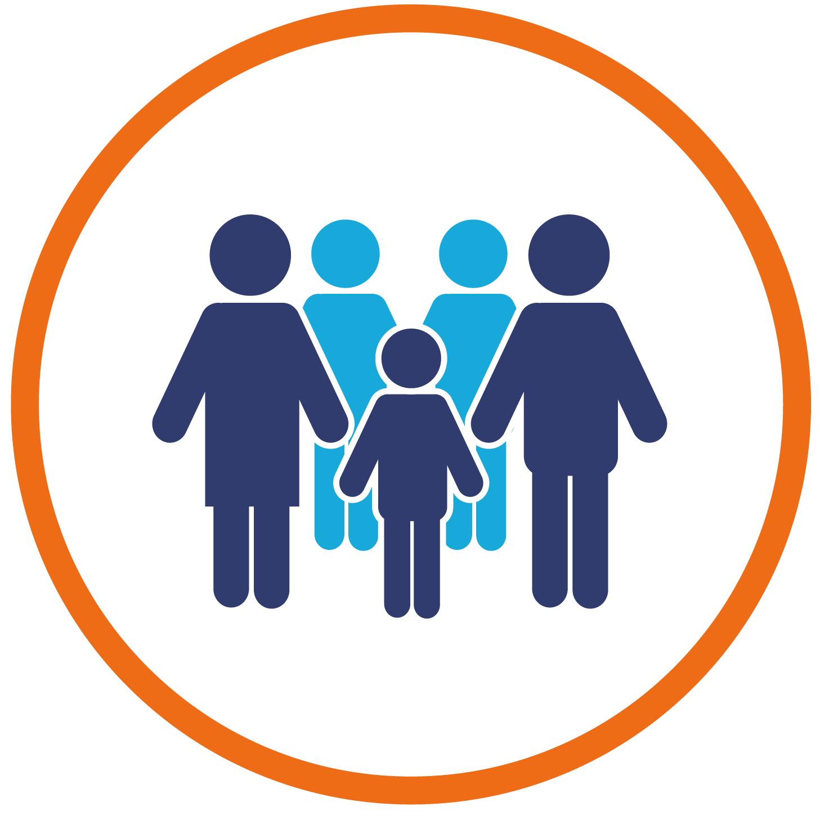



Recommendations: populations to be screened
TB screening is strongly recommended for:
Household and close contacts
People living with HIV
Miners exposed to silica dust
Prisoners
These populations should always be screened in all global settings.
Notes:
For these populations:
Screening should always be conducted
Question is how – what tools and algorithms, implementation model, frequency
TPT should be provided when appropriate
Monitoring and evaluation should be conducted to monitor outcomes of screening and continually inform questions of implementation

Slide 12

Recommendations: populations to be screened
TB screening is strongly recommended for:
Child contacts of people with TB
Children living with HIV
Very high risk of TB
Higher risk of rapid progression from infection to disease

Slide 13
Recommendations: populations to be screened
TB screening is conditionally recommended for:
People with risk factors for TB seeking health-care service in settings with ≥0.1% TB prevalence
  Malnourishment
  Diabetes
  History of previous TB
  Chronic lung disease
  Health care workers
  Those with other risk factors for TB
People with structural risk factors for TB and limited access to health care
  Urban poor
  Homeless
  Refugees
  Migrants
  Other vulnerable, marginalized groups
People with untreated fibrotic lesions on chest X-ray
People in settings with 0.5% TB prevalence
Notes:
For these populations, consideration should be given to:
Weighing the benefits and risks of screening
Considering opportunity costs for other TB and health interventions
Prioritizing risk groups that represent the greatest burden or have the greatest vulnerability in a particular setting

Slide 14
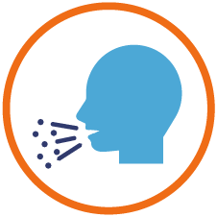
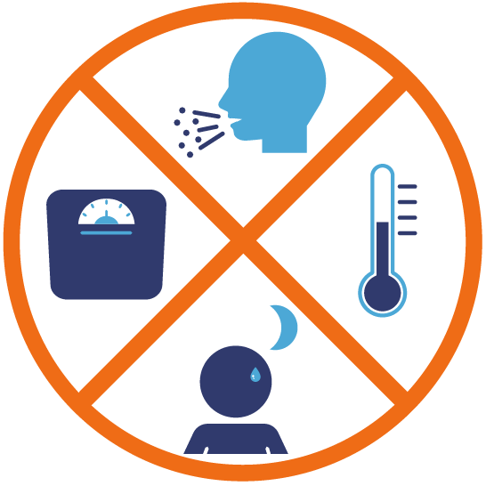

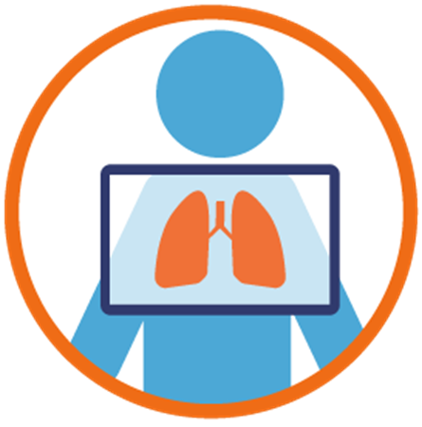
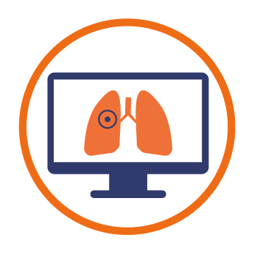

Recommendations: tools for screening (>15 years)
Symptom screening:
Cough
Multiple symptom
Feasible and easy to implement
Low resource requirements
Not highly accurate
Does not detect everyone with TB
Chest X-ray
Computer-aided detection (CAD)
Highly sensitive for TB disease
Can detect TB before onset of symptoms
CAD approved in place of human reading of CXR for adults (>15 y)
Less sensitive as screening tool but highly specific
Still requires a follow-up test
Rapid molecular tests
Module 2: Systematic screening for TB disease​

Slide 15


Recommendations: tools for screening - HIV
For adults & adolescents (>10 years) living with HIV:
WHO 4-symptom screen (W4SS)
Any one of cough, fever, night sweats, weight loss
Recommended to be done at every health visit
C-Reactive Protein
A general marker of inflammation, can be used as a point-of-care test
Increases specificity of screening, particularly among those not yet on ART
Chest X-ray & CAD
Improves the sensitivity of screening, particularly among those in regular ART care
CAD only recommended for those 15 years & older
Rapid molecular tests
Can be used for screening all people living with HIV
Strongly recommended for acutely ill and hospitalized patients in a “test and treat” strategy directly to guide treatment

Slide 16
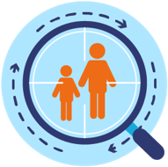


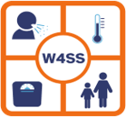
Recommendations: tools for screening children
For child contacts of TB patients (≤ 15 years)
Symptom screening (cough, fever, weight loss/lack of weight gain, reduced playfulness)
Chest X-ray
For childen living with HIV (≤ 10 years)
Symptom screening (cough, fever, weight loss/lack of weight gain, reduced playfulness)
Contact with TB patient

Slide 17
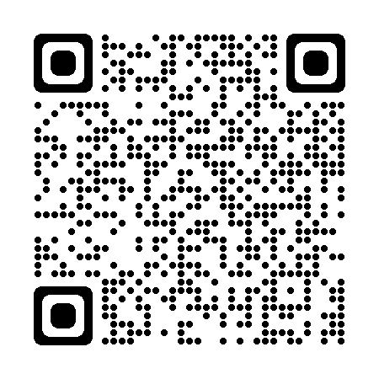
Operational handbook
The handbook provides
Support on developing context-specific screening approaches
A sound basis for national guidelines based on TB epidemiology in different risk groups and the health care system in the country
Target audience:
Staff in national TB programmes and national HIV/AIDS programmes
Other health programmes involved in screening in public and private sectors
Communities and implementing partners
https://extranet.who.int/tbknowledge/en/node/1275
Notes:
*Continue to update text

Slide 18
Operational handbook
How to create, implement, and update a national TB screening strategy?
Setting goals and specific objectives
Assessing the situation
1
2
Monitoring, evaluation,
and modifying the programme
6
Identifying and prioritizing risk groups
3
5
Planning, budgeting and implementing
4
Choosing algorithms for prioritized risk groups

Slide 19





Operational handbook
What are different screening models, and what are the pros and cons of them?
Health facilities
Residential, occupational, penitentiary settings
Community events and gatherings
Mobile outreach screening campaign
Home
Institution-based screening approaches
Can increase efficiency
Will note reach remote or isolated populations
Community-based screening approaches
Can increase reach and coverage
Higher resource requirements

Slide 20







Operational handbook
What is a single screening test algorithm?
Utilizes one screening test to distinguish between people who possibly have TB and are referred for TB diagnostic evaluation and people in whom TB has been ruled out and who can be assess for TPT
Why use this algorithm?
Straightforward to understand
Can be very effective if using screening and diagnostic tests of sufficient accuracy
Examples
Cough screening for all clinic attendees
Community chest X-ray screening via a mobile van

Slide 21
Operational handbook
What is a parallel screening algorithm?
Utilizes two screening tests together – a positive or abnormal on either or both test is an indication for diagnostic evaluation
Why use this algorithm?
More sensitive than a single screening test approach – will detect more prevalent TB ​
However, less specific – will result in diagnostic evaluation for more people who do not have TB​, higher cost implications
If either or both are positive
Example
Prevalence survey screening algorithm – CXR and symptom screening for all participants

Slide 22

Operational handbook
What is a positive sequential screening algorithm?
Uses two screening tests - only those positive on the first test going on to a second screen, and only those positive on both screens go on for diagnosis
Why use this algorithm?
More specific than a single or parallel screening approach – more efficient at selecting people with the highest risk of TB
However, less sensitive – will not detect all prevalent TB cases
Example
Screening for symptoms, followed by chest X-ray to select who should go on for diagnostic testing

Slide 23
Operational handbook
What is a negative sequential screening algorithm?
Uses two screening tests - those positive on the first test go straight to diagnostic evaluation, those negative on the first test go on to a second screen – thus those positive on either screen go on for diagnosis
Why use this algorithm?
High sensitivity but saves resources – the more expensive screening test is conducted only among those who do not already screen positive with the less expensive screening test
Example
Screening for symptoms first, then screening with chest X-ray only among those who don’t report symptoms

Slide 24
Operational handbook
How to monitor and evaluate TB screening?
# people eligible for TB screening
# people screened for TB
Acceptability (B/A)
Screened positive (C/B)
Testing retention (D/C)
NNS and number necessary to treat (E/B) and tested (E/D)
Linkage to care (F/E)
Treatment success (G/F)
# people with presumptive TB identified
# people evaluated for TB disease
# people diagnosed with TB
# people initiated on TB treatment
# people successfully completing TB treatment
Global Indicators | By 2025
Contact investigation coverage Number of contacts of people with bacteriologically confirmed TB who were evaluated for TB, divided by the number eligible (%) | ≥ 90%
Treatment coverage Number of people that developed TB, and were notified and treated, out of the total estimated number of incident cases in the same year (%). | ≥ 90%

Slide 25
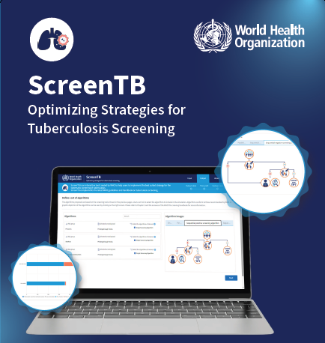
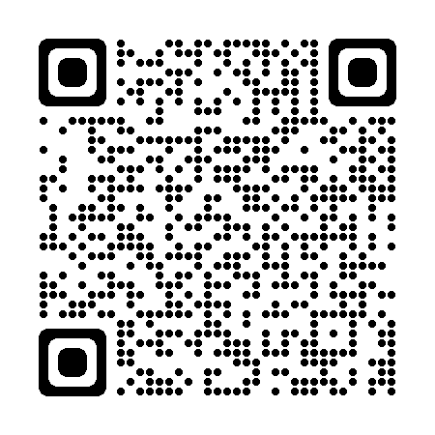
Useful tools – ScreenTB online tool
ScreenTB
Web-based tool to assist countries with prioritization of risk groups for screening and selection of screening tools and algorithms
Harnesses data from a variety of sources – WHO Global TB Report, UN HIV data, published literature
Produces estimates of yield and cost of screening, allowing for comparison between risk groups and across algorithm options within groups
Creates figures to allow for easy visual analysis
ScreenTB.org

Slide 26
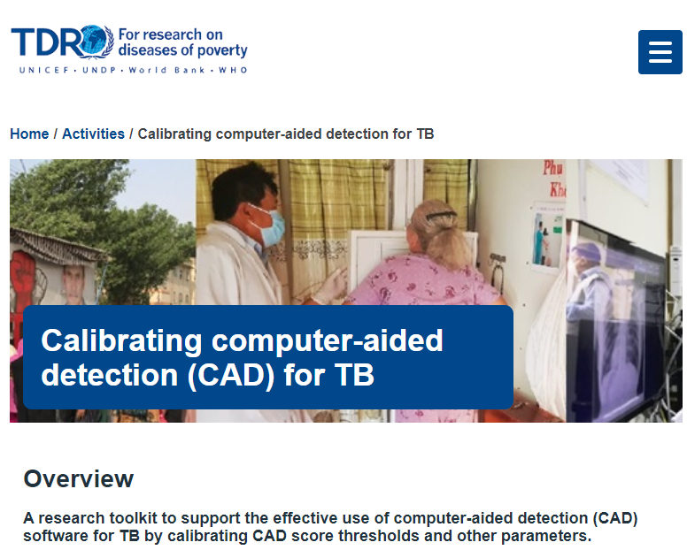
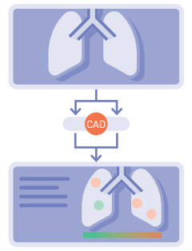
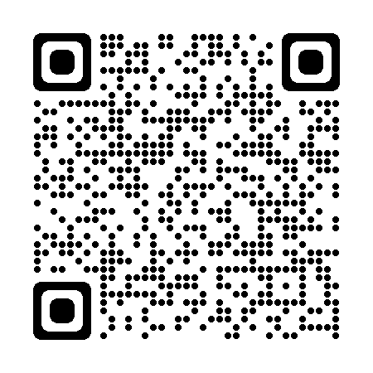
Useful tools – CAD calibration toolkit
What tools and resources are available?
CAD for TB Calibration
A toolkit to assist countries with calibration and implementation of CAD
Includes a protocol for gathering data and a web-based tool for data analysis to support decision-making
https://tdr.who.int/activities/calibrating-computer-aided-detection-for-tb

Slide 27
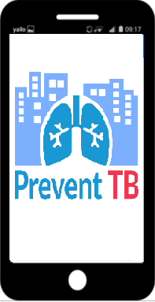
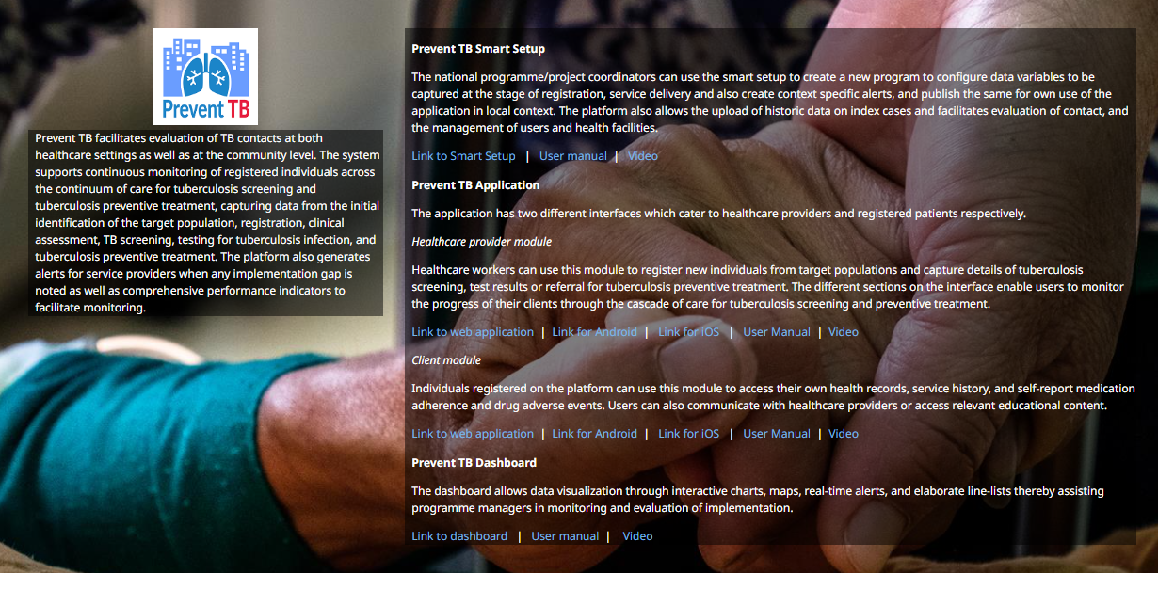
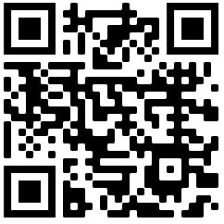
Useful tools – PreventTB application
What tools and resources are available?
PreventTB
A mobile application that enables digital data recording and reporting, analysis, monitoring and evaluation when implementing TB screening and TPT
https://www.who.int/activities/preventing-tb/

Slide 28
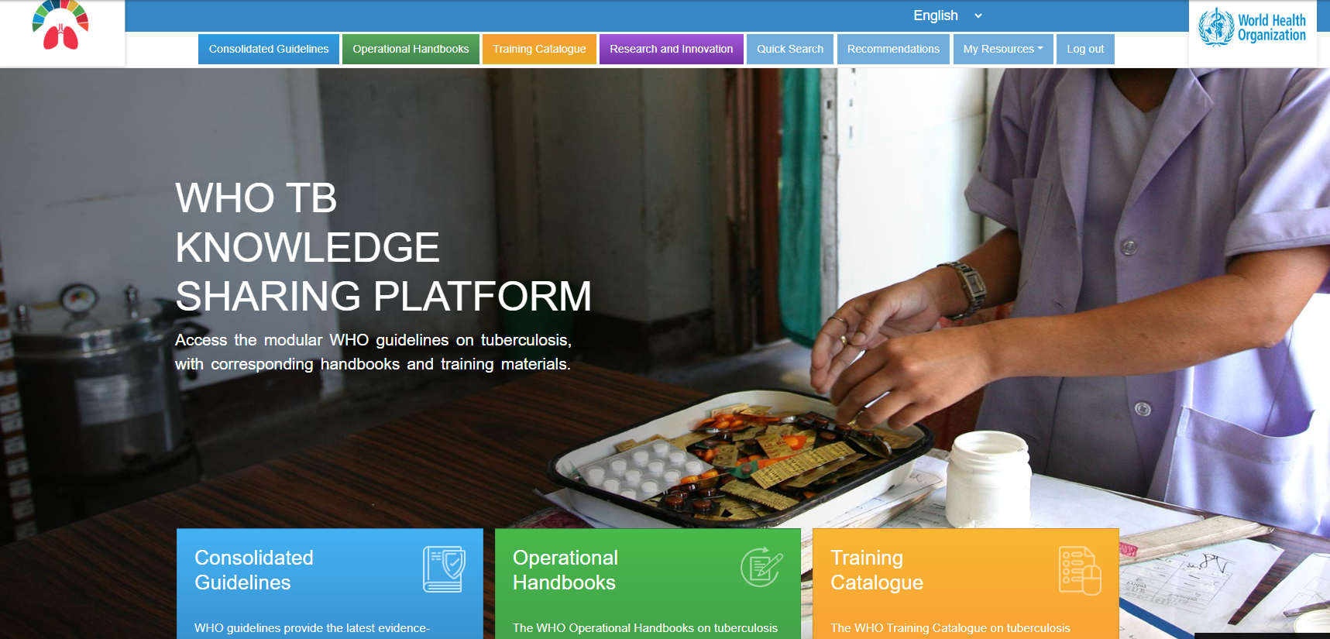
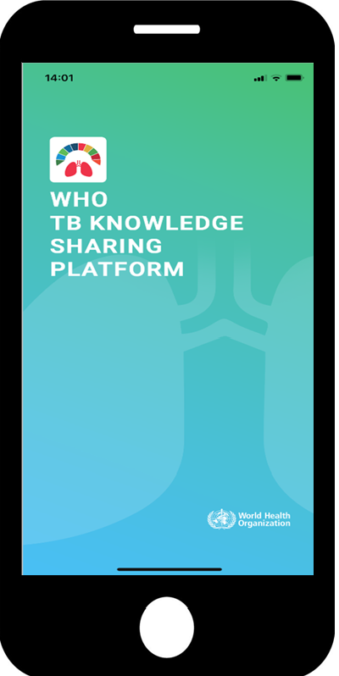
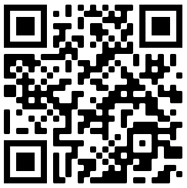
Useful tools – KSP website

Slide 29
Main messages
TB screening is a key intervention to find missing people with TB who are often the most vulnerable, and enables initiation of TPT in those at highest risk of TB
Chest X-ray is the preferred screening tool due to high sensitivity and ability to detect
Computer-aided detection (CAD) software using artificial intelligence can now be used to automatically interpret digital chest X-rays for TB screening
New screening tools also include rapid molecular tests and C-Reactive Protein for people living with HIV
A process of prioritization, planning, and careful monitoring and evaluation is necessary when implementing screening in order to ensure that :
  The appropriate risk groups are chosen for screening interventions
  The best screening algorithms are chosen for each risk group, to maximize yield, cost-effectiveness, efficiency of screening

Slide 30
Acknowledgements
Cecily Miller, Saskia den Boon, Dennis Falzon at WHO Global TB Programme
Other WHO staff at Headquarters, Regional, and Country Offices
Patients and participants who contributed to evidence presented here
Evidence Reviewers
National TB and HIV Programmes
Guideline Development Group, External Review Group
FIND, Stop TB Partnership, IoM
TAG, civil society
Global Fund, USAID
Other experts and funding agencies

Slide 31
© WORLD HEALTH ORGANIZATION 2023
All rights reserved. Publications of the World Health Organization can be obtained from WHO Press, World Health Organization, 20 Avenue Appia, 1211 Geneva 27, Switzerland (tel: +41 22 791 3264; fax: +41 22 791 4857; email: bookorders@who.int). Requests for permission to reproduce or translate WHO publications – whether for sale or for noncommercial distribution – should be addressed to WHO Press, at the above address (fax: +41 22 791 4806; email: permissions@who.int).
The designations employed and the presentation of the material in this publication do not imply the expression of any opinion whatsoever on the part of the World Health Organization concerning the legal status of any country, territory, city or area or of its authorities, or concerning the delimitation of its frontiers or boundaries. Dotted lines on maps represent approximate border lines for which there may not yet be full agreement.
The mention of specific companies or of certain manufacturers’ products does not imply that they are endorsed or recommended by the World Health Organization in preference to others of a similar nature that are not mentioned. Errors and omissions excepted, the names of proprietary products are distinguished by initial capital letters.
All reasonable precautions have been taken by the World Health Organization to verify the information contained in this publication. However, the published material is being distributed without warranty of any kind, either expressed or implied. The responsibility for the interpretation and use of the material lies with the reader. In no event shall the World Health Organization be liable for damages arising from its use.

