Slide 1
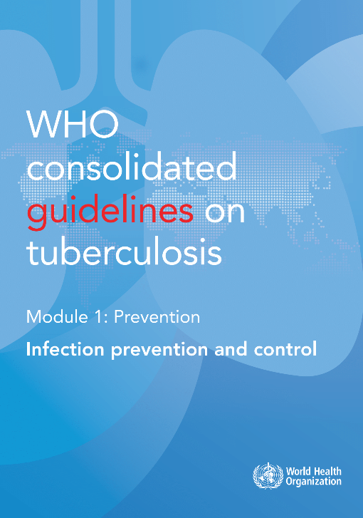
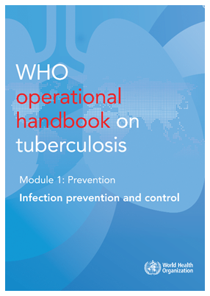
WHO guidelines & operational handbook:
Module 1:
TB infection prevention and control

Slide 2

Overview of guidelines
2019
18 recommendations and 3 good practice statements under the key areas of
TB infection prevention and control (TB IPC):
Administrative controls
Environmental controls
Respiratory protection
Core components of IPC programmes
(Research gaps)
https://extranet.who.int/tbknowledge/en/node/671

Slide 3
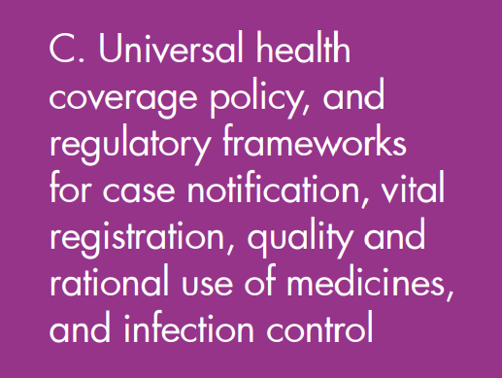
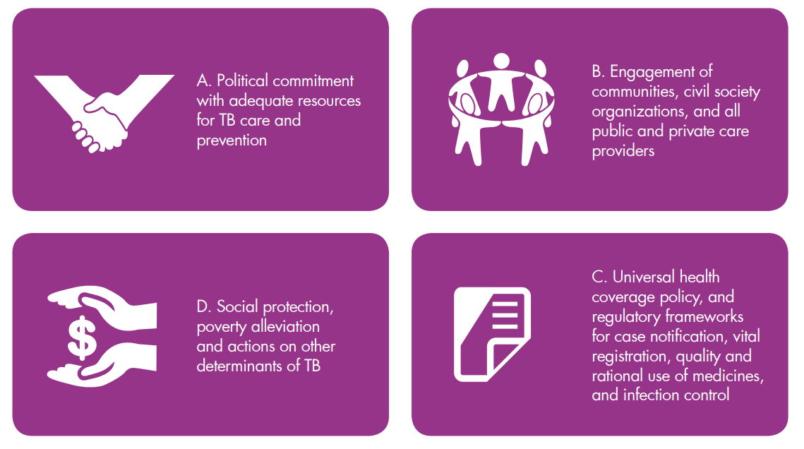
Background (1)
The End TB Strategy – Pillar 2
“Bold policies and supportive systems”

Slide 4
Background (2)
Initial WHO recommendations on TB IPC focused primarily on decreasing the risk of transmission in health care facilities in resource-limited settings
Recommendations were expanded in 2009 to provide further guidance on the use of specific measures for health care facilities, congregate settings and households.
The 2019 guidelines arose from a need to review more recent evidence and link to the general principles of infection control, beyond TB. They employ a public health approach within both domains of clinical and programmatic management of TB

Slide 5
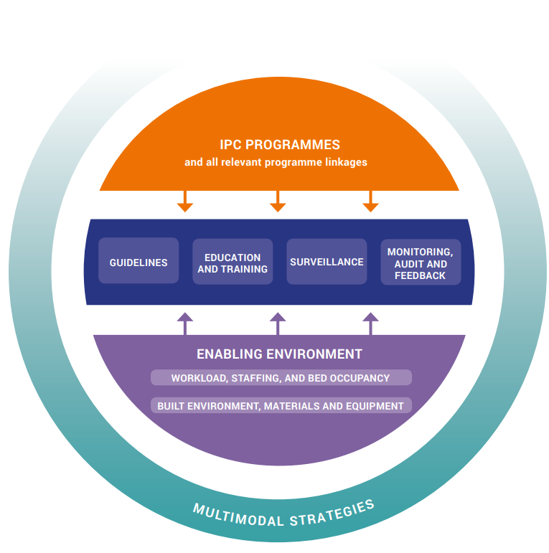
Background (3)
Core components of IPC programmes
Notes:
Collaborative work.
Implement the TB infection control model.
Consider the context when developing implementation plans.
Foster and environment for knowledge management.
Surveillance as the basis of the process.
Systematize, evaluate and provide feedback (plan, do, evaluate, act).

Slide 6

Evidence (1)
about evidence reviewed
  Systematic reviews informed 3 background and 4 PICO questions
  Evidence from studies reviewed was generally of low quality. A high proportion of studies were from the 1990s in US hospitals, several in response to TB outbreaks
  Studies implemented interventions of interest in combination, and so the discrete effect of specific interventions was difficult to elicit. Heterogeneity of study design and reporting of results precluded meta-analysis
  Almost all studies showed reductions in TB infection or disease after implementation of IPC measures
  A selection of key findings are shown in the following slides
Notes:
Background question 1. whether healthcare workers (HCWs) working in hospitals and outpatients are at higher risk of TB infection or disease than the general population from which they are drawn, who are not working in healthcare settings.
Background question 2. whether individuals living in TB-affected households or spending time in congregate settings at higher risk of TB infection or disease than the general population from which they are drawn, who are not similarly exposed.
Background question 3. how the infectiousness of TB patients changes after starting on effective treatment depending on susceptibility patterns
PICO question 1. In health workers (including community health workers) or other persons attending health care settings, can triage, respiratory separation / isolation of presumed or demonstrated infectious TB cases, and effective treatment reduce TB transmission when compared with transmission to the same populations in settings with no intervention or different interventions?
PICO question 2. In health workers or other persons attending health care or congregate settings, can respiratory hygiene and/or cough etiquette in people with presumed of confirmed TB reduce TB transmission when compared with settings where these interventions are not implemented?
PICO question 3. In health workers and persons in health care or other settings with a high risk of TB transmission, does use of the following engineering and environmental controls – natural ventilation; mechanical ventilation; mixed-mode ventilation; recirculated air filtration; upper-room GUV; and room-air cleaner appliances – reduce TB transmission when compared with similar populations in settings with no intervention?
PICO question 4. In health workers and persons in health care or other settings with a high risk of TB transmission, do the following interventions – use of particulate respirators and implementation of a respiratory protection programme – when compared with no intervention, reduce risk of TB transmission?

Slide 7
Evidence (2)
Effect of triage, respiratory separation and effective treatment on transmission
  Triage : absolute reduction of incidence of TB infection ranged from 2.3% to 20.5%. Three studies in high TB burden settings showed slight or no reduction in incidence of TB disease among healthcare workers and one in a low TB burden setting showed a moderate reduction in TB incidence.
  Respiratory separation: effect on incidence of TB infection ranged from an increase of 1% to a reduction of 21% (the two largest studies showed reductions in crude incidence of 1% in a low TB burden setting and 2% in high TB burden). Six studies reported the incidence of TB disease; estimates of effect ranged from almost no difference in three studies in high TB burden settings to a reduction of 29% in one study in low TB burden setting.
  Effective treatment: Four studies showed an absolute reduction in TST conversion after implementation of (composite) infection control measures, ranging from 0.1% to 21%. Only one study conducted in a low TB burden setting estimated the incidence of TB disease and found a change in incidence among people with HIV, from 8.8% before the intervention to 2.6% after its implementation.
Notes:
Triage : Studies varied greatly in their definitions of triage. Among the studies that implemented triage and reported a change in LTBI incidence, estimates of effect ranged from an absolute reduction of 2.3% to 20.5%. Among the studies that implemented triage and estimated the incidence of TB disease, three (in high TB burden settings) showed slight or no reduction in TB incidence among healthcare workers and one (in low TB burden settings) showed a moderate reduction in TB incidence.
Isolation: Among the 12 studies that reported differences in LTBI incidence, effects ranged from an increase of 1% to a reduction of 21%. The two largest studies (more than 300 outcomes) both showed reductions in incidence (of 1% [low TB burden] and 2% [high TB burden]; crude estimates). Six studies reported the incidence of TB disease; estimates of effect ranged from almost no difference between intervention and control groups in three studies (all in high TB burden settings) to a reduction of 29% in one study (low TB burden setting).
Effective treatment: Four studies showed an absolute reduction in TST conversion after implementation of (composite) infection control measures, ranging from 0.1% to 21%, though all studies had small numbers of outcomes and all except one had small sample sizes. Only one study (conducted in a low TB burden setting) estimated the incidence of TB disease and found a change in incidence among HIV-positive individuals, from 8.8% before implementation of the (composite) intervention, to 2.6% after implementation

Slide 8
Evidence (3)
Effect of respiratory hygiene & cough etiquette on TB transmission
Outcome | Respiratory hygiene or cough etiquette | No intervention
TB infection incidence or prevalence, surgical mask by TB patient (animal study) | 36/90 (40.0%) | 69/90 (76.7%)
TB disease incidence or prevalence in HCW | 0/44 (0.0%) | 26/90 (28.9%)
Effect of selected engineering and environmental controls on TB transmission
Outcome (4 studies reporting a reduction in TST conversion) | Intervention | No intervention
After composite intervention, including negative pressure room | 23/5,153 (0.4%) | 118/3,579 (3.3%)
After mechanical ventilation and engineering measures | 6/2,108 (0.28%) | 98/2,221 (4.4%)
After mechanical ventilation and isolation rooms | 3/17 (18%) | 7/25 (28%)
After mechanical ventilation with other measures | 4/78 (5.1%) | 15/90 (16.7%)
TB disease incidence or prevalence after composite intervention, including mixed mode ventilation / UVGI | 19/4,780 (0.4%) | 30/4,357 (0.7%)

Slide 9
Evidence (4)
Effect of particulate filters or a respiratory protection programme on
TB transmission in healthcare workers
Outcome (6 studies reporting a reduction in TST conversion in staff) | Intervention | No intervention
After a respiratory protection intervention | 9.4/1,000 person years | 26.3/1,000 person years
After a composite intervention including a particulate respirator | 23/5,153 (0.4%) | 118/3,579 (3.3%)
After a composite intervention including a particulate respirator | 4.1/1,000 persons | 12.4/1,000 persons
After a particulate respirator intervention | 21/446 (4.7%) | 41/303 (13.5%)
After a composite intervention including moulded surgical masks | 4/78 (5.1%) | 15/90 (16.7%)
After a composite intervention including mixed mode ventilation | 2/96 (2.1%) | 13/77 (16.9%)
TB incidence or prevalence after a composite intervention, including use of particulate respirators by staff | 19/4,780 (0.4%) | 30/4,357 (0.7%)

Slide 10
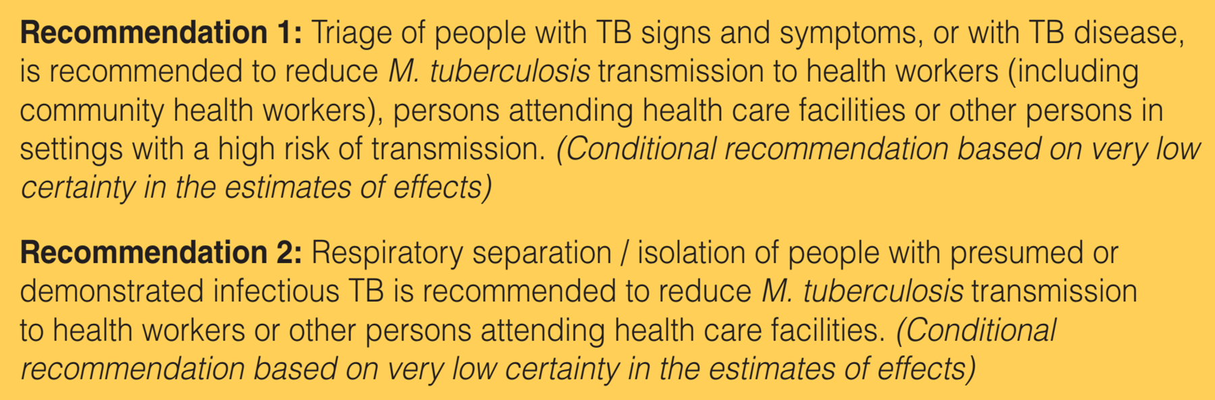
Recommendations (1)
Administrative controls (1)
Notes:
Recommendation 1: Triage of people with TB signs and symptoms, or with TB disease, is recommended to reduce M. tuberculosis transmission to health workers (including community health workers), persons attending health care facilities or other persons in settings with a high risk of transmission. (Conditional recommendation based on very low certainty in the estimates of effects)
Recommendation 2: Respiratory separation / isolation of people with presumed or demonstrated infectious TB is recommended to reduce M. tuberculosis transmission to health workers or other persons attending health care facilities. (Conditional recommendation based on very low certainty in the estimates of effects)

Slide 11
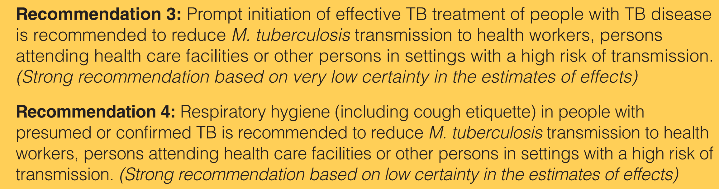
Recommendations (2)
Administrative controls (2)
Notes:
Recommendation 3: Prompt initiation of effective TB treatment of people with TB disease is recommended to reduce M. tuberculosis transmission to health workers, persons attending health care facilities or other persons in settings with a high risk of transmission. (Strong recommendation based on very low certainty in the estimates of effects)
Recommendation 4: Respiratory hygiene (including cough etiquette) in people with presumed or confirmed TB is recommended to reduce M. tuberculosis transmission to health workers, persons attending health care facilities or other persons in settings with a high risk of transmission. (Strong recommendation based on low certainty in the estimates of effects)

Slide 12
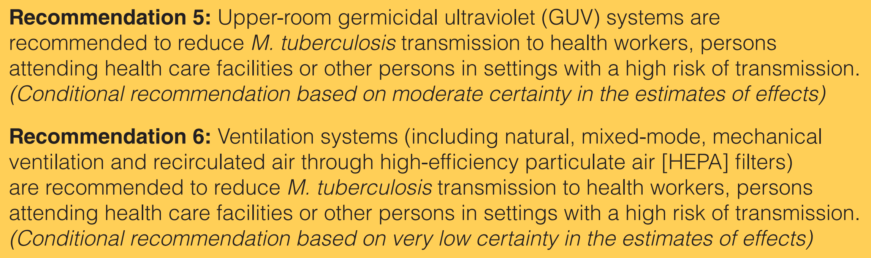
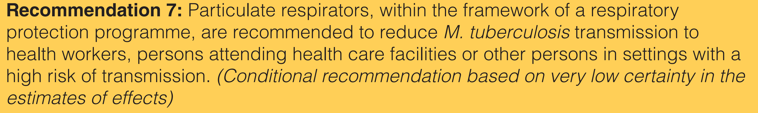
Recommendations (3)
Environmental controls & Respiratory protection
Notes:
Recommendation 5: Upper-room germicidal ultraviolet (GUV) systems are recommended to reduce M. tuberculosis transmission to health workers, persons attending health care facilities or other persons in settings with a high risk of transmission. (Conditional recommendation based on moderate certainty in the estimates of effects)
Recommendation 6: Ventilation systems (including natural, mixed-mode, mechanical ventilation and recirculated air through high-efficiency particulate air [HEPA] filters) are recommended to reduce M. tuberculosis transmission to health workers, persons attending health care facilities or other persons in settings with a high risk of transmission. (Conditional recommendation based on very low certainty in the estimates of effects)
Recommendation 7: Particulate respirators, within the framework of a respiratory protection programme, are recommended to reduce M. tuberculosis transmission to health workers, persons attending health care facilities or other persons in settings with a high risk of transmission. (Conditional recommendation based on very low certainty in the estimates of effects)

Slide 13
Recommendations (4)
Core Components of IPC programmes
  Collaborative work.
  Implement the TB infection control model.
  Consider the context when developing implementation plans.
  Foster an environment for knowledge management.
  Surveillance as the basis of the process.
  Systematize, evaluate and provide feedback (plan, do, evaluate, act).
Notes:
Key guiding principles of TB IPC guidelines
Effective IPC measures are a critical part of the quality of health service delivery to achieve people-centred, integrated universal health coverage.
These guidelines are based on a public health approach to strengthening the adoption and implementation of evidence-based interventions for IPC, including transmission-based precautions. Recommendations should be considered as the minimum IPC standard
Implementing these guidelines requires an understanding of the interdependence of the three-level hierarchy of IPC, giving prominence to the implementation of administrative controls as the basis for reducing the risk of transmission of M. tuberculosis.
The implementation of these recommendations needs to be accompanied by efforts to promote and protect the human rights of all patients, their communities and care providers.

Slide 14

Operational handbook
The handbook provides practical advice, best practices, checklists and other job aids on how to implement WHO recommendations on TB IPC within the clinical and programmatic contexts, using a public health approach with multisectoral actions across relevant settings.
It targets policy-makers at national and subnational levels, programme managers for TB, HIV and noncommunicable disease programmes; managers and clinicians at inpatient and outpatient health care facilities; managers at congregate settings, occupational health officials; engineers; frontline health care workers; and other key stakeholders in the public and private sectors.
2023
https://apps.who.int/iris/bitstream/handle/10665/372738/9789240078154-eng.pdf

Slide 15
Operational handbook : Frequently asked questions (1)
What are key strategies to prevent TB infection?
  Early detection and treatment of active TB disease
  Other infection control measures, such as separation of infectious patients, proper ventilation, cough etiquette and use of masks
  Screening and testing high-risk groups, such as contacts of TB patients, people living with HIV and occupationally exposed
  TB preventive treatment

Slide 16
Operational handbook : Frequently asked questions (2)
What is triage in the context of TB IPC?
  Triage implies identifying individuals with clinical features of TB among those presenting to a health facility and fast-tracking them through the waiting areas for respiratory separation, clinical evaluation, TB tests, and provision of treatment as necessary.
  Triage aims to minimize the time a potentially infectious individual spends in contact with other visitors or staff at the facility. By itself triage is estimated to reduce the absolute risk of TB infection by about 6% among health care workers and about 12% in non-health care workers.
  Checklists can be run with people presenting to health facilities to identify those with signs, symptoms or history of TB. Individuals with cough or other symptoms should be routed for quick evaluation. Use of marks by patients limits exposure to others. Staff should wear certified respirators (N95, filtering facepiece 2 [FFP2] or elastomeric) when in contact with patients who are or who may be infectious. People with HIV or other vulnerable groups should receive care separate from clinic areas where patients are evaluated for TB. Early start of treatment if TB is diagnosed is very important.

Slide 17
Operational handbook : Frequently asked questions (3)
What are the advantages and disadvantages of different types of room ventilation?
 | Mechanical ventilation | Natural ventilation | Hybrid (mixed mode) ventilation
Advantages | Suitable for all climates and weather | Suitable for warm and temperate climates | Suitable for most climates and weather
 | More controlled and comfortable environment | Lower capital, operational, maintenance costs for simple implementations | Energy saving, relative to mechanical ventilation
 | Occupants have limited control to affect ventilation | Capable of achieving very high ventilation rates | More flexible
Disadvantages | Expensive to install and maintain | Easily affected by outdoor climate and occupant’s behavior | May be more costly or difficult to design
 | Can fail to deliver required ventilation rates through faulty design, maintenance or operation | May be difficult to plan, design, and predict performance
 | Noise from equipment | Reduced comfort level of occupants in extreme weather
 |  | Cannot achieve directional control of airflow, if required

Slide 18
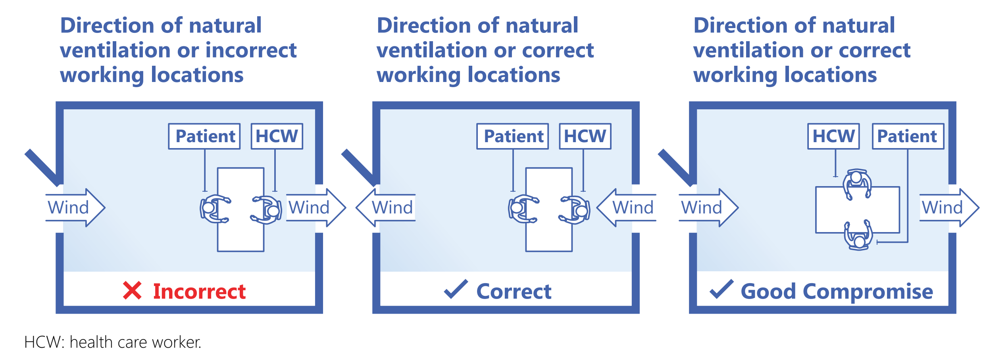
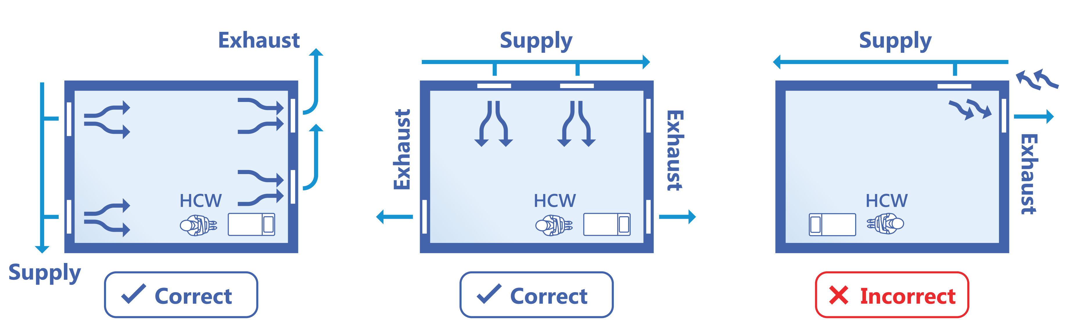
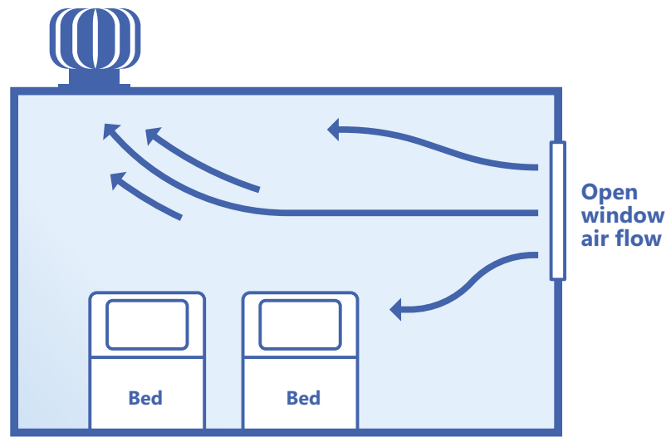
Operational handbook : Frequently asked questions (4)
How to position patients with respect to room ventilation
Source: Stop TB Partnership
Source: P Jensen
Turbine-driven ventilation
Source: P Jensen
Notes:
Given the cost and the high risk of design or maintenance failures, ventilation systems that recirculate air may not be suitable for settings with a high risk of M. tuberculosis transmission, such as TB inpatient wards. In such settings, natural or hybrid mechanical ventilation without recirculation or upper-room GUV systems may be more suitable.

Slide 19
Operational handbook : Frequently asked questions (5)
Do you need UV lamps for effective TB IPC?
  Germicidal ultraviolet light (GUV) is one of the environmental controls that can reduce the concentration of infectious particles in the air
  Upper-room GUV aims to create a disinfection zone above the people occupying a room. They kill or inactivate any airborne pathogens that pass through the disinfection zone and thus reduce the risk of airborne infection. Upper-room GUVs can be an add-on to ventilation strategies in high-risk areas, particularly where unidentified infectious patients may be present
  The need for technical capacity and funding for installation and maintenance may limit the implementation of GUV on low resource settings to places with the highest risk of TB transmission
  GUV should be part of the package of IPC interventions, not a standalone intervention. Their use could impart a false sense of security if other critical measures are lacking

Slide 20
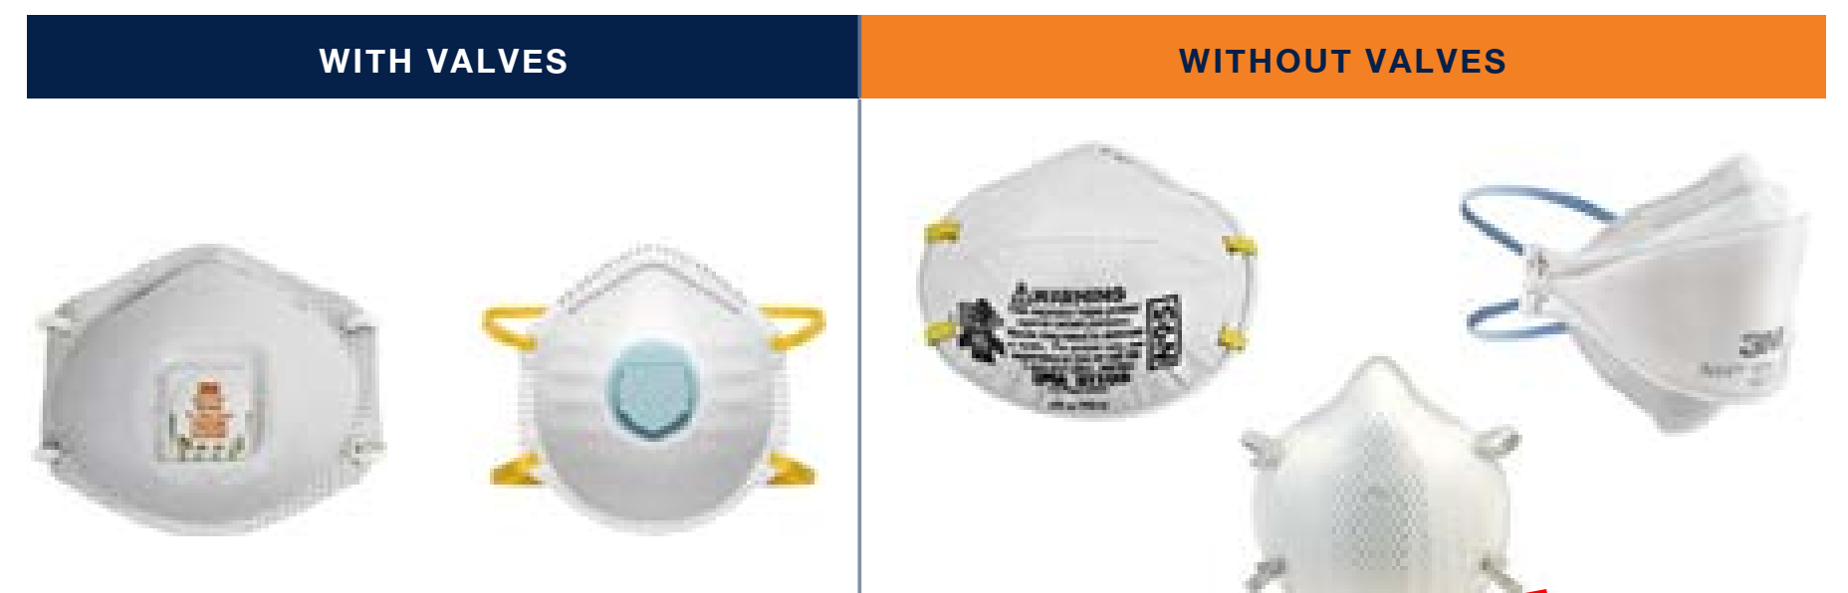
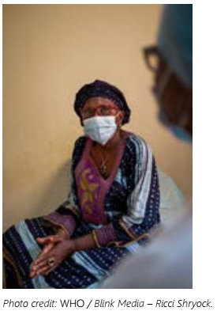
Operational handbook : Frequently asked questions (6)
How do respirators differ from medical masks?
Respirators
Masks
- Masks can protect from
infection via droplets but
offer minimal protection
against airborne transmitted
M. tuberculosis
- Masks can be made of gauze
or tissue, without a filter
- They are best suited for use
by people with infectious TB
to reduce the release of infectious particles into a space
- Respirators protect healthcare workers and contacts from inhaling infectious particles that are small enough for airborne transmission
- Some respirators have valves, and some do not
- Their coding refers to filtering capacity when used correctly (eg, N95 filters 95%+ of particles 0.3μm in size)
Notes:
Respiratory protection should be implemented as a part of a package of TB IPC interventions. However, inappropriate implementation of respiratory protection measures, or reliance on these measures alone, may create a false sense of security and increase the risk of TB. The available studies assessing the effectiveness of respiratory protection in reducing the risk of M. tuberculosis transmission are highly heterogeneous. The absolute reduction in TST conversion ranged from 4.3% to 14.8%. However, since the studies usually test a package of TB IPC interventions, direct evidence on the role of respiratory protection is lacking. The WHO GDG noted that the overall protection depends on whether respirators have been properly fit-tested and maintained, and on the quality of training and the way the respirators are used.

Slide 21
Operational handbook : Frequently asked questions (7)
What should the respiratory protection component of IPC include?
  TB IPC focal person at the site responsible for respiratory protection
  written SOPs
  dedicated funding and human resources for medical masks and respirators, education material and training of staff
  respirators of different sizes that meet global standards for protection
  fit-testing for all users and a practice to “seal check” before wearing a respirator
  respirators used by all staff in high-risk situations (eg infectious TB patients, staff with HIV)
  general health screening of those using respirators

Slide 22
Operational handbook : Frequently asked questions (8)
What are the 5 key indicators of TB IPC measures for routine reporting at national level?
Indicator | Source of information
1. Proportion of health facilities that have a valid and updated TB IPC plan | Policy document from the NTP, field visits and survey data
2. Proportion of health facilities that have appointed a TB IPC focal person as a part of facility IPC committee | Policy document from the NTP, field visits and survey data
3. Time from diagnosis to start of appropriate TB treatment | Surveillance data (should be available in most case-based records)
4. Proportion of health care workers involved in the care of DS-TB or MDR-TB, or in the collection of sputum samples, who are provided with at least one respirator per week | Supervisory visits
5. Relative risk of TB disease among health care workers compared with the TB notification rate in the adult population of the same area in the same year | Surveillance data

Slide 23
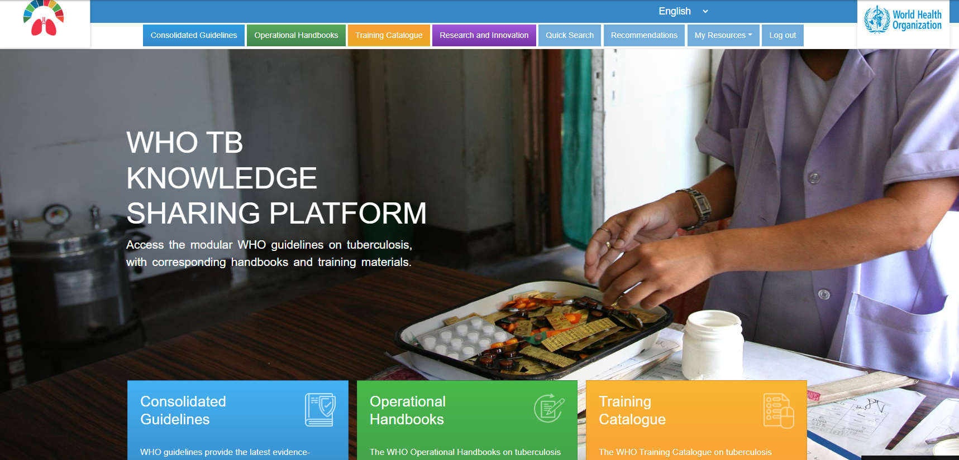
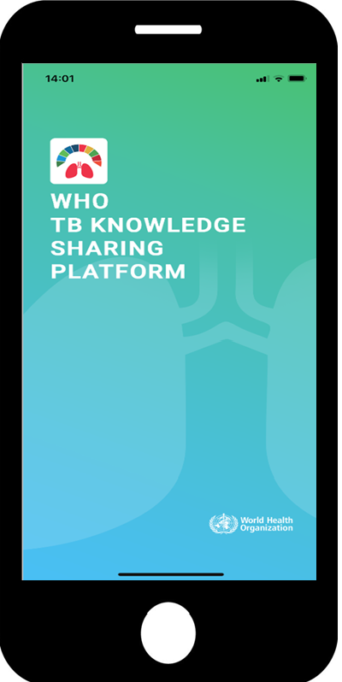

https://extranet.who.int/tbknowledge

Slide 24
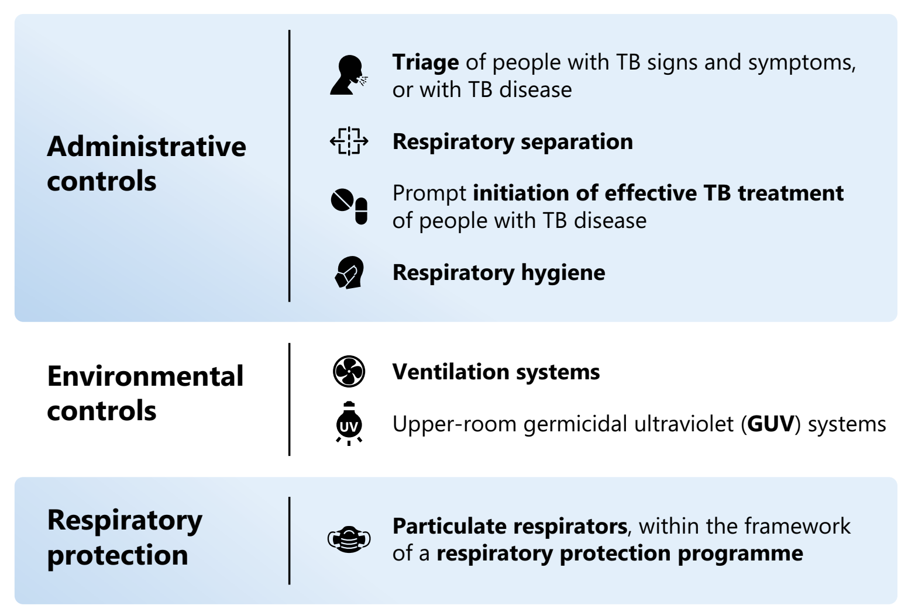
Main messages (1)

Slide 25
Main messages (2)
  Effective IPC measures are a critical part of the quality of health service delivery to achieve people-centred, integrated universal health coverage. They should articulate well with
  TB IPC interventions should not be implemented individually or in a way that dissociates them from other administrative and environmental controls, and personal protection. They must be considered as an integrated package of IPC interventions to prevent M. tb transmission
  Dialogue with both health care staff and patients is important
  These guidelines are based on a public health approach to strengthen the adoption and implementation of evidence-based interventions for IPC, including transmission-based precautions. The recommendations given here should be considered as the minimum IPC standard.

Slide 26
Acknowledgments
  WHO Global TB Programme (Licé Gonzalez Angulo, Fuad Mirzayev, Avinash Kanchar, Dennis Falzon)
  Other WHO staff at HQ, Regions and Country offices
  Guideline Development Group & other experts (see https://extranet.who.int/tbknowledge/en/node/674)
  Contributors to the handbook, especially GB Migliori, UCSF (L Chen), US CDC (A Date), ETTI (C Tudor, G Volenchikov, P Jensen)
  Staff of national TB programmes in Member States

Slide 27
© WORLD HEALTH ORGANIZATION 2023
All rights reserved. Publications of the World Health Organization can be obtained from WHO Press, World Health Organization, 20 Avenue Appia, 1211 Geneva 27, Switzerland (tel: +41 22 791 3264; fax: +41 22 791 4857; email: bookorders@who.int). Requests for permission to reproduce or translate WHO publications – whether for sale or for noncommercial distribution – should be addressed to WHO Press, at the above address (fax: +41 22 791 4806; email: permissions@who.int).
The designations employed and the presentation of the material in this publication do not imply the expression of any opinion whatsoever on the part of the World Health Organization concerning the legal status of any country, territory, city or area or of its authorities, or concerning the delimitation of its frontiers or boundaries. Dotted lines on maps represent approximate border lines for which there may not yet be full agreement.
The mention of specific companies or of certain manufacturers’ products does not imply that they are endorsed or recommended by the World Health Organization in preference to others of a similar nature that are not mentioned. Errors and omissions excepted, the names of proprietary products are distinguished by initial capital letters.
All reasonable precautions have been taken by the World Health Organization to verify the information contained in this publication. However, the published material is being distributed without warranty of any kind, either expressed or implied. The responsibility for the interpretation and use of the material lies with the reader. In no event shall the World Health Organization be liable for damages arising from its use.

