Slide 1
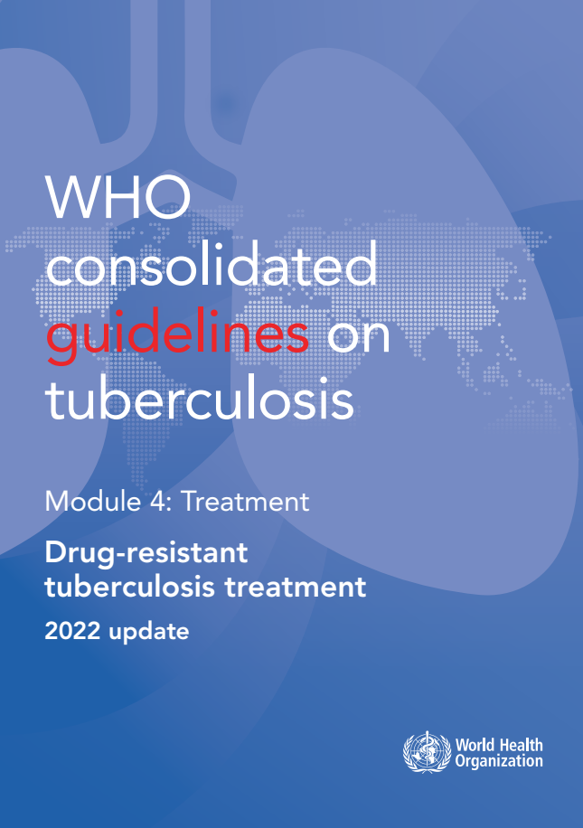
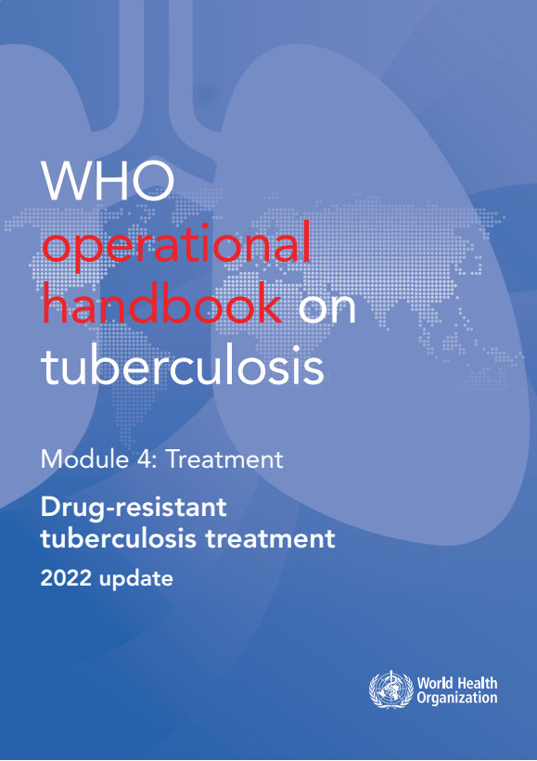
WHO guidelines & operational handbook:
Module 4:
Drug-resistant
TB treatment

Slide 2

Overview of guidelines
The new chapters on BPaLM/BPaL and 9-month regimen
2022
Section 1. The 6-month bedaquiline, pretomanid, linezolid, and moxifloxacin (BPaLM) regimen for MDR/RR-TB (new)
Section 2. The 9-month all-oral regimen for MDR/RR-TB (new)
Section 3: Longer regimens for MDR/RR-TB
Section 4: Regimen for rifampicin-susceptible and isoniazid-resistant tuberculosis
Section 5. Monitoring patient response to MDR/RR-TB treatment using culture
Section 6. Start of antiretroviral therapy in patients on MDR/RR-TB regimens
Section 7. Surgery for patients on MDR/RR-TB treatment
https://extranet.who.int/tbknowledge/en/node/286

Slide 3
Overview of guidelines
2022
There are 24 recommendations in the 2022 update:
New: The 6-month bedaquiline, pretomanid, linezolid and moxifloxacin (BPaLM) regimen for MDR/RR-TB and pre-XDR-TB
New: The 9-month all-oral regimen for MDR/RR-TB
17 recommendations for longer regimen
2 recommendations for rifampicin-susceptible and isoniazid-resistant TB
1 recommendation on monitoring patient response to MDR/TB treatment
1 recommendation on ART for MDR/RR-TB patients
1 recommendation on surgery for patients on MDR/RR-TB treatment
https://extranet.who.int/tbknowledge/en/node/286

Slide 4
Background
New developments in 2022: Guidelines
Update on the all-oral shorter regimens for MDR/RR-TB
(9-month regimen containing 3 group A medicines (South Africa),
6-month regimen (NeXT trial regimen)
Review TB-PRACTECAL trial regimen (BPaLM)
Update on BPaL for pre-XDR-TB (use, duration of components and dosing)
DR-TB guidelines 2022 (update)
DR-TB

Slide 5
Evidence: BPaLM: Data and studies considered
1. TB PRACTECAL Trial (sites: Uzbekistan, South Africa, Belarus)
Investigational regimens in Stage 1
  Arm 1: bedaquiline (B) + pretomanid (Pa) + linezolid (Lzd) + moxifloxacin (Mfx) for 24 weeks (BPaLM)
  Arm 2: bedaquiline + pretomanid + linezolid + clofazimine for 24 weeks (BPaLC)
  Arm 3: bedaquiline + pretomanid + linezolid for (BPaL) 24 weeks
Investigational regimen in Stage 2 (selected after stage 1)
  Arm 1: bedaquiline (B) + pretomanid (Pa) + linezolid (Lzd) + moxifloxacin (Mfx) for 24 weeks (BPaLM)
Comparator: Standard of care
  Locally approved standard of care which is as much as possible consistent with WHO recommendations for RR/MDR-TB (9-month and 18-month regimens depending on the site)

Slide 6
Evidence: BPaLM: Data and studies considered
2. ZENIX - trial (sites: Georgia, Moldova, Russia, and South Africa)
BPaL regimen with different doses and duration of linezolid
Bedaquiline and pretomanid at standard doses
One of the following oral daily linezolid doses:
  1200mg 26 weeks (primary analysis)
  1200mg 9 weeks
  600mg 26 weeks
  600mg 9 weeks
No SoC comparator regimen included in the trial

Slide 7
Evidence: 9-month regimen: Data and studies considered
3. South African - 2019 regimen
  Programmatic data
  9-month regimen containing linezolid
  4-6-month intensive phase: Lzd(2m)-Bdq(6m)-Lfx-Cfz-Hh-Z-E
  5-month continuation phase: Lfx-Cfz-Z-E
9-month regimen containing ethionamide
  9-month regimen containing Eto: Bdq(6m)-Lfx/Mfx-Eto-Cfz-Hh-Z-E
  WHO recommended longer regimens

Slide 8
Recommendations
Recommendation 1.1
WHO suggests the use of a 6-month treatment regimen composed of bedaquiline, pretomanid, linezolid (600 mg) and moxifloxacin (BPaLM) rather than the 9-month or longer (18-month) regimens in MDR/RR-TB patients.
(Conditional recommendation, very low certainty of evidence)
Remarks
DST for fluoroquinolones is strongly encouraged in people with MDR/ RR-TB, and although it should not delay initiation of the BPaLM, results of the test should guide the decision on whether moxifloxacin can be retained or should be dropped from the regimen – in cases of documented resistance to fluoroquinolones, BPaL without moxifloxacin would be initiated or continued.
This recommendation does not apply to pregnant and breastfeeding women owing to limited evidence on the safety of pretomanid.
The recommended dose of linezolid is 600 mg once daily for BPaLM/BPaL

Slide 9
Recommendations
Recommendation 2.1
WHO suggests the use of the 9-month all-oral regimen rather than longer (18-month) regimens in patients with MDR/RR-TB and in whom resistance to fluoroquinolones has been excluded.
(Conditional recommendation, very low certainty of evidence)
Remarks
The 9-month all-oral regimen consists of bedaquiline (used for 6 months), in combination with levofloxacin/moxifloxacin, ethionamide, ethambutol, isoniazid (high-dose), pyrazinamide and clofazimine (for 4 months, with the possibility of extending to 6 months if the patient remains sputum smear positive at the end of 4 months), followed by treatment with levofloxacin/moxifloxacin, clofazimine, ethambutol and pyrazinamide (for 5 months). Ethionamide can be replaced by 2 months of linezolid (600 mg daily).
A 9-month regimen with linezolid instead of ethionamide may be used in pregnant women, unlike the regimen with ethionamide.
3. This recommendation applies to :
a. people with MDR/RR-TB and without resistance to fluoroquinolones.
b. patients without extensive TB disease and without severe extrapulmonary TB.
c. patients with less than 1 month exposure to bedaquiline, fluoroquinolones, ethionamide, linezolid and clofazimine; when exposure is greater than 1 month, these patients may still receive this regimen if resistance to the specific medicines with such exposure has been ruled out;.
d. All people regardless of HIV status.
e. children (and patients in other age groups) who do not have bacteriological confirmation of TB or resistance patterns but who do have a high likelihood of MDR/RR-TB (based on clinical signs and symptoms of TB, in combination with a history of contact with a patient with confirmed MDR/RR-TB).

Slide 10
Recommendations
Recommendation 3.1
In MDR/RR-TB patients on longer regimens, all three Group A agents and at least one Group B agent should be included to ensure that treatment starts with at least four TB agents likely to be effective, and that at least three agents are included for the rest of the treatment if bedaquiline is stopped. If only one or two Group A agents are used, both Group B agents are to be included.
If the regimen cannot be composed with agents from Groups A and B alone, Group C agents are added to complete it.
(Conditional recommendation, very low certainty of evidence)

Slide 11
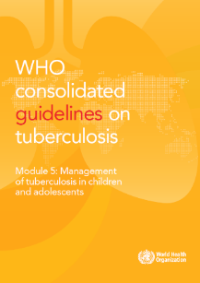
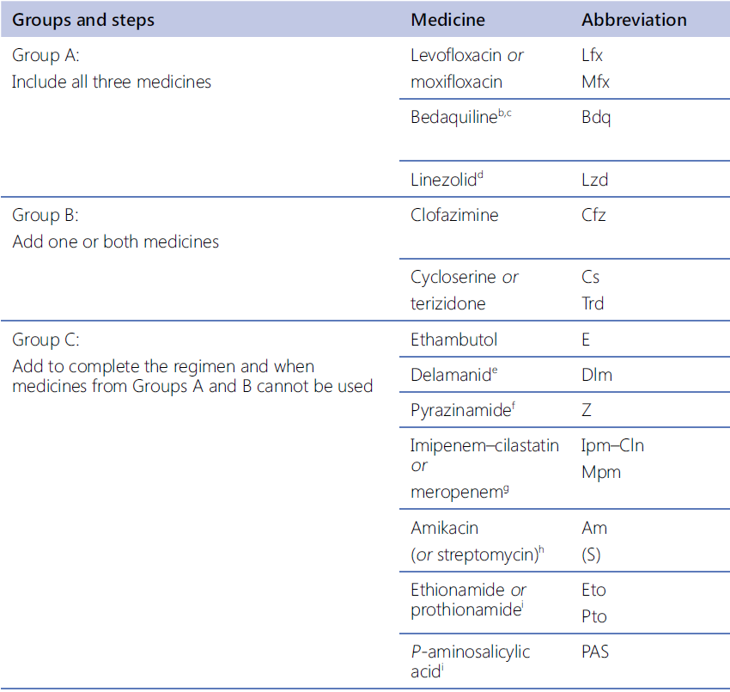
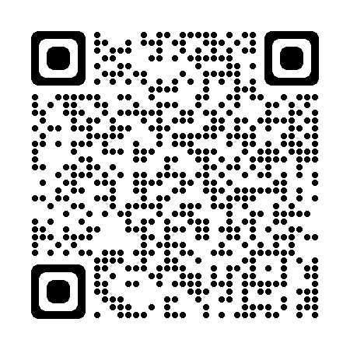
Recommendations
Recommendations 3.2-3.14
Grouping of medicines recommended for use in longer MDR-TB regimens
NEW. In children with MDR/RR-TB aged below 6 years, an all-oral treatment regimen containing bedaquiline may be used.
NEW. In children with MDR/RR-TB aged below 3 years delamanid may be used as part of longer regimens.

Slide 12
Recommendations
Duration of longer regimen: 3.15 – 3.17
Regimen for rifampicin-susceptible and isoniazid-resistant TB: 4.1 - 4.2
Monitoring patient response to MDR/RR-TB treatment using culture: 5.1
Starting antiretroviral therapy in patients on MDR/RR-TB regimens: 6.1
Surgery for patients on MDR/RR-TB treatment: 7.1
3.15:
In MDR/RR-TB patients on longer regimens, a total treatment duration of 18–20 months is suggested for most patients; the duration may be modified according to the patient’s response to therapy.
(Conditional recommendation, very low certainty of evidence
6.1:
Antiretroviral therapy is recommended for all patients with HIV and drug-resistant tuberculosis requiring second-line antituberculosis drugs, irrespective of CD4 cell count, as early as possible (within the first 8 weeks) following initiation of antituberculosis treatment.
(Strong recommendation, very low certainty of evidence)
7.1:
In patients with rifampicin-resistant tuberculosis (RR-TB) or multidrug-resistant TB (MDR-TB), elective partial lung resection (lobectomy or wedge resection) may be used alongside a recommended MDR-TB regimen.
(Conditional recommendation, very low certainty of evidence
4.2:
In patients with confirmed rifampicin-susceptible, isoniazid-resistant tuberculosis, it is not recommended to add streptomycin or other injectable agents to the treatment regimen.
(Conditional recommendation, very low certainty of evidence)
5.1:
In MDR/RR-TB patients on longer regimens, the performance of sputum culture in addition to sputum smear microscopy is recommended to monitor treatment response. It is desirable for sputum culture to be repeated at monthly intervals.
(Strong recommendation, moderate certainty of evidence)
4.1:
In patients with confirmed rifampicin-susceptible, isoniazid-resistant tuberculosis , treatment with rifampicin, ethambutol, pyrazinamide and levofloxacin is recommended for a duration of 6 months.
(Conditional recommendation, very low certainty in the estimates of evidence)
3.16:
In MDR/RR-TB patients on longer regimens, a treatment duration of 15–17 months after culture conversion is suggested for most patients; the duration may be modified according to the patient’s response to therapy.
(Conditional recommendation, very low certainty of evidence)
3.17:
In MDR/RR-TB patients on longer regimens containing amikacin or streptomycin, an intensive phase of 6–7 months is suggested for most patients; the duration may be modified according to the patient’s response to therapy.
(Conditional recommendation, very low certainty of evidence)

Slide 13
Operational Handbook
What are the treatment options for MDR/RR-TB patients?
BPaLM/BPaL regimen (MDR/RR-TB and pre-XDR-TB)
- in patients (aged ≥14 years) with MDR/RR-TB who have not had previous exposure to bedaquiline, pretomanid and linezolid (defined as >1 month exposure).
- This regimen may be used without moxifloxacin (BPaL) in the case of documented resistance to fluoroquinolones (in patients with pre-XDR-TB).
- DST to fluoroquinolones is strongly encouraged, but DST should not delay treatment initiation.
- Cannot be used during pregnancy
- if DST confirms susceptibility can be used in those exposed to B, Pa, or L for more than 1 month
- no TB meningitis, osteoarticular or disseminated TB
9-month regimens (MDR/RR-TB)
- 2 months of linezolid (600 mg) can be used as an alternative to 4 months of ethionamide.
- no previous exposure to second-line treatment (including bedaquiline),
- no fluoroquinolone resistance and
- no extensive pulmonary TB disease or severe extrapulmonary TB.
- rapid DST for ruling out fluoroquinolone resistance is required.
- can be used in all age groups
- regimen with linezolid can be used in pregnant women
Longer regimens (18-month, individualized, mostly in XDR-TB)
- Last resort regimen
- Those who failed or not eligible for two shorter regimens
- XDR-TB patients
- Individualized based on current recommendations

Slide 14
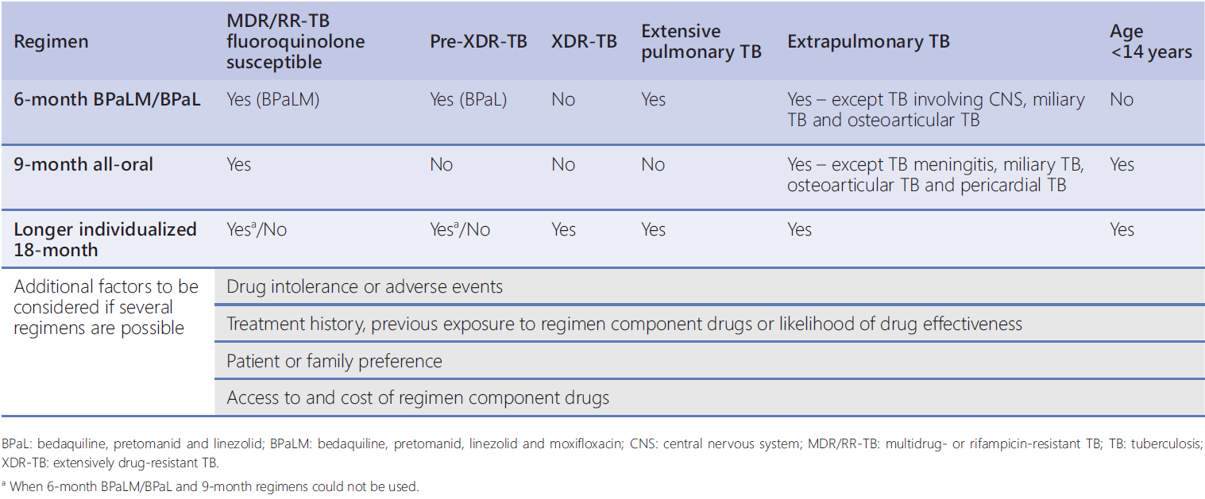
Operational Handbook
What key factors should be taken into consideration when making decisions about selecting the available treatment regimens?

Slide 15
Operational Handbook
What is the composition and dosage of BPaLM regimen?
BPaLM is a combination of bedaquiline, pretomanid, linezolid and moxifloxacin
Drug | Dose
Bedaquiline (100 mg tablet) | 400 mg once daily for 2 weeks, then 200 mg 3 times per week OR 200 mg daily for 8 weeks, then 100 mg daily
Pretomanid (200 mg tablet) | 200 mg once daily
Linezolid (600 mg tablet) | 600 mg once daily
Moxifloxacin (400 mg tablet) | 400 mg once daily

Slide 16
Operational Handbook
What are the two bedaquiline dosages used in the BPaLM regimen?
400 mg once daily for 2 weeks, then 200 mg three times per week (Product label)
OR
200 mg daily for 8 weeks followed by 100 mg daily (ZeNix trial)
  an alternative way to dose Bdq that allows for daily dosing of all drugs throughout the regimen
  may be more convenient for patients and health care providers

Slide 17
Operational Handbook
What is the recommended dosage of Linezolid in BPaLM regimen and how does it vary in specific situations?
Lzd 600 mg
preferred for the entire duration, at least the first 9 weeks
Reduce to Lzd 300 mg (after 9 weeks) in case of toxicity
with possible drug interruption for 1–2 weeks before dose reduction
Permanent suspension
due to significant AEs

Slide 18
Operational Handbook
What is the duration and dosing frequency of BPaL and BPaLM regimens?
BPaLM - standardizing treatment duration to 6 months (26 weeks)
BPaL – 6 to 9 months (39 weeks)
Note: extension to 9 months applies if sputum culture is positive months 4 – 6.
All medicines to be used throughout treatment duration
Ideally, missing doses of all three or four drugs in the regimen should be avoided
If doses are missed, any interruption of >7 days should be made up for by extending the treatment duration (for the number of missed doses)

Slide 19
Operational Handbook
What factors need to be considered when modifying BPaL regimen?
The only experience using BPaL/BPaLM regimens stems from two clinical trials; it is therefore suggested that the programmatic implementation be aligned with this experience. However:
If Mfx alone is discontinued, the regimen can be continued as the BPaL.
Dose of Lzd dose can be reduced to 300mg due to AEs after 9 weeks.
If Lzd needs to be discontinued in the last 8 weeks of the regimen, the regimen is considered as completed.
Duration extension from 6 to 9 months for BPaL - if culture positive between 4-6 months.

Slide 20
Operational Handbook
When is appropriate time to discontinue BPaLM regimen?
The most common situations in which the regimen may be discontinued are:
  treatment failure
  inability to use linezolid for enough time owing to adverse effects
  pregnancy that occurs during treatment
The entire BPaLM/BPaL regimen should be discontinued if:
  Bdq or Pa is permanently stopped
  Lzd is permanently discontinued during the initial 9 weeks of treatment
Missed doses: Consider longer regimen when:
  > 2 weeks of consecutive treatment interruption of all medicines in the regimen; or
  >4 weeks cumulative of nonconsecutive treatment interruption of all medicines in the regimen

Slide 21
Operational Handbook
What is the composition and duration of 9-month regimen with Ethionamide?
Ethionamide variation:
4-6 Bdq-Eto-Lfx/Mfx-Cfz-Z-E-Hh/5Lfx/Mfx-Cfz-Z-E
Initial phase: 4-6 Bdq (6m)-Eto-Lfx/Mfx-Cfz-Z-E-Hh
Continuation phase: 5Lfx/Mfx-Cfz-Z-E
Bdq can be also extended to 9 months.
If sputum remains positive at month 4, initial phase is extended to 6 months.
Eto & High-dose H can be dropped after initial phase depending on smear status.

Slide 22
Operational Handbook
What is the composition and duration of 9-month regimen with Linezolid?
Linezolid variation:
4-6 Bdq–Lzd-Lfx/Mfx-Cfz-Z-E-Hh/5Lfx/Mfx-Cfz-Z-E
Initial phase:4-6 Bdq(6m) –Lzd (2m) -Lfx/Mfx-Cfz-Z-E-Hh
Continuation phase: 5Lfx/Mfx-Cfz-Z-E
Bdq can be also extended to 9 months.
Lzd is only given the first 2 months of treatment.
The rest six drugs are given for another 2 or 4 months depending on smear status.
High-dose H can be dropped after initial phase depending on smear status.

Slide 23
Operational Handbook
What is the dosage and frequency of 9-month regimens?
Drug dosage and frequency
Bdq: higher loading dose first 2 weeks, then 3 times a week.
If Bdq interrupted < 2 wks in the maintenance phase - no loading
If Bdq interrupted > 2 wks (but <8wks) in the maintenance phase- reloading at the higher dose for 7 days before resuming thrice-weekly schedule.
Lzd is only given the first 2 months at 600 mg once a day ( LZD variation)
If Lzd doses occasionally missed → add on to the end of the 2-month period
If Lzd full dose is not tolerated first 2 month→ switch to a new regimen

Slide 24
Operational Handbook
What factors should be considered when choosing 9-month regimen options?
Factors/conditions | Ethionamide variation | Linezolid variation
Any sign of optic neuritis | Yes | No
Severe or mild peripheral neuropathy | Yes | No
Hemoglobin (> 8 g/dl) neutrophils (> 0.75 X 10⁹/L) & platelets (>150 × 10⁹/L) | Yes | Yes
Pill burden | Eto for 4 months | Lzd only for 2 month
Use during pregnancy and breastfeeding | No | Yes
Other factors to be considered:
preferences of patients and clinicians feasibility of monitoring for drug adverse effects availability of blood transfusion or ophthalmology services

Slide 25
Operational Handbook
What factors need to be considered when modifying 9-month regimens?
9-month shorter all-oral regimen should be implemented as a standardized package.
A few possible exceptions:
Bedaquiline can be extended from 6 to 9 months if initial phase prolonged from 4 to 6 months.
Prothionamide may be used instead of ethionamide.
Moxifloxacin (with ECG monitoring) may be used instead of levofloxacin.
If full dose (600mg) of Linezolid is not tolerated for the first full 2 months (apart from occasionally missed doses), then switch to a new regimen.
In case of intolerance of pyrazinamide or ethambutol, one of them (only one) can be dropped during continuation phase without switch to a new regimen.
If bedaquiline, levofloxacin/moxifloxacin, linezolid/ ethionamide or clofazimine are stopped early → switch to a new regimen.

Slide 26
Operational Handbook
What key considerations should guide the decision-making process when switching between a 9-month regimen and other treatment options?
If patients started 9-month all-oral regimen but is later found to be ineligible due to resistance to fluoroquinolones, they must switch to a different regimen.
If additional resistance is detected later during 9-month all-oral regimen (after initial susceptibility to Group A and B drugs), patients should be considered for a treatment outcome of failure and should switch to longer regimen.
Patients who are initially started on a longer regimen but are eligible for the 9-month all-oral regimen may switch to the shorter regimen within the first month of starting treatment.
If patients started BPaLM/BPaL and stopped due to Lzd toxicity they may switch to 9-month all-oral regimen, provided they meet the necessary eligibility criteria.

Slide 27
Main messages
6-month BPaLM/BPaL regimen is the preferred choice for patients with MDR/RR-TB
9-month regimens can be considered as good alternatives, although they have some limitations
Linezolid variation of the 9-month shorter all-oral regimen can be used in pregnant women.
Linezolid (600 mg) for 2 months can be used as an alternative to 4 months of ethionamide.
Longer, 18-20 months regimen – the “last resort” individualized regimen
DST, extent of TB disease and other factors to be considered for choosing the shorter regimens.
The duration of MDR/RR-TB treatment can be the same as of DS-TB treatment.

Slide 28
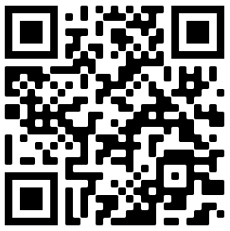
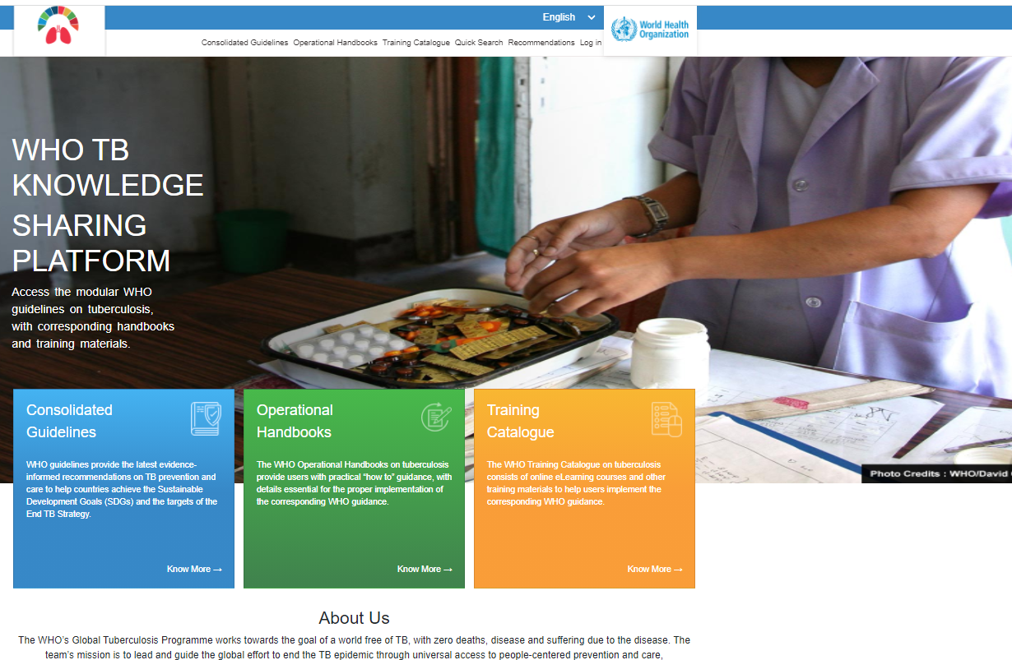
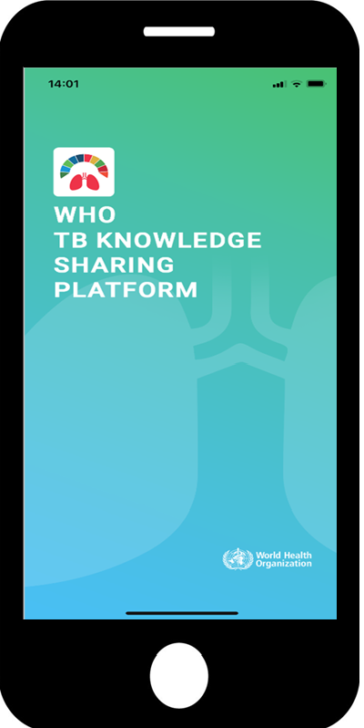
https://extranet.who.int/tbknowledge

Slide 29
© WORLD HEALTH ORGANIZATION 2023
All rights reserved. Publications of the World Health Organization can be obtained from WHO Press, World Health Organization, 20 Avenue Appia, 1211 Geneva 27, Switzerland (tel: +41 22 791 3264; fax: +41 22 791 4857; email: bookorders@who.int). Requests for permission to reproduce or translate WHO publications – whether for sale or for noncommercial distribution – should be addressed to WHO Press, at the above address (fax: +41 22 791 4806; email: permissions@who.int).
The designations employed and the presentation of the material in this publication do not imply the expression of any opinion whatsoever on the part of the World Health Organization concerning the legal status of any country, territory, city or area or of its authorities, or concerning the delimitation of its frontiers or boundaries. Dotted lines on maps represent approximate border lines for which there may not yet be full agreement.
The mention of specific companies or of certain manufacturers’ products does not imply that they are endorsed or recommended by the World Health Organization in preference to others of a similar nature that are not mentioned. Errors and omissions excepted, the names of proprietary products are distinguished by initial capital letters.
All reasonable precautions have been taken by the World Health Organization to verify the information contained in this publication. However, the published material is being distributed without warranty of any kind, either expressed or implied. The responsibility for the interpretation and use of the material lies with the reader. In no event shall the World Health Organization be liable for damages arising from its use.

